Slide 1
Fractions: Dividing with mixed numbers
Silent
Teacher
Intelligent Practice
Narration
Your Turn
$\frac{2}{3}$÷ $2\frac{1}{5}$
3$\frac{2}{5}$÷ $3\frac{1}{3}$
$−4\frac{2}{7}$÷ $−2\frac{2}{7}$
Practice

Slide 2
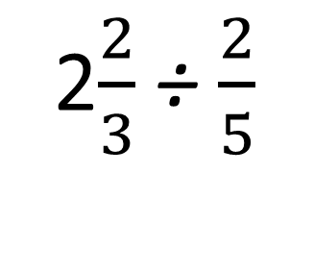
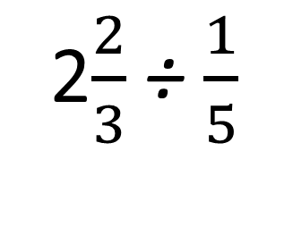
Worked Example
Your Turn
2$\frac{2}{3}$÷ $\frac{1}{5}$
2$\frac{2}{3}$÷ $\frac{2}{5}$

Slide 3
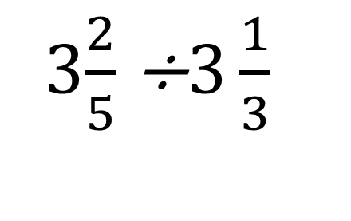
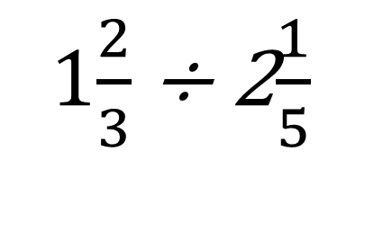
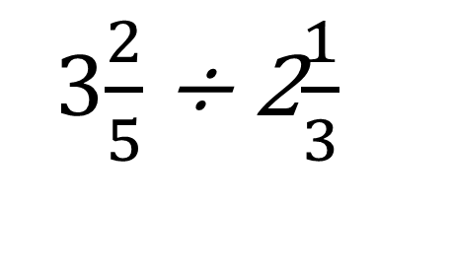
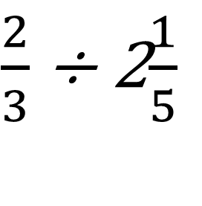
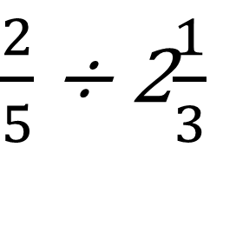
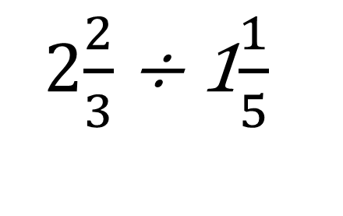
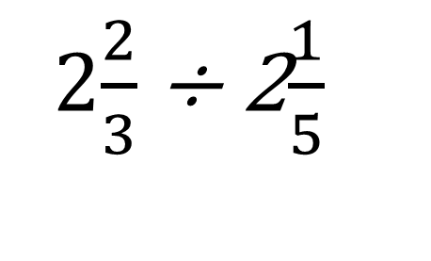
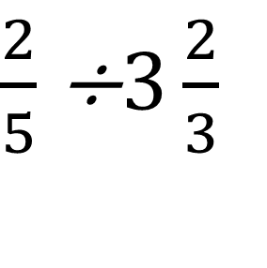
$\frac{2}{3}$÷ 2$\frac{1}{5}$
$\frac{2}{5}$÷ 2$\frac{1}{3}$
1$\frac{2}{3}$÷ 2$\frac{1}{5}$
3$\frac{2}{5}$÷ 2$\frac{1}{3}$
2$\frac{2}{3}$÷ 2$\frac{1}{5}$
3$\frac{2}{5}$÷$3\frac{1}{3}$
2$\frac{2}{3}$÷ 1$\frac{1}{5}$
$\frac{2}{5}$÷$3\frac{2}{3}$

Slide 4
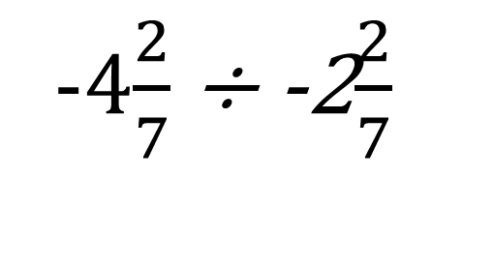

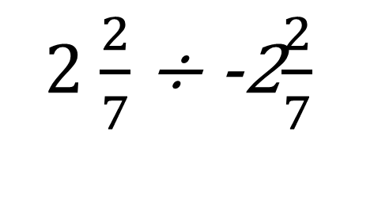
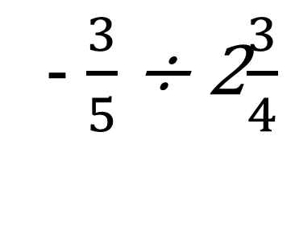
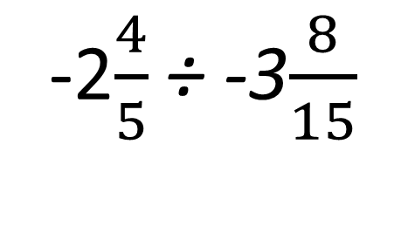
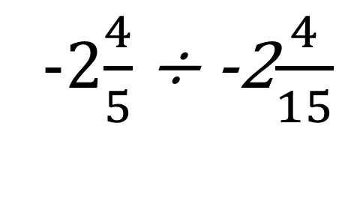
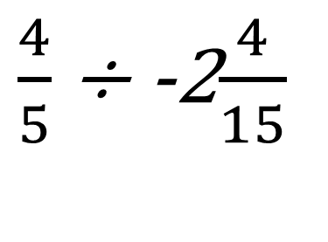

- $\frac{3}{5}$÷ 2$\frac{3}{4}$
$\frac{2}{7}$÷ 2$\frac{2}{7}$
$\frac{4}{5}$÷ -2$\frac{4}{15}$
2 $\frac{2}{7}$÷ -2$\frac{2}{7}$
-2$\frac{4}{5}$÷ -2$\frac{4}{15}$
-4$\frac{2}{7}$÷ -2$\frac{2}{7}$
-2$\frac{4}{5}$÷ -3$\frac{8}{15}$
-4$\frac{2}{7}$÷ -1$\frac{2}{7}$

Slide 5

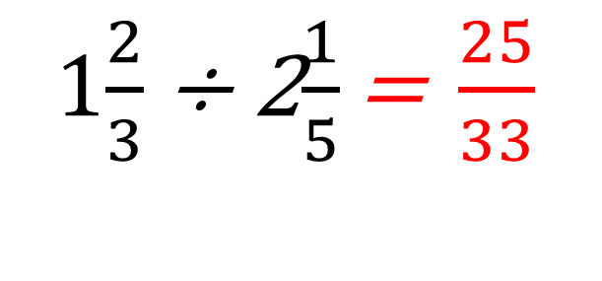
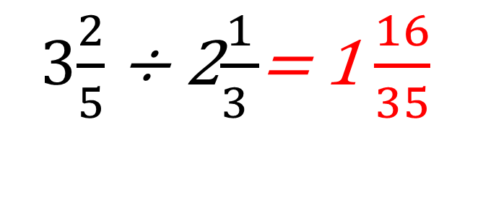
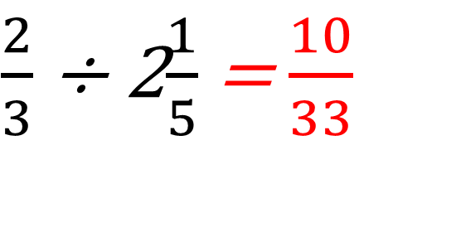
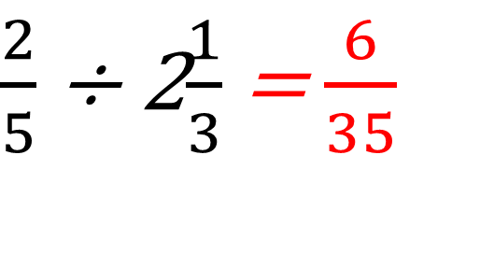


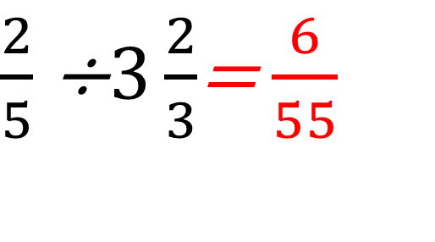
$\frac{2}{3}$÷ 2$\frac{1}{5}$ = $\frac{10}{33}$
$\frac{2}{5}$÷ 2$\frac{1}{3}$ = $\frac{6}{35}$
1$\frac{2}{3}$÷ 2$\frac{1}{5}\text{= }\frac{25}{33}$
3$\frac{2}{5}$÷ 2$\frac{1}{3 }$= 1 $\frac{16}{35}$
2$\frac{2}{3}$÷ 2$\frac{1}{5}\text{= }1\frac{7}{33}$
3$\frac{2}{5}$÷$3\frac{1}{3}$ = 1$\frac{1}{50}$
2$\frac{2}{3}$÷ 1$\frac{1}{5}$= 2$\frac{2}{9}$
$\frac{2}{5}$÷$3\frac{2}{3}$= $\frac{6}{55}$

Slide 6





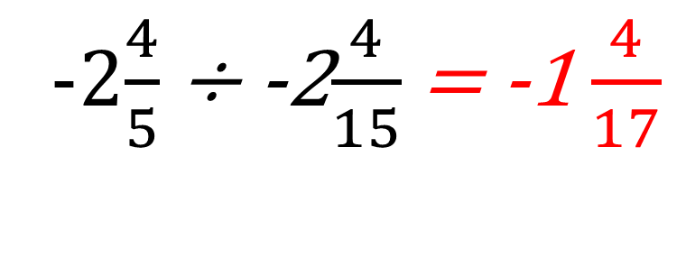
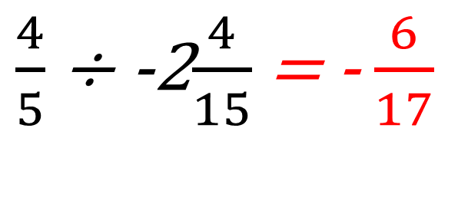
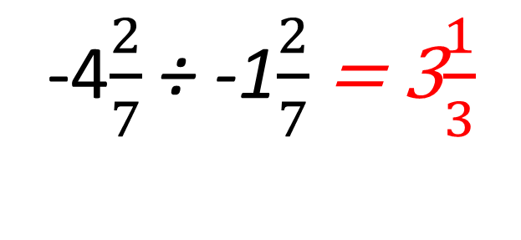
- $\frac{3}{5}$÷ 2$\frac{3}{4}$ = - $\frac{12}{55}$
$\frac{2}{7}$÷ 2$\frac{2}{7}$ = $\frac{1}{8}$
$\frac{4}{5}$÷ -2$\frac{4}{15}$ = - $\frac{6}{17}$
2 $\frac{2}{7}$÷ -2$\frac{2}{7}$= -1
-2$\frac{4}{5}$÷ -2$\frac{4}{15}$ = -1 $\frac{4}{17}$
-4$\frac{2}{7}$÷ -2$\frac{2}{7}$ =-1 $\frac{7}{8}$
-2$\frac{4}{5}$÷ -3$\frac{8}{15}\text{= }\frac{42}{53}$
-4$\frac{2}{7}$÷ -1$\frac{2}{7}$ = 3$\frac{1}{3}$

