Slide 1
Expanding and factorising single brackets: Fill in the gaps
Silent
Teacher
Intelligent Practice
Narration
Your Turn
$$5(2x+1)$$
Practice

Slide 2




Worked Example
Your Turn
$$4x+10=$$
$$4x+12=$$
$$=3(x−2)$$
$$=5(x−2)$$
@mrbartonmaths

Slide 3
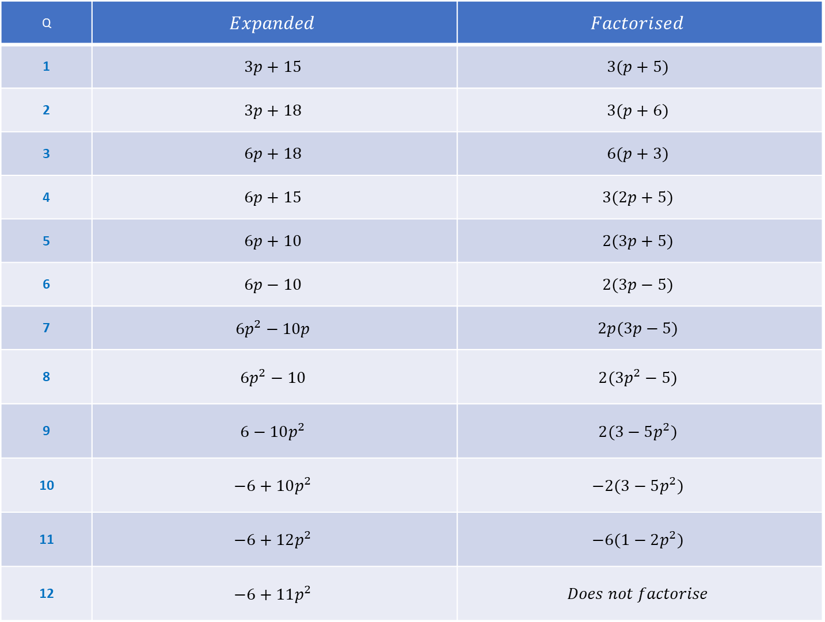
Q | $$Expanded$$ | $$Factorised$$
1 | $$3p+15$$ | $$3(p+5)$$
2 | $$3p+18$$ | $$3(p+6)$$
3 | $$6p+18$$ | $$6(p+3)$$
4 | $$6p+15$$ | $$3(2p+5)$$
5 | $$6p+10$$ | $$2(3p+5)$$
6 | $$6p−10$$ | $$2(3p−5)$$
7 | $$6p^{2}−10p$$ | $$2p(3p−5)$$
8 | $$6p^{2}−10$$ | $$2(3p^{2}−5)$$
9 | $$6−10p^{2}$$ | $$2(3−5p^{2})$$
10 | $$−6+10p^{2}$$ | $$−2(3−5p^{2})$$
11 | $$−6+12p^{2}$$ | $$−6(1−2p^{2})$$
12 | $$−6+11p^{2}$$ | $$Does not factorise$$

Slide 4
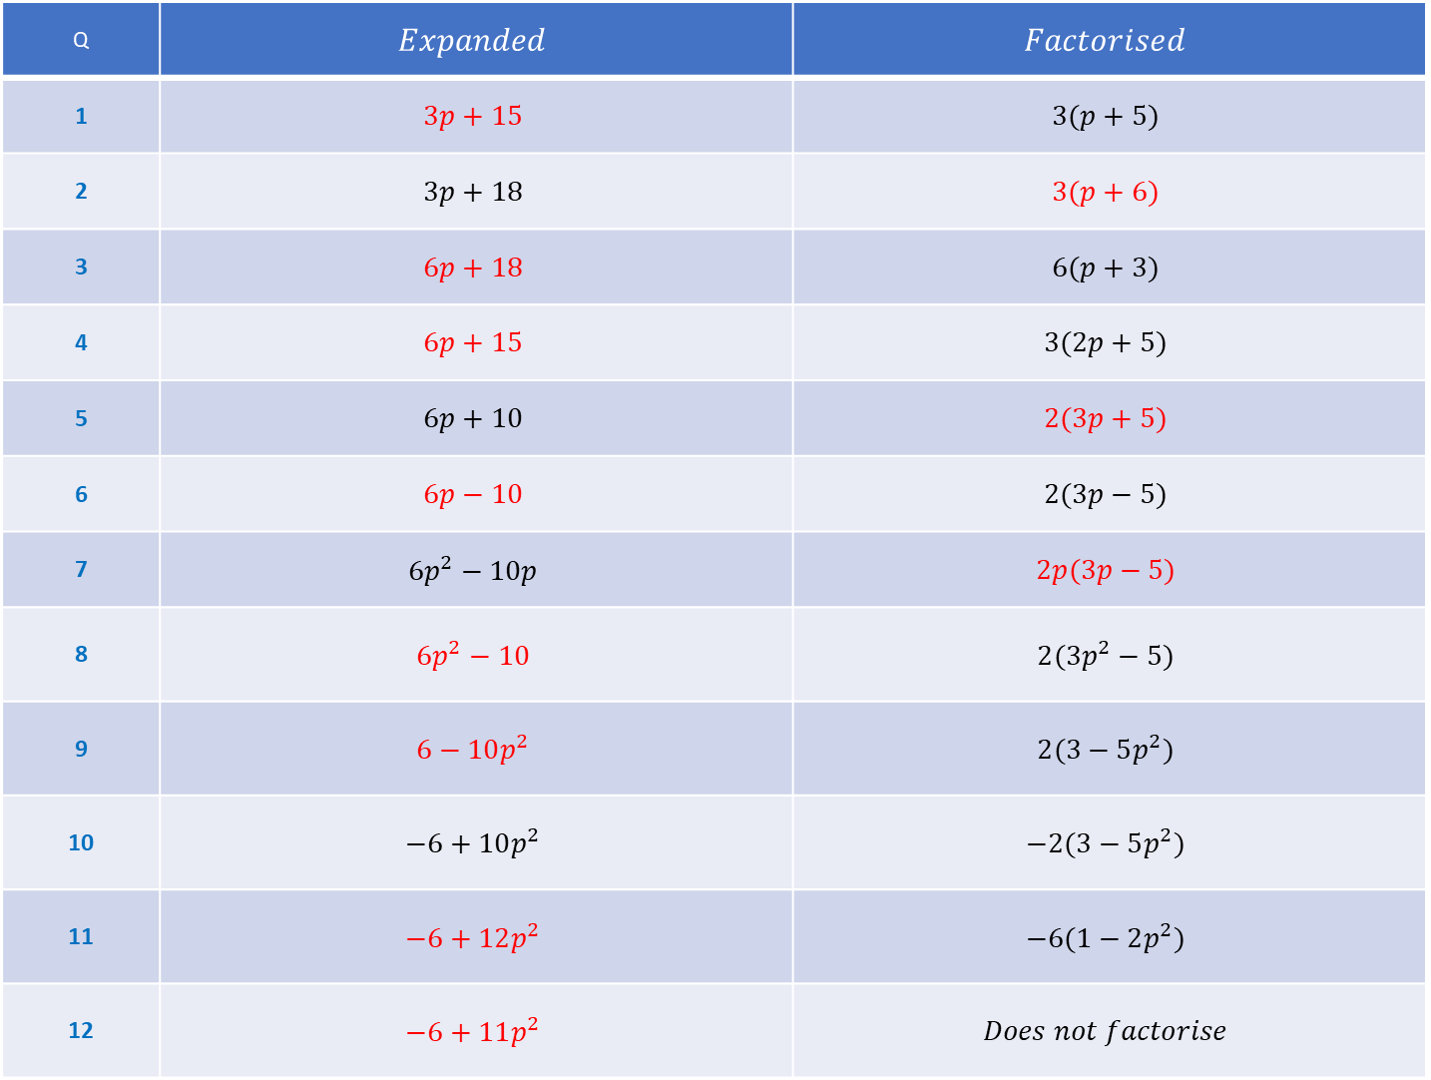
Q | $$Expanded$$ | $$Factorised$$
1 | $$3p+15$$ | $$3(p+5)$$
2 | $$3p+18$$ | $$3(p+6)$$
3 | $$6p+18$$ | $$6(p+3)$$
4 | $$6p+15$$ | $$3(2p+5)$$
5 | $$6p+10$$ | $$2(3p+5)$$
6 | $$6p−10$$ | $$2(3p−5)$$
7 | $$6p^{2}−10p$$ | $$2p(3p−5)$$
8 | $$6p^{2}−10$$ | $$2(3p^{2}−5)$$
9 | $$6−10p^{2}$$ | $$2(3−5p^{2})$$
10 | $$−6+10p^{2}$$ | $$−2(3−5p^{2})$$
11 | $$−6+12p^{2}$$ | $$−6(1−2p^{2})$$
12 | $$−6+11p^{2}$$ | $$Does not factorise$$

