Slide 1
Fractions of Amounts
Silent
Teacher
Intelligent Practice
Narration
Your Turn
Find ¼ of £24 $=$
Find ¾ of £24 $=$
Find ½ of £48 $=$
Practice

Slide 2


Worked Example
Your Turn
$Find \frac{1}{3 }$ of £15
$Find \frac{2}{3 }$ of £15
$Find \frac{1}{3 }$ of £30
$Find \frac{2}{3 }$ of £30

Slide 3
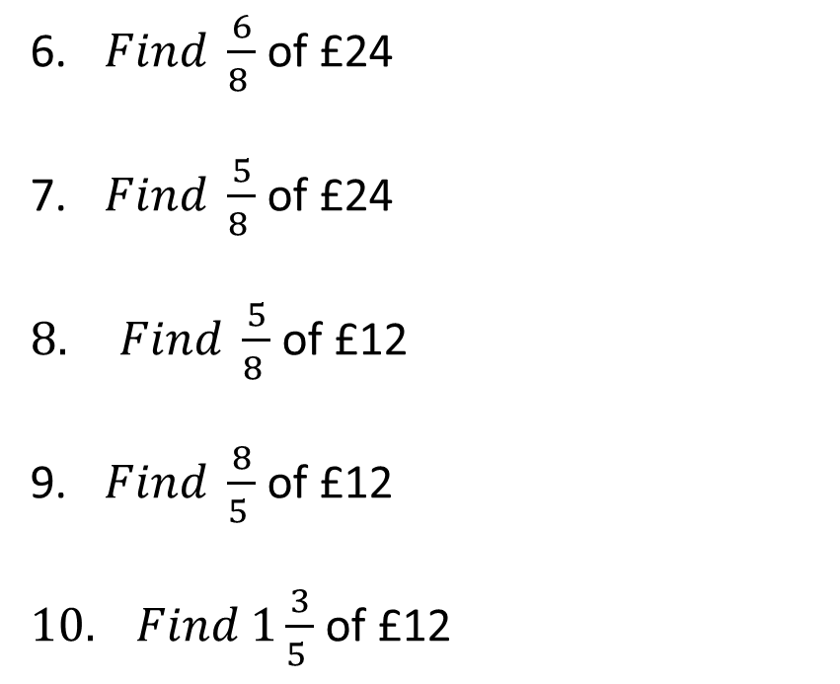
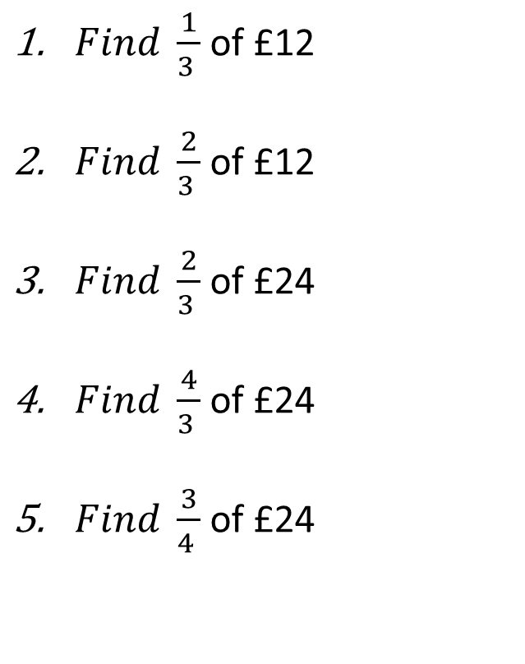
$Find \frac{1}{3 }$ of £12
$Find \frac{2}{3 }$ of £12
$Find \frac{2}{3 }$ of £24
$Find \frac{4}{3 }$ of £24
$Find \frac{3}{4 }$ of £24
6. $Find \frac{6}{8 }$ of £24
7. $Find \frac{5}{8 }$ of £24
$8. Find \frac{5}{8 }$ of £12
9. $Find \frac{8}{5 }$ of £12
$10. Find 1\frac{3}{5 }$ of £12

Slide 4
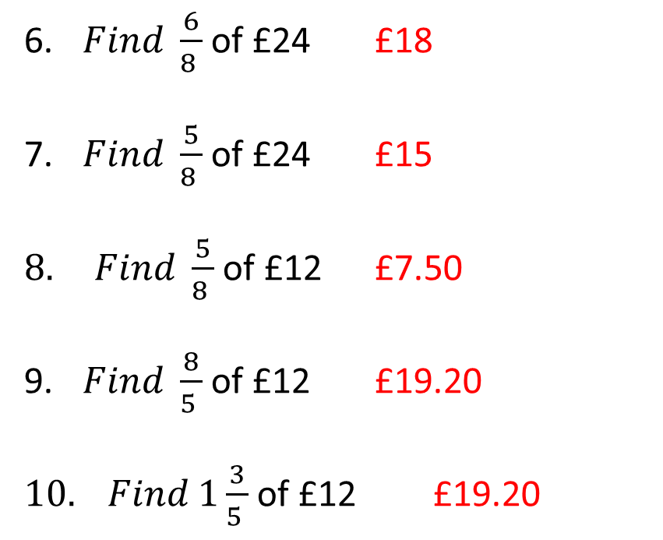
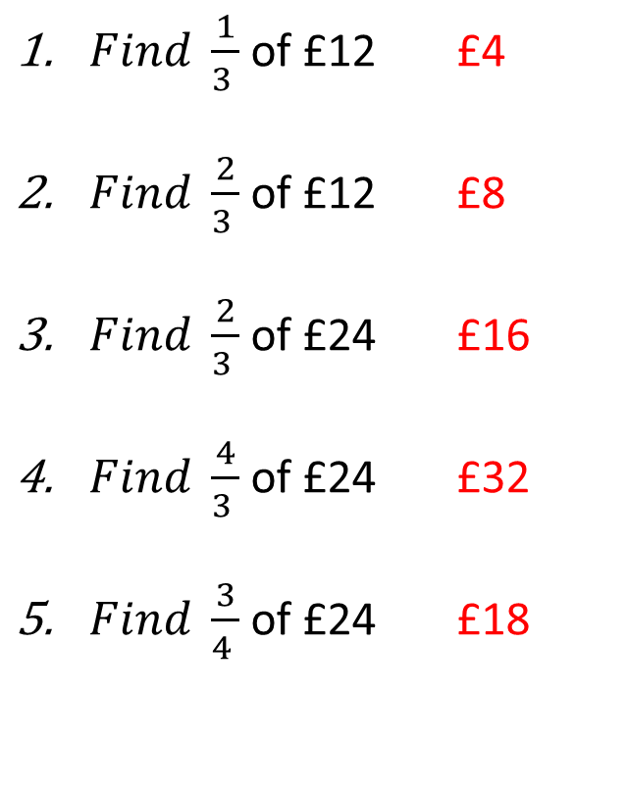
$Find \frac{1}{3 }$ of £12 £4
$Find \frac{2}{3 }$ of £12 £8
$Find \frac{2}{3 }$ of £24 £16
$Find \frac{4}{3 }$ of £24 £32
$Find \frac{3}{4 }$ of £24 £18
6. $Find \frac{6}{8 }$ of £24 £18
7. $Find \frac{5}{8 }$ of £24 £15
$8. Find \frac{5}{8 }$ of £12 £7.50
9. $Find \frac{8}{5 }$ of £12 £19.20
$10. Find 1\frac{3}{5 }$ of £12 £19.20

