Slide 1
Powers and indices: Fractional Indices
Silent
Teacher
Intelligent Practice
Narration
Your Turn
$$4^{\frac{1}{2}}=$$
$$8^{\frac{2}{3}}=$$
$$x^{\frac{1}{y}}=$$
Example

Slide 2
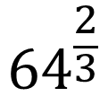
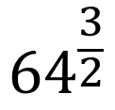
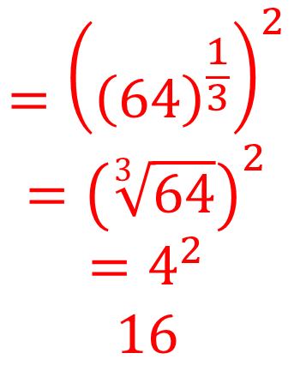
Worked Example
Your Turn
$${64}^{\frac{3}{2}}$$
$${64}^{\frac{2}{3}}$$
$$={\left({\left(64\right)}^{\frac{1}{3}}\right)}^{2}$$
$$={\left(\sqrt[3]{64}\right)}^{2}$$
$$=4^{2}$$
$$16$$

Slide 3
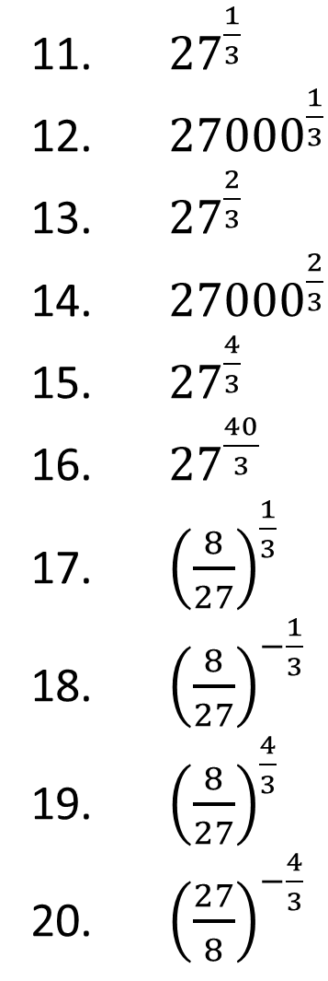
Evaluate
${27}^{\frac{1}{3}}$
${27000}^{\frac{1}{3}}$
${27}^{\frac{2}{3}}$
${27000}^{\frac{2}{3}}$
${27}^{\frac{4}{3}}$
${27}^{\frac{40}{3}}$
${\left(\frac{8}{27}\right)}^{\frac{1}{3}}$
${\left(\frac{8}{27}\right)}^{−\frac{1}{3}}$
${\left(\frac{8}{27}\right)}^{\frac{4}{3}}$
${\left(\frac{27}{8}\right)}^{−\frac{4}{3}}$
$9^{\frac{1}{3}}$
${16}^{\frac{1}{4}}$
$9^{\frac{1}{4}}$
$9^{\frac{1}{2}}$
$9^{\frac{3}{4}}$
${\left(\frac{1}{9}\right)}^{\frac{3}{4}}$
${\left(\frac{16}{9}\right)}^{\frac{1}{4}}$
${\frac{16}{9}}^{\frac{1}{4}}$
$\frac{16}{9^{\frac{1}{4}}}$
${0.16}^{\frac{1}{2}}$
${100}^{\frac{1}{2}}$
${200}^{\frac{1}{2}}$
${400}^{\frac{1}{2}}$
$4^{\frac{1}{2}}$
$2^{\frac{1}{2}}$
$1^{\frac{1}{2}}$
$8^{\frac{1}{2}}$
$8^{\frac{1}{3}}$
$8^{\frac{2}{3}}$
$8^{\frac{4}{3}}$

Slide 4
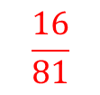
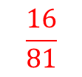

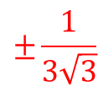

Evaluate
${27}^{\frac{1}{3}}$
${27000}^{\frac{1}{3}}$
${27}^{\frac{2}{3}}$
${27000}^{\frac{2}{3}}$
${27}^{\frac{4}{3}}$
${27}^{\frac{40}{3}}$
${\left(\frac{8}{27}\right)}^{\frac{1}{3}}$
${\left(\frac{8}{27}\right)}^{−\frac{1}{3}}$
${\left(\frac{8}{27}\right)}^{\frac{4}{3}}$
${\left(\frac{27}{8}\right)}^{−\frac{4}{3}}$
$9^{\frac{1}{3}}$
${16}^{\frac{1}{4}}$
$9^{\frac{1}{4}}$
$9^{\frac{1}{2}}$
$9^{\frac{3}{4}}$
${\left(\frac{1}{9}\right)}^{\frac{3}{4}}$
${\left(\frac{16}{9}\right)}^{\frac{1}{4}}$
${\frac{16}{9}}^{\frac{1}{4}}$
$\frac{16}{9^{\frac{1}{4}}}$
${0.16}^{\frac{1}{2}}$
$$3$$
$$\sqrt[3]{9}$$
${100}^{\frac{1}{2}}$
${200}^{\frac{1}{2}}$
${400}^{\frac{1}{2}}$
$4^{\frac{1}{2}}$
$2^{\frac{1}{2}}$
$1^{\frac{1}{2}}$
$8^{\frac{1}{2}}$
$8^{\frac{1}{3}}$
$8^{\frac{2}{3}}$
$8^{\frac{4}{3}}$
$$±10$$
$$30$$
$$±2$$
$$±\sqrt{200}$$
$$9$$
$$±\sqrt{3}$$
$$±20$$
$$900$$
$$±3$$
$$±2$$
$$±3\sqrt{3}$$
$$81$$
$$±\sqrt{2}$$
$$3^{40}$$
$$±\frac{1}{3\sqrt{3}}$$
$$=±\frac{\sqrt{3}}{9}$$
$$=12157665459056928801$$
$$±1$$
$$\frac{2}{3}$$
$$±\frac{2}{\sqrt{3}}$$
$$=±\frac{\sqrt{3}}{3}$$
$$±\sqrt{8}$$
$$\frac{3}{2}$$
$$±\frac{2}{9}$$
$$2$$
$$4$$
$$\frac{16}{81}$$
$$±\frac{16}{\sqrt{3}}$$
$$=±\frac{16\sqrt{3}}{3}$$
$$16$$
$$±\frac{2}{5}$$
$$\frac{16}{81}$$

Slide 5
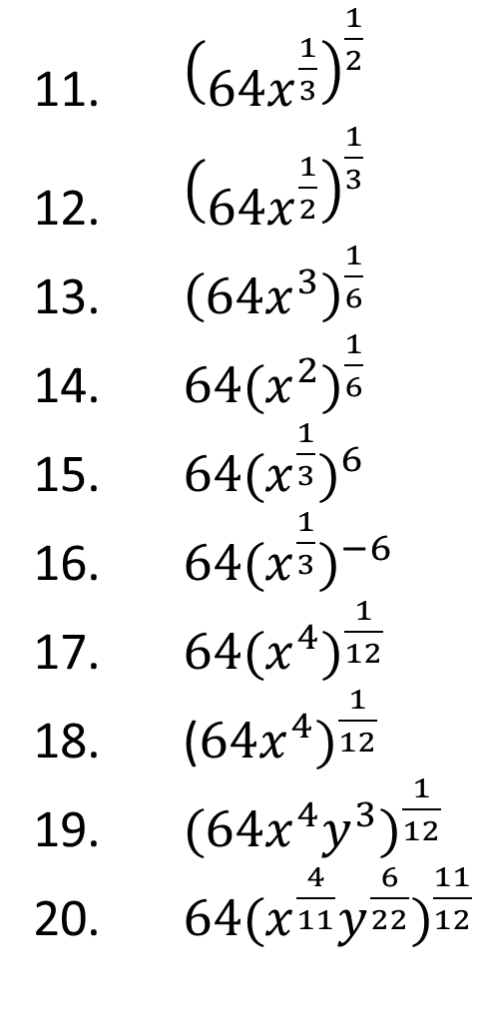
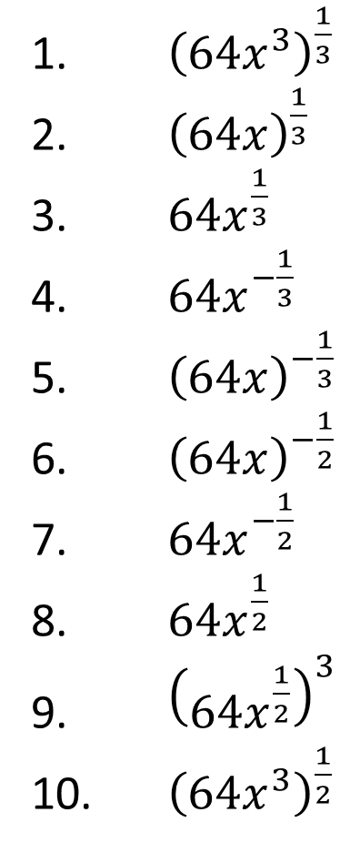
Evaluate
${\left(64x^{\frac{1}{3}}\right)}^{\frac{1}{2}}$
${\left(64x^{\frac{1}{2}}\right)}^{\frac{1}{3}}$
${\left(64x^{3}\right)}^{\frac{1}{6}}$
${64{(x}^{2})}^{\frac{1}{6}}$
${64{(x}^{\frac{1}{3}})}^{6}$
${64{(x}^{\frac{1}{3}})}^{−6}$
${64{(x}^{4})}^{\frac{1}{12}}$
(${64x^{4})}^{\frac{1}{12}}$
${{(64x}^{4}y^{3})}^{\frac{1}{12}}$
${{64(x}^{\frac{4}{11}}y^{\frac{6}{22}})}^{\frac{11}{12}}$
${\left(64x^{3}\right)}^{\frac{1}{3}}$
${\left(64x\right)}^{\frac{1}{3}}$
$64x^{\frac{1}{3}}$
$64x^{−\frac{1}{3}}$
${\left(64x\right)}^{−\frac{1}{3}}$
${\left(64x\right)}^{−\frac{1}{2}}$
$64x^{−\frac{1}{2}}$
$64x^{\frac{1}{2}}$
${\left(64x^{\frac{1}{2}}\right)}^{3}$
${\left(64x^{3}\right)}^{\frac{1}{2}}$

Slide 6
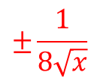
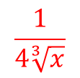
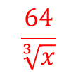
Evaluate
${\left(64x^{\frac{1}{3}}\right)}^{\frac{1}{2}}$
${\left(64x^{\frac{1}{2}}\right)}^{\frac{1}{3}}$
${\left(64x^{3}\right)}^{\frac{1}{6}}$
${64{(x}^{2})}^{\frac{1}{6}}$
${64{(x}^{\frac{1}{3}})}^{6}$
${64{(x}^{\frac{1}{3}})}^{−6}$
${64{(x}^{4})}^{\frac{1}{12}}$
(${64x^{4})}^{\frac{1}{12}}$
${{(64x}^{4}y^{3})}^{\frac{1}{12}}$
${{64(x}^{\frac{4}{11}}y^{\frac{6}{22}})}^{\frac{11}{12}}$
${\left(64x^{3}\right)}^{\frac{1}{3}}$
${\left(64x\right)}^{\frac{1}{3}}$
$64x^{\frac{1}{3}}$
$64x^{−\frac{1}{3}}$
${\left(64x\right)}^{−\frac{1}{3}}$
${\left(64x\right)}^{−\frac{1}{2}}$
$64x^{−\frac{1}{2}}$
$64x^{\frac{1}{2}}$
${\left(64x^{\frac{1}{2}}\right)}^{3}$
${\left(64x^{3}\right)}^{\frac{1}{2}}$
$$±8\sqrt[6]{x}$$
$$4x$$
$$4\sqrt[3]{x}$$
$$±4\sqrt[6]{x}$$
$$64\sqrt[3]{x}$$
$$±2\sqrt{x}$$
$$\frac{64}{\sqrt[3]{x}}$$
$$±2\sqrt[3]{x}$$
$$\frac{1}{4\sqrt[3]{x}}$$
$$2x^{2}$$
$$±\frac{1}{8\sqrt{x}}$$
$$\frac{2}{x^{2}}$$
$±\frac{1}{\sqrt{x}}$
$$64\sqrt[3]{x}$$
$$±64\sqrt{x}$$
$$\sqrt{2}\sqrt[3]{x}$$
$$±{64}^{3}{\sqrt{x}}^{3} or±{64}^{3}\sqrt{x^{3}}$$
$$\sqrt{2}\sqrt[3]{x}\sqrt[4]{y}$$
$$±8{\sqrt{x}}^{3} or±8\sqrt{x^{3}}$$
$$64\sqrt[3]{x}\sqrt[4]{y}$$

