Slide 1
Factorisng into single brackets: It is fully factorised?
True/false
Reflect
Your Turn
$$∎(3x+2)$$
$$∎(3x+3)$$
$$∎(3x−3)$$
Rule

Slide 2
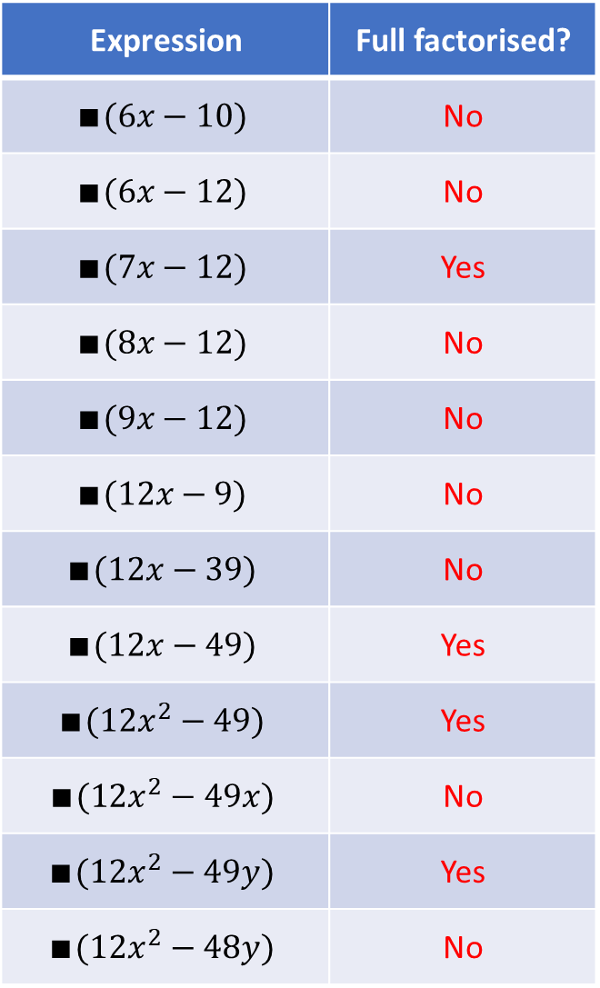
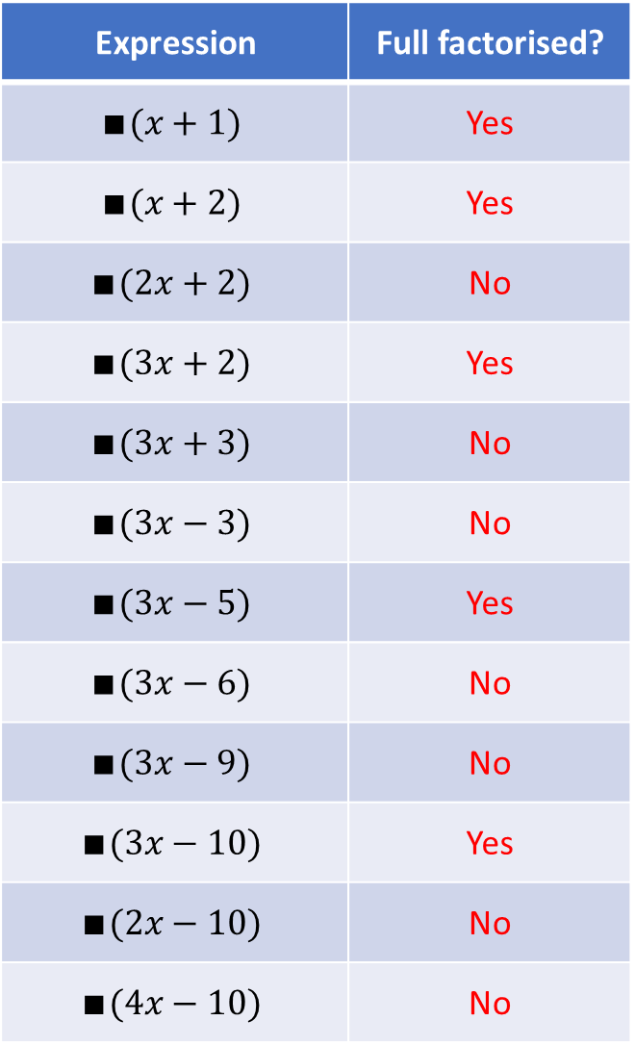
Expression | Full factorised?
$$∎(x+1)$$ | Yes
$$∎(x+2)$$ | Yes
$$∎(2x+2)$$ | No
$$∎(3x+2)$$ | Yes
$$∎(3x+3)$$ | No
$$∎(3x−3)$$ | No
$$∎(3x−5)$$ | Yes
$$∎(3x−6)$$ | No
$$∎(3x−9)$$ | No
$$∎(3x−10)$$ | Yes
$$∎(2x−10)$$ | No
$$∎(4x−10)$$ | No
Expression | Full factorised?
$$∎(6x−10)$$ | No
$$∎(6x−12)$$ | No
$$∎(7x−12)$$ | Yes
$$∎(8x−12)$$ | No
$$∎(9x−12)$$ | No
$$∎(12x−9)$$ | No
$$∎(12x−39)$$ | No
$$∎(12x−49)$$ | Yes
$$∎(12x^{2}−49)$$ | Yes
$$∎(12x^{2}−49x)$$ | No
$$∎(12x^{2}−49y)$$ | Yes
$$∎(12x^{2}−48y)$$ | No

Slide 3
Expression | Full factorised?
$$∎(x+1)$$ | Yes
$$∎(x+2)$$ | Yes
$$∎(2x+2)$$ | No
$$∎(3x+2)$$ | Yes
$$∎(3x+3)$$ | No
$$∎(3x−3)$$ | No
$$∎(3x−5)$$ | Yes
$$∎(3x−6)$$ | No
$$∎(3x−9)$$ | No
$$∎(3x−10)$$ | Yes
$$∎(2x−10)$$ | No
$$∎(4x−10)$$ | No
Expression | Full factorised?
$$∎(6x−10)$$ | No
$$∎(6x−12)$$ | No
$$∎(7x−12)$$ | Yes
$$∎(8x−12)$$ | No
$$∎(9x−12)$$ | No
$$∎(12x−9)$$ | No
$$∎(12x−39)$$ | No
$$∎(12x−49)$$ | Yes
$$∎(12x^{2}−49)$$ | Yes
$$∎(12x^{2}−49x)$$ | No
$$∎(12x^{2}−49y)$$ | Yes
$$∎(12x^{2}−48y)$$ | No

Slide 4
Expression | Full factorised?
$$∎(x+1)$$ | Yes
$$∎(x+2)$$ | Yes
$$∎(2x+2)$$ | No
$$∎(3x+2)$$ | Yes
$$∎(3x+3)$$ | No
$$∎(3x−3)$$ | No
$$∎(3x−5)$$ | Yes
$$∎(3x−6)$$ | No
$$∎(3x−9)$$ | No
$$∎(3x−10)$$ | Yes
$$∎(2x−10)$$ | No
$$∎(4x−10)$$ | No
Expression | Full factorised?
$$∎(6x−10)$$ | No
$$∎(6x−12)$$ | No
$$∎(7x−12)$$ | Yes
$$∎(8x−12)$$ | No
$$∎(9x−12)$$ | No
$$∎(12x−9)$$ | No
$$∎(12x−39)$$ | No
$$∎(12x−49)$$ | Yes
$$∎(12x^{2}−49)$$ | Yes
$$∎(12x^{2}−49x)$$ | No
$$∎(12x^{2}−49y)$$ | Yes
$$∎(12x^{2}−48y)$$ | No

Slide 5
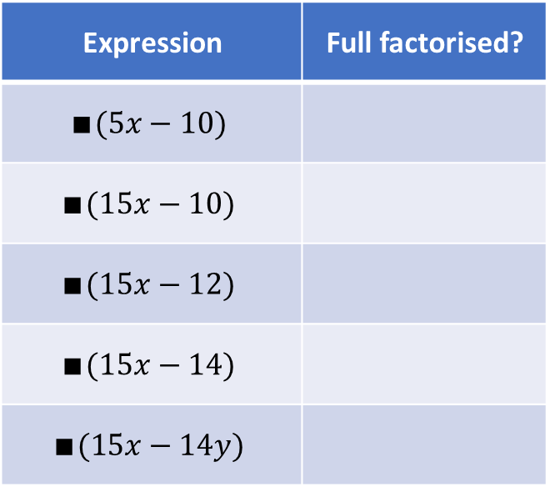
Your Turn
Expression | Full factorised?
$$∎(5x−10)$$
$$∎(15x−10)$$
$$∎(15x−12)$$
$$∎(15x−14)$$
$$∎(15x−14y)$$
@mrbartonmaths

Slide 6
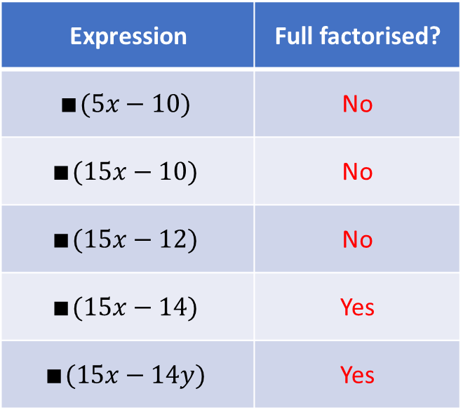
Your Turn - answers
Expression | Full factorised?
$$∎(5x−10)$$ | No
$$∎(15x−10)$$ | No
$$∎(15x−12)$$ | No
$$∎(15x−14)$$ | Yes
$$∎(15x−14y)$$ | Yes
@mrbartonmaths

