Slide 1
Vectors: Multiplying by a scalar
Silent
Teacher
Intelligent Practice
Narration
Your Turn
a) $3\left({1 \atop 4}\right)$ =
b) $5\left({1 \atop 4}\right)=$
c) $−2\left({1 \atop 4}\right)$ =
Practice

Slide 2
Worked Example
Your Turn
$$4\left({5 \atop −1}\right)$$
$$2\left({−5 \atop 1}\right)$$

Slide 3
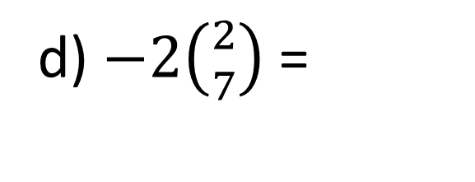
a) $3\left({1 \atop 4}\right)$ =
h) $−3\left({5 \atop 3}\right)$ =
b) $5\left({1 \atop 4}\right)=$
i) $3\left({5 \atop 3}\right)$=
c) $−2\left({1 \atop 4}\right)$ =
j)$3\left({−5 \atop 3}\right)$=
d) $−2\left({2 \atop 7}\right)$ =
k) $−3\left({−5 \atop 3}\right)$=
e) $6\left({2 \atop 7}\right)$ =
l) $−3\left({−5 \atop −9}\right)$=
f) $6\left({11 \atop 4}\right)$ =
m) $−3\left({\frac{1}{2} \atop −9}\right)$=
g) $−3\left({11 \atop 4}\right)$ =
n) $−12\left({−\frac{3}{4} \atop −9}\right)$=

Slide 4















$$\left({3 \atop 12}\right)$$
a) $3\left({1 \atop 4}\right)$ =
h) $−3\left({5 \atop 3}\right)$ =
$$\left({−15 \atop −9}\right)$$
$$\left({5 \atop 20}\right)$$
b) $5\left({1 \atop 4}\right)=$
i) $3\left({5 \atop 3}\right)$=
$$\left({15 \atop 9}\right)$$
c) $−2\left({1 \atop 4}\right)$ =
$$\left({−2 \atop −8}\right)$$
j)$3\left({−5 \atop 3}\right)$=
$$\left({−15 \atop 9}\right)$$
d) $−2\left({2 \atop 7}\right)$ =
$$\left({−4 \atop −14}\right)$$
k) $−3\left({−5 \atop 3}\right)$=
$$\left({15 \atop −9}\right)$$
e) $6\left({2 \atop 7}\right)$ =
$$\left({15 \atop 27}\right)$$
$$\left({12 \atop 42}\right)$$
l) $−3\left({−5 \atop −9}\right)$=
f) $6\left({11 \atop 4}\right)$ =
$$\left({66 \atop 24}\right)$$
m) $−3\left({\frac{1}{2} \atop −9}\right)$=
$$\left({−1.5 \atop 27}\right)$$
$$\left({−33 \atop −12}\right)$$
g) $−3\left({11 \atop 4}\right)$ =
n) $−12\left({−\frac{3}{4} \atop −9}\right)$=
$$\left({3 \atop 108}\right)$$

