Slide 1
Cosine rule: Missing angles
Silent
Teacher
Intelligent Practice
Narration
Your Turn
5cm
2.5cm
6cm
3cm
θ
θ
4cm
2cm
Practice

Slide 2
Worked Example
Your Turn
7cm
14cm
12cm
12cm
θ
θ
10cm
10cm
@sunday_panic

Slide 3
1.
6cm
2.
6cm
6cm
3.
4cm
8cm
8cm
θ
θ
θ
5cm
5cm
5cm
4.
5.
6.
8cm
8cm
8cm
7cm
8cm
8cm
θ
θ
θ
8cm
8cm
8cm
7.
8.
5cm
8cm
6cm
9.
6cm
8cm
1cm
θ
θ
θ
9cm
9cm
1cm
@sunday_panic

Slide 4
1.
6cm
2.
6cm
6cm
3.
4cm
8cm
8cm
θ
θ
θ
θ = 41.40º
θ = 92.87º
θ = 48.51º
5cm
5cm
5cm
4.
5.
6.
8cm
8cm
8cm
7cm
8cm
8cm
θ
θ
θ
θ = 51.98º
θ = 60º
θ = 60º
8cm
8cm
8cm
7.
8.
5cm
8cm
6cm
9.
6cm
8cm
2cm
θ
θ
θ
θ = 40.80º
θ = 60.61º
maths error
9cm
9cm
2cm
@sunday_panic

Slide 5
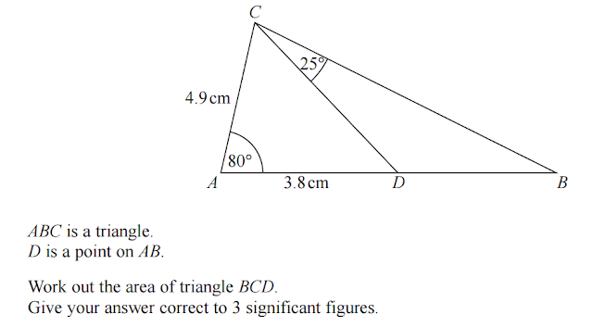
What can you work out about this diagram?

