Slide 1
Brackets: Factorising double brackets (double negatives)
Silent
Teacher
Intelligent Practice
Narration
Your Turn
$$x^{2}−25x+24=$$
$$x^{2}−10x+24=$$
$$x^{2}−14x+24=$$
Practice

Slide 2
Worked Example
Your Turn
$$x^{2}−8x+15 =$$
$$x^{2}−16x+15$$
emmas@DCA

Slide 3

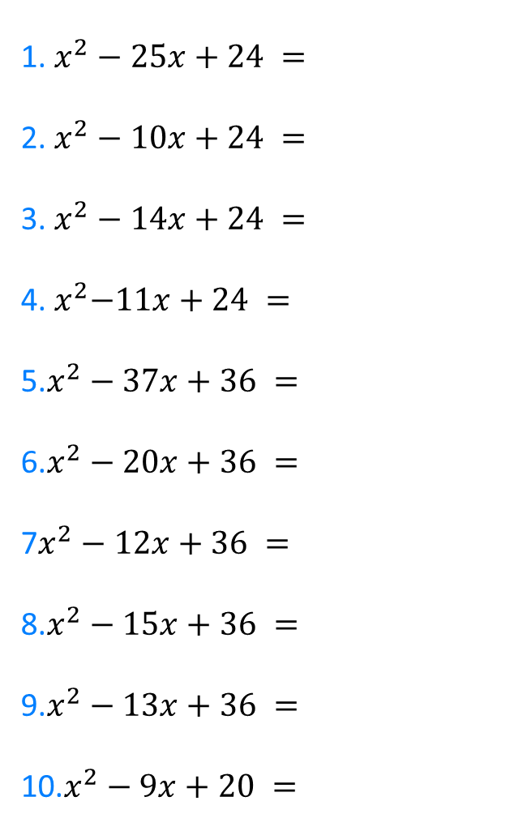
1. $x^{2}−25x+24 =$
2. $x^{2}−10x+24 =$
3. $x^{2}−14x+24 =$
4.${ x}^{2}−11x+24 =$
5.$x^{2}−37x+36 =$
6.$x^{2}−20x+36 =$
7$x^{2}−12x+36 =$
8.$x^{2}−15x+36 =$
9.$x^{2}−13x+36 =$
10.$x^{2}−9x+20 =$
11. $x^{2}−21x+20 =$
12. $x^{2}−12x+20 =$
13. $x^{2}−14x+40 =$
14.${ x}^{2}−13x+40 =$
15.$x^{2}−41x+40 =$
16.$x^{2}−22x+40 =$
17.$x^{2}−10x+25 =$
18.$x^{2}−8x+16 =$
19.$x^{2}−6x+9 =$
20.$x^{2}−20x+100 =$
emmas@DCA

Slide 4
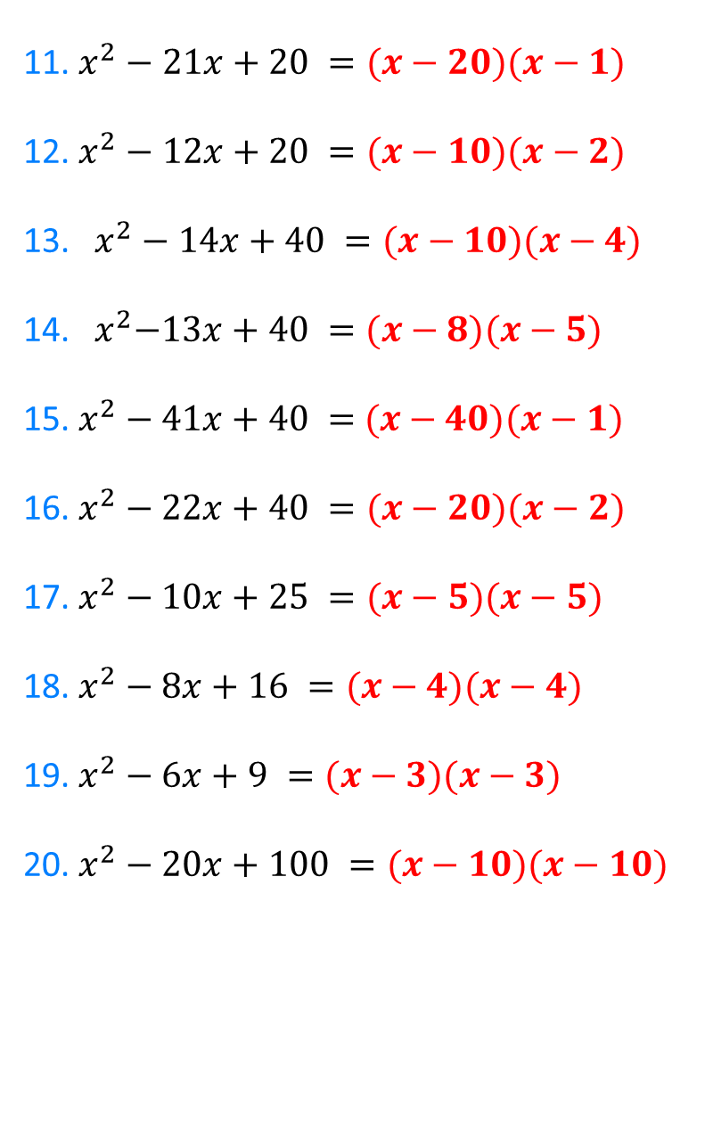
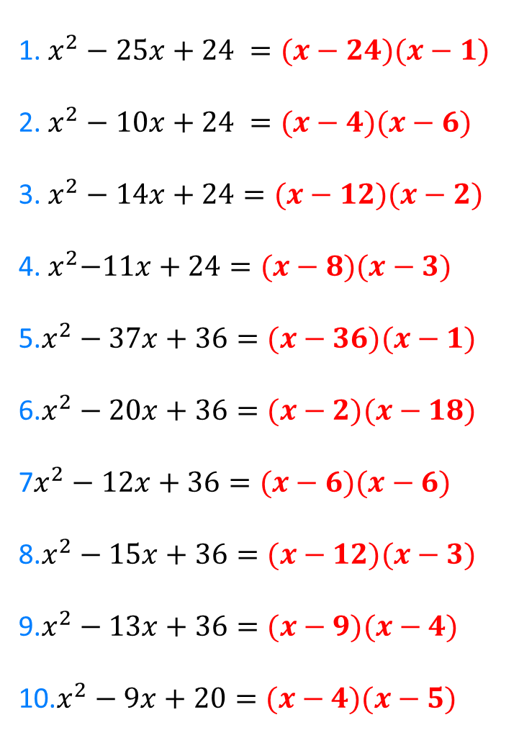
1. $x^{2}−25x+24 =(x−24)(x−1)$
2. $x^{2}−10x+24 =(x−4)(x−6)$
3. $x^{2}−14x+24=(x−12)(x−2)$
4.${ x}^{2}−11x+24=(x−8)(x−3)$
5.$x^{2}−37x+36=(x−36)(x−1)$
6.$x^{2}−20x+36=(x−2)(x−18)$
7$x^{2}−12x+36=(x−6)(x−6)$
8.$x^{2}−15x+36=(x−12)(x−3)$
9.$x^{2}−13x+36=(x−9)(x−4)$
10.$x^{2}−9x+20=(x−4)(x−5)$
11. $x^{2}−21x+20 =(x−20)(x−1)$
12. $x^{2}−12x+20 =(x−10)(x−2)$
13. $x^{2}−14x+40 =(x−10)(x−4)$
14.${ x}^{2}−13x+40 =(x−8)(x−5)$
15.$x^{2}−41x+40 =$ $(x−40)(x−1)$
16.$x^{2}−22x+40 =(x−20)(x−2)$
17.$x^{2}−10x+25 =(x−5)(x−5)$
18.$x^{2}−8x+16 =(x−4)(x−4)$
19.$x^{2}−6x+9 =(x−3)(x−3)$
20.$x^{2}−20x+100 =(x−10)(x−10)$
emmas@DCA

