Slide 1
Quadratic Graphs: Fill in the gaps
Silent
Teacher
Intelligent Practice
Narration
Your Turn
Practice

Slide 2
Worked Example
Your Turn
$$x^{2}+2x−15$$
$$x^{2}+2x−24$$
Factorise:
Complete the square:
Intercepts:
Turning point:
Sketch:
Factorise:
Complete the square:
Intercepts:
Turning point:
Sketch:

Slide 3
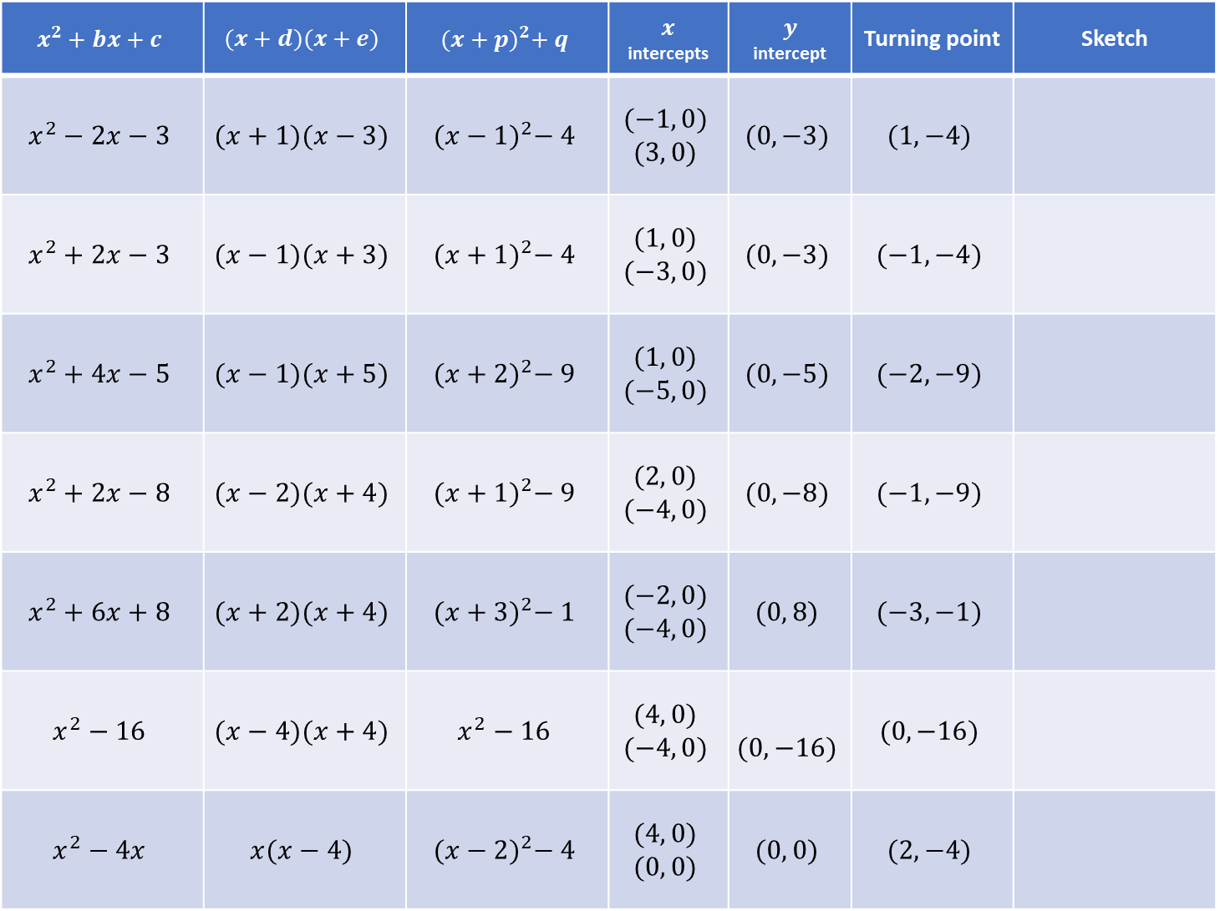
$$x^{2}+bx+c$$ | $$(x+d)(x+e)$$ | $${(x+p)}^{2}+ q$$ | $x$ intercepts | $$y$$ intercept | Turning point | Sketch
$$x^{2}−2x−3$$ | $$(x+1)(x−3)$$ | $${(x−1)}^{2}− 4$$ | $$(−1, 0)$$ $$(3, 0)$$ | $$(0, −3)$$ | $$(1, −4)$$
$$x^{2}+2x−3$$ | $$(x−1)(x+3)$$ | $${(x+1)}^{2}− 4$$ | $$(1, 0)$$ $$(−3, 0)$$ | $$(0, −3)$$ | $$(−1, −4)$$
$$x^{2}+4x−5$$ | $$(x−1)(x+5)$$ | $${(x+2)}^{2}− 9$$ | $$(1, 0)$$ $$(−5, 0)$$ | $$(0, −5)$$ | $$(−2, −9)$$
$$x^{2}+2x−8$$ | $$(x−2)(x+4)$$ | $${(x+1)}^{2}− 9$$ | $$(2, 0)$$ $$(−4, 0)$$ | $$(0, −8)$$ | $$(−1, −9)$$
$$x^{2}+6x+8$$ | $$(x+2)(x+4)$$ | $${(x+3)}^{2}− 1$$ | $$(−2, 0)$$ $$(−4, 0)$$ | $$(0, 8)$$ | $$(−3, −1)$$
$$x^{2}−16$$ | $$(x−4)(x+4)$$ | $$x^{2}−16$$ | $$(4, 0)$$ $$(−4, 0)$$ | $$(0, −16)$$ | $$(0, −16)$$
$$x^{2}−4x$$ | $$x(x−4)$$ | $${(x−2)}^{2}− 4$$ | $$(4, 0)$$ $$(0, 0)$$ | $$(0, 0)$$ | $$(2, −4)$$
1.
$$−1$$
$$3$$
$$−3$$
2.
$$−3$$
$$1$$
$$−3$$
3.
$$1$$
$$−5$$
$$−5$$
4.
$$−4$$
$$2$$
$$−8$$
$$8$$
5.
$$−4$$
$$−2$$
6.
$$−4$$
$$4$$
$$−16$$
7.
$$0$$
$$4$$

Slide 4
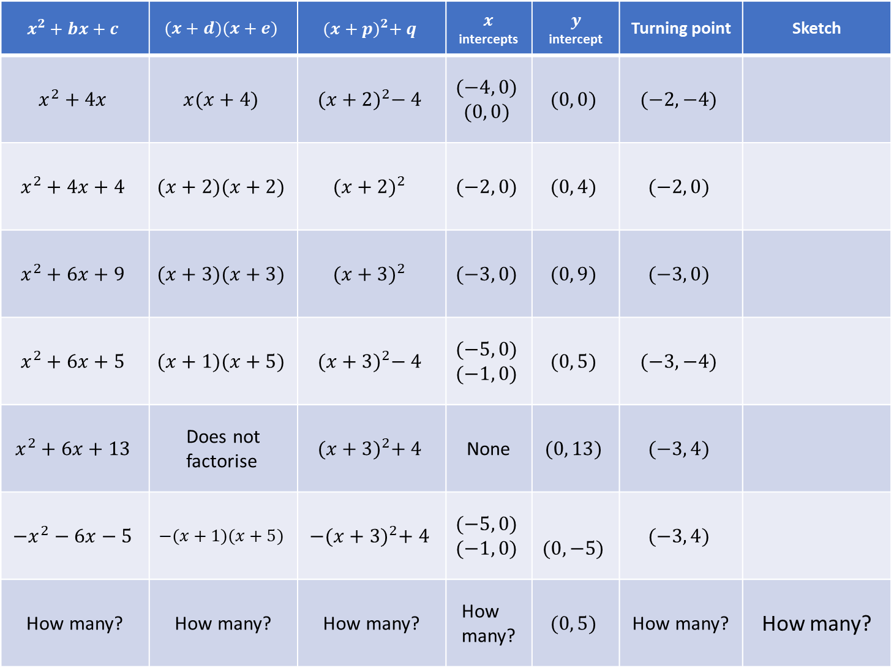
$$x^{2}+bx+c$$ | $$(x+d)(x+e)$$ | $${(x+p)}^{2}+ q$$ | $x$ intercepts | $$y$$ intercept | Turning point | Sketch
$$x^{2}+4x$$ | $$x(x+4)$$ | $${(x+2)}^{2}− 4$$ | $$(−4, 0)$$ $$(0, 0)$$ | $$(0, 0)$$ | $$(−2, −4)$$
$$x^{2}+4x+4$$ | $$(x+2)(x+2)$$ | $${(x+2)}^{2}$$ | $$(−2, 0)$$ | $$(0, 4)$$ | $$(−2, 0)$$
$$x^{2}+6x+9$$ | $$(x+3)(x+3)$$ | $${(x+3)}^{2}$$ | $$(−3, 0)$$ | $$(0, 9)$$ | $$(−3, 0)$$
$$x^{2}+6x+5$$ | $$(x+1)(x+5)$$ | $${(x+3)}^{2}− 4$$ | $$(−5, 0)$$ $$(−1, 0)$$ | $$(0, 5)$$ | $$(−3, −4)$$
$$x^{2}+6x+13$$ | Does not factorise | $${(x+3)}^{2}+ 4$$ | None | $$(0, 13)$$ | $$(−3, 4)$$
$${−x}^{2}−6x−5$$ | $$−(x+1)(x+5)$$ | $$−{(x+3)}^{2}+ 4$$ | $$(−5, 0)$$ $$(−1, 0)$$ | $$(0, −5)$$ | $$(−3, 4)$$
How many? | How many? | How many? | How many? | $$(0, 5)$$ | How many? | How many?
8.
$$−4$$
$$0$$
$$4$$
9.
$$−2$$
10.
$$9$$
$$−3$$
11.
$$5$$
$$−5$$
$$−1$$
$$13$$
12.
13.
$$−5$$
$$−1$$
$$−5$$
14.

Slide 5
$$x^{2}+bx+c$$ | $$(x+d)(x+e)$$ | $${(x+p)}^{2}+ q$$ | $x$ intercepts | $$y$$ intercept | Turning point | Sketch
$$x^{2}−2x−3$$ | $$(x+1)(x−3)$$ | $${(x−1)}^{2}− 4$$ | $$(−1, 0)$$ $$(3, 0)$$ | $$(0, −3)$$ | $$(1, −4)$$
$$x^{2}+2x−3$$ | $$(x−1)(x+3)$$ | $${(x+1)}^{2}− 4$$ | $$(1, 0)$$ $$(−3, 0)$$ | $$(0, −3)$$ | $$(−1, −4)$$
$$x^{2}+4x−5$$ | $$(x−1)(x+5)$$ | $${(x+2)}^{2}− 9$$ | $$(1, 0)$$ $$(−5, 0)$$ | $$(0, −5)$$ | $$(−2, −9)$$
$$x^{2}+2x−8$$ | $$(x−2)(x+4)$$ | $${(x+1)}^{2}− 9$$ | $$(2, 0)$$ $$(−4, 0)$$ | $$(0, −8)$$ | $$(−1, −9)$$
$$x^{2}+6x+8$$ | $$(x+2)(x+4)$$ | $${(x+3)}^{2}− 1$$ | $$(−2, 0)$$ $$(−4, 0)$$ | $$(0, 8)$$ | $$(−3, −1)$$
$$x^{2}−16$$ | $$(x−4)(x+4)$$ | $$x^{2}−16$$ | $$(4, 0)$$ $$(−4, 0)$$ | $$(0, −16)$$ | $$(0, −16)$$
$$x^{2}−4x$$ | $$x(x−4)$$ | $${(x−2)}^{2}− 4$$ | $$(4, 0)$$ $$(0, 0)$$ | $$(0, 0)$$ | $$(2, −4)$$
1.
$$−1$$
$$3$$
$$−3$$
2.
$$−3$$
$$1$$
$$−3$$
3.
$$1$$
$$−5$$
$$−5$$
4.
$$−4$$
$$2$$
$$−8$$
$$8$$
5.
$$−4$$
$$−2$$
6.
$$−4$$
$$4$$
$$−16$$
7.
$$0$$
$$4$$

Slide 6
$$x^{2}+bx+c$$ | $$(x+d)(x+e)$$ | $${(x+p)}^{2}+ q$$ | $x$ intercepts | $$y$$ intercept | Turning point | Sketch
$$x^{2}+4x$$ | $$x(x+4)$$ | $${(x+2)}^{2}− 4$$ | $$(−4, 0)$$ $$(0, 0)$$ | $$(0, 0)$$ | $$(−2, −4)$$
$$x^{2}+4x+4$$ | $$(x+2)(x+2)$$ | $${(x+2)}^{2}$$ | $$(−2, 0)$$ | $$(0, 4)$$ | $$(−2, 0)$$
$$x^{2}+6x+9$$ | $$(x+3)(x+3)$$ | $${(x+3)}^{2}$$ | $$(−3, 0)$$ | $$(0, 9)$$ | $$(−3, 0)$$
$$x^{2}+6x+5$$ | $$(x+1)(x+5)$$ | $${(x+3)}^{2}− 4$$ | $$(−5, 0)$$ $$(−1, 0)$$ | $$(0, 5)$$ | $$(−3, −4)$$
$$x^{2}+6x+13$$ | Does not factorise | $${(x+3)}^{2}+ 4$$ | None | $$(0, 13)$$ | $$(−3, 4)$$
$${−x}^{2}−6x−5$$ | $$−(x+1)(x+5)$$ | $$−{(x+3)}^{2}+ 4$$ | $$(−5, 0)$$ $$(−1, 0)$$ | $$(0, −5)$$ | $$(−3, 4)$$
How many? | How many? | How many? | How many? | $$(0, 5)$$ | How many? | How many?
8.
$$−4$$
$$0$$
$$4$$
9.
$$−2$$
10.
$$9$$
$$−3$$
11.
$$5$$
$$−5$$
$$−1$$
$$13$$
12.
13.
$$−5$$
$$−1$$
$$−5$$
14.

