Slide 1
Sharing in a ratio: Fill in the gaps
Silent
Teacher
Intelligent Practice
Narration
Your Turn
$$2 :3$$
Practice

Slide 2
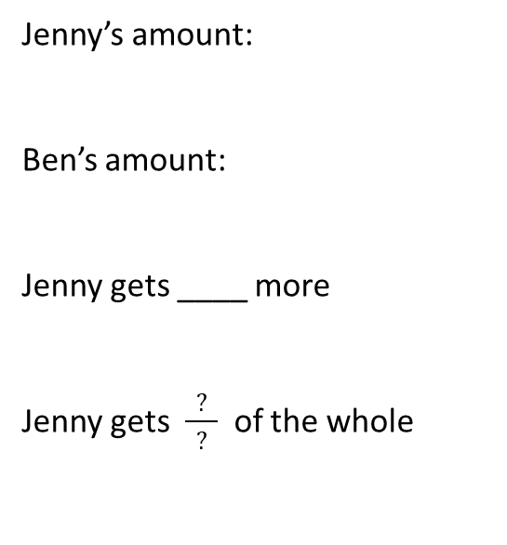
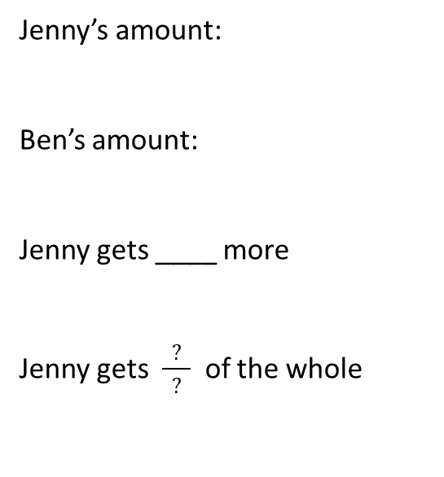
Worked Example
Your Turn
Jenny and Ben share £12 in the ratio 2 : 1
Jenny and Ben share £12 in the ratio 3 : 1
Jenny’s amount:
Ben’s amount:
Jenny gets ____ more
Jenny gets $\frac{ ? }{ ? }$ of the whole
Jenny’s amount:
Ben’s amount:
Jenny gets ____ more
Jenny gets $\frac{ ? }{ ? }$ of the whole

Slide 3
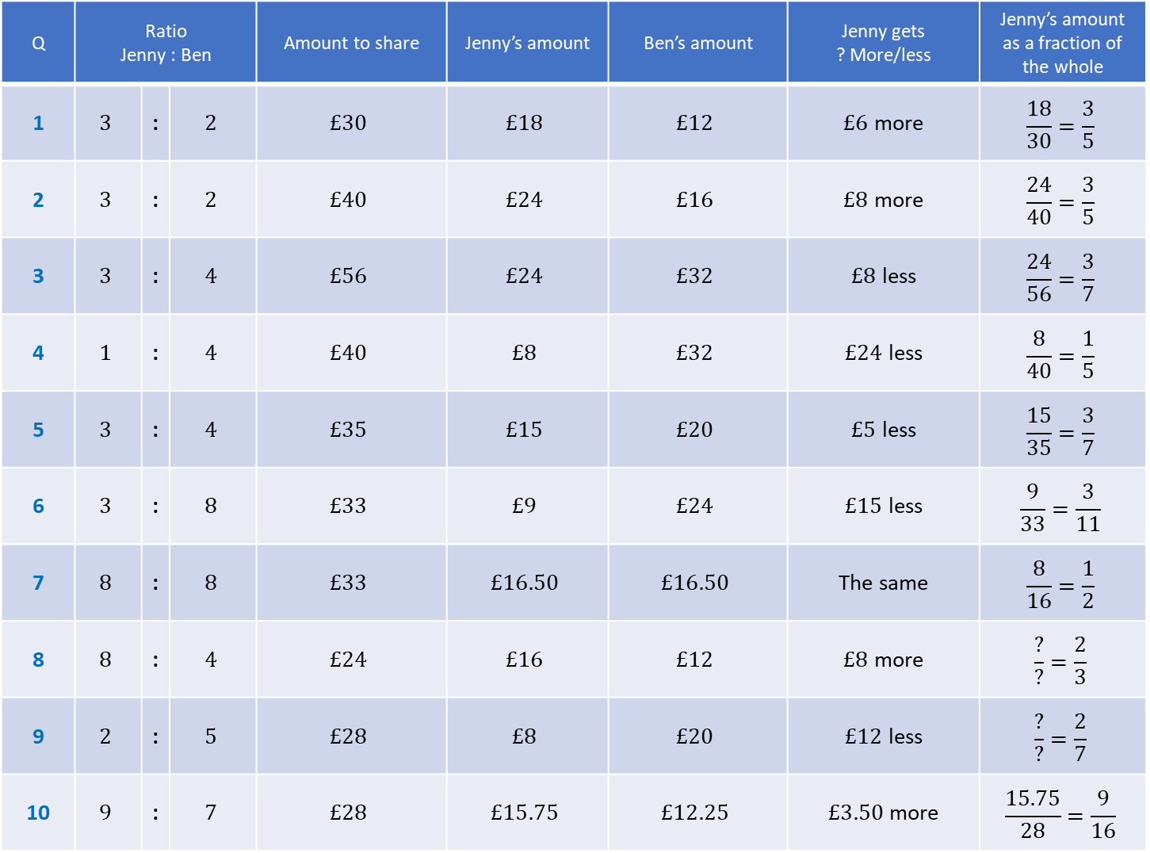
Q | Ratio Jenny : Ben |  |  | Amount to share | Jenny’s amount | Ben’s amount | Jenny gets ? More/less | Jenny’s amount as a fraction of the whole
1 | $$3$$ | : | $$2$$ | $$£30$$ | $$£18$$ | $$£12$$ | $£6$ more | $$\frac{18}{30}=\frac{3}{5}$$
2 | $$3$$ | : | $$2$$ | $$£40$$ | $$£24$$ | $$£16$$ | $£8$ more | $$\frac{24}{40}=\frac{3}{5}$$
3 | $$3$$ | : | $$4$$ | $$£56$$ | $$£24$$ | $$£32$$ | $£8$ less | $$\frac{24}{56}=\frac{3}{7}$$
4 | $$1$$ | : | $$4$$ | $$£40$$ | $$£8$$ | $$£32$$ | $£24$ less | $$\frac{8}{40}=\frac{1}{5}$$
5 | $$3$$ | : | $$4$$ | $$£35$$ | $$£15$$ | $$£20$$ | $£5$ less | $$\frac{15}{35}=\frac{3}{7}$$
6 | $$3$$ | : | $$8$$ | $$£33$$ | $$£9$$ | $$£24$$ | $£15$ less | $$\frac{9}{33}=\frac{3}{11}$$
7 | $$8$$ | : | $$8$$ | $$£33$$ | $$£16.50$$ | $$£16.50$$ | The same | $$\frac{8}{16}=\frac{1}{2}$$
8 | $$8$$ | : | $$4$$ | $$£24$$ | $$£16$$ | $$£12$$ | $£8$ more | $$\frac{?}{?}=\frac{2}{3}$$
9 | $$2$$ | : | $$5$$ | $$£28$$ | $$£8$$ | $$£20$$ | $£12$ less | $$\frac{?}{?}=\frac{2}{7}$$
10 | $$9$$ | : | $$7$$ | $$£28$$ | $$£15.75$$ | $$£12.25$$ | $£3.50$ more | $$\frac{15.75}{28}=\frac{9}{16}$$

Slide 4
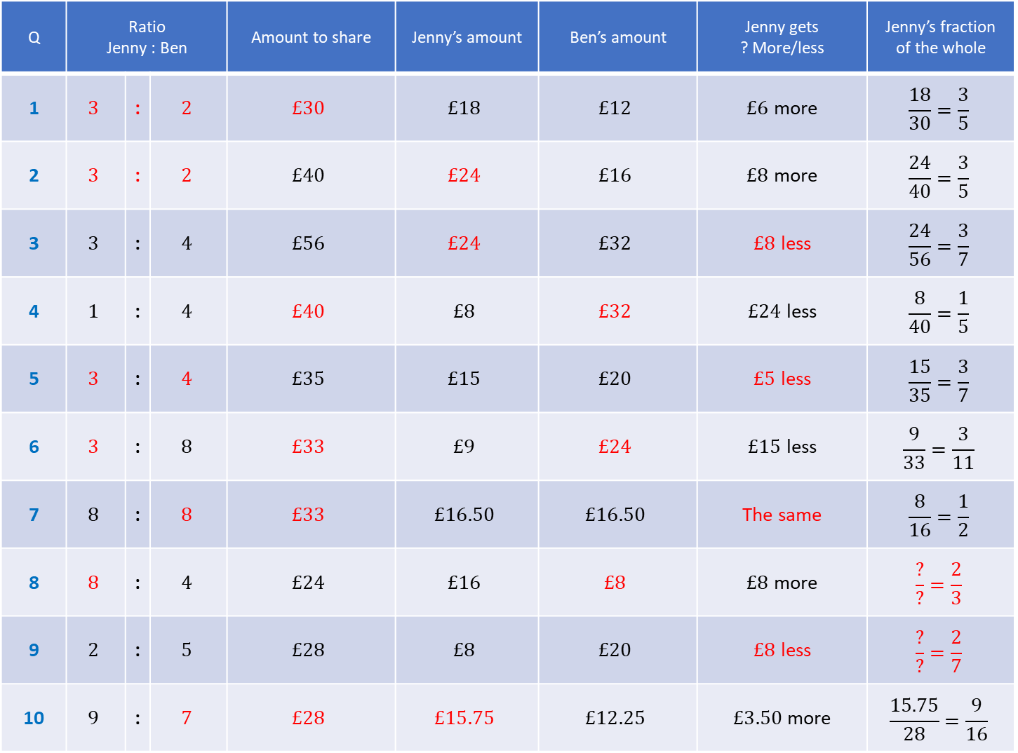
Q | Ratio Jenny : Ben |  |  | Amount to share | Jenny’s amount | Ben’s amount | Jenny gets ? More/less | Jenny’s fraction of the whole
1 | $$3$$ | : | $$2$$ | $$£30$$ | $$£18$$ | $$£12$$ | $£6$ more | $$\frac{18}{30}=\frac{3}{5}$$
2 | $$3$$ | : | $$2$$ | $$£40$$ | $$£24$$ | $$£16$$ | $£8$ more | $$\frac{24}{40}=\frac{3}{5}$$
3 | $$3$$ | : | $$4$$ | $$£56$$ | $$£24$$ | $$£32$$ | $£8$ less | $$\frac{24}{56}=\frac{3}{7}$$
4 | $$1$$ | : | $$4$$ | $$£40$$ | $$£8$$ | $$£32$$ | $£24$ less | $$\frac{8}{40}=\frac{1}{5}$$
5 | $$3$$ | : | $$4$$ | $$£35$$ | $$£15$$ | $$£20$$ | $£5$ less | $$\frac{15}{35}=\frac{3}{7}$$
6 | $$3$$ | : | $$8$$ | $$£33$$ | $$£9$$ | $$£24$$ | $£15$ less | $$\frac{9}{33}=\frac{3}{11}$$
7 | $$8$$ | : | $$8$$ | $$£33$$ | $$£16.50$$ | $$£16.50$$ | The same | $$\frac{8}{16}=\frac{1}{2}$$
8 | $$8$$ | : | $$4$$ | $$£24$$ | $$£16$$ | $$£8$$ | $£8$ more | $$\frac{?}{?}=\frac{2}{3}$$
9 | $$2$$ | : | $$5$$ | $$£28$$ | $$£8$$ | $$£20$$ | $£8$ less | $$\frac{?}{?}=\frac{2}{7}$$
10 | $$9$$ | : | $$7$$ | $$£28$$ | $$£15.75$$ | $$£12.25$$ | $£3.50$ more | $$\frac{15.75}{28}=\frac{9}{16}$$

