Slide 1
Ratio: Sharing in a Ratio 3
Silent
Teacher
Intelligent Practice
Narration
Your Turn
$$30g \text{in} \text{the} \text{ratio} 1 :2=$$
$$30g \text{in} \text{the} \text{ratio} 2 :4=$$
$$30g \text{in} \text{the} \text{ratio} 1 :5=$$
Practice

Slide 2
Worked Example
Your Turn
$$24g \text{in} \text{the} \text{ratio} 3 :1$$
$$24g \text{in} \text{the} \text{ratio} 5 :1$$
@mrbartonmaths

Slide 3
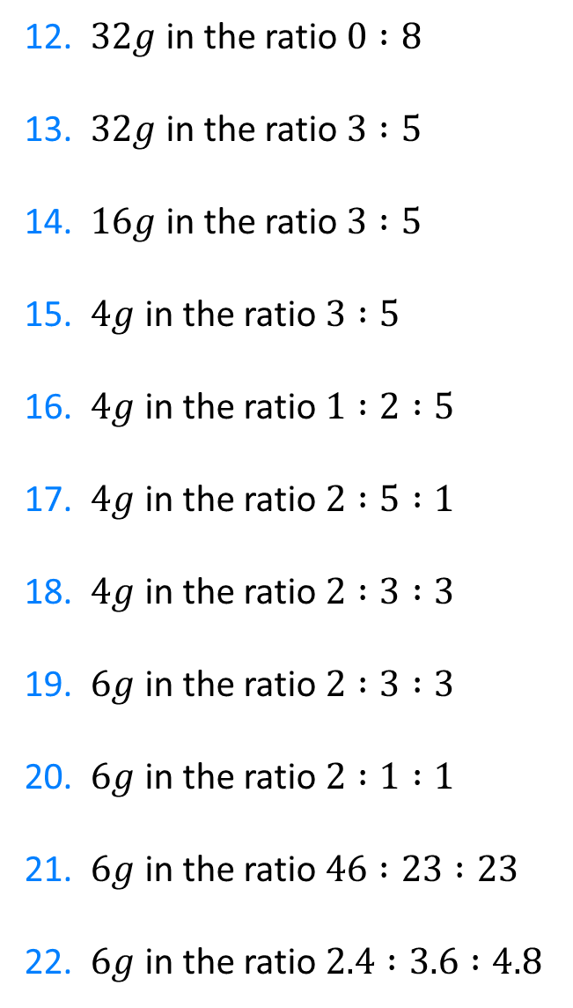
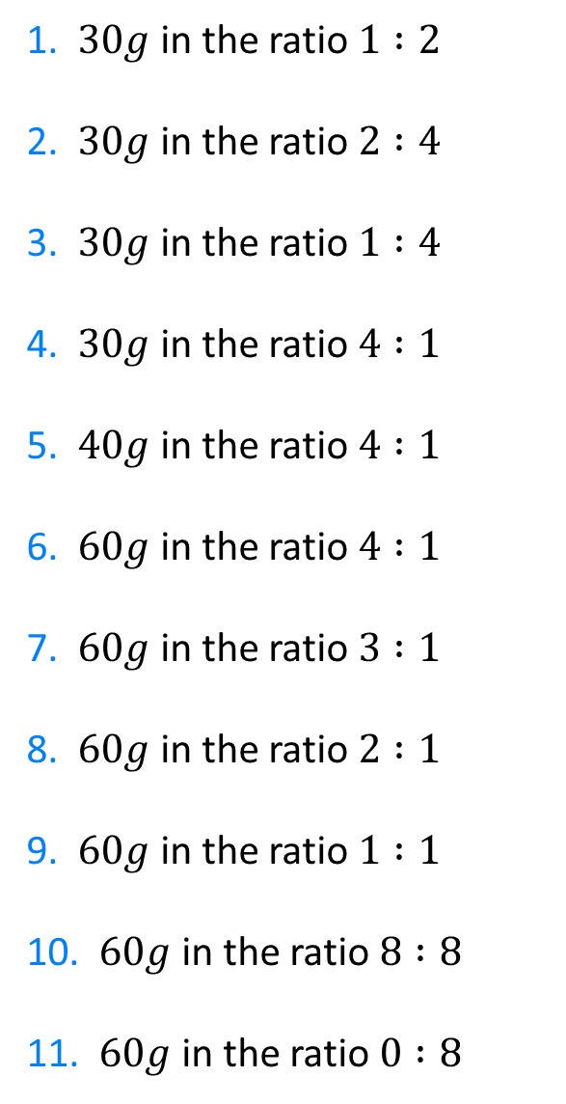
1. $30g$ in the ratio $1 :2$
2. $30g$ in the ratio $2 :4$
3. $30g$ in the ratio $1 :4$
4. $30g$ in the ratio $4 :1$
5. $40g$ in the ratio $4 :1$
6. $60g$ in the ratio $4 :1$
7. $60g$ in the ratio $3 :1$
8. $60g$ in the ratio $2 :1$
9. $60g$ in the ratio $1 :1$
10. $60g$ in the ratio $8 :8$
11. $60g$ in the ratio $0 :8$
12. $32g$ in the ratio $0 :8$
13. $32g$ in the ratio $3 :5$
14. $16g$ in the ratio $3 :5$
15. $4g$ in the ratio $3 :5$
16. $4g$ in the ratio $1 :2 :5$
17. $4g$ in the ratio $2 :5 :1$
18. $4g$ in the ratio $2 :3 :3$
19. $6g$ in the ratio $2 :3 :3$
20. $6g$ in the ratio $2 :1 :1$
21. $6g$ in the ratio $46 :23 :23$
22. $6g$ in the ratio $2.4 :3.6 :4.8$

Slide 4
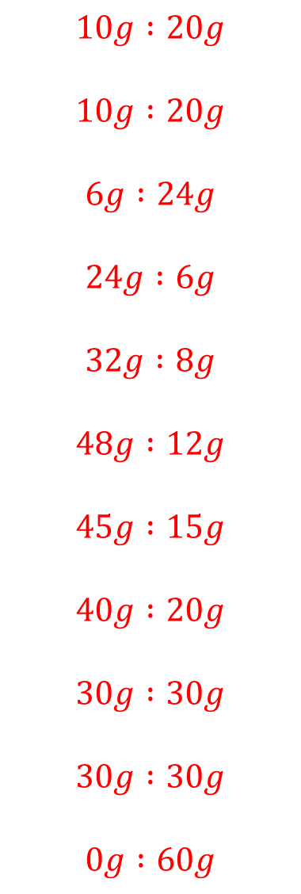
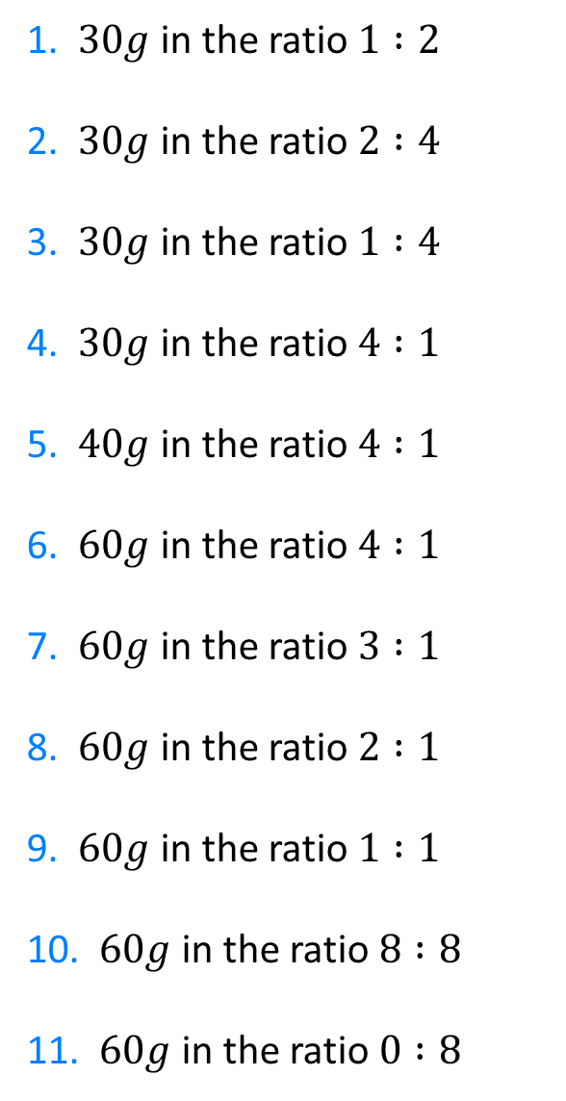
1. $30g$ in the ratio $1 :2$
2. $30g$ in the ratio $2 :4$
3. $30g$ in the ratio $1 :4$
4. $30g$ in the ratio $4 :1$
5. $40g$ in the ratio $4 :1$
6. $60g$ in the ratio $4 :1$
7. $60g$ in the ratio $3 :1$
8. $60g$ in the ratio $2 :1$
9. $60g$ in the ratio $1 :1$
10. $60g$ in the ratio $8 :8$
11. $60g$ in the ratio $0 :8$
$$10g :20g$$
$$10g :20g$$
$$6g :24g$$
$$24g :6g$$
$$32g :8g$$
$$48g :12g$$
$$45g :15g$$
$$40g :20g$$
$$30g :30g$$
$$30g :30g$$
$$0g :60g$$

Slide 5
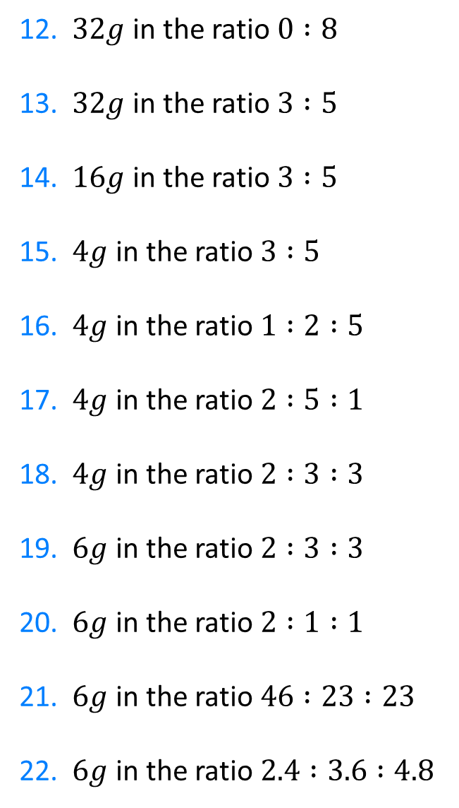
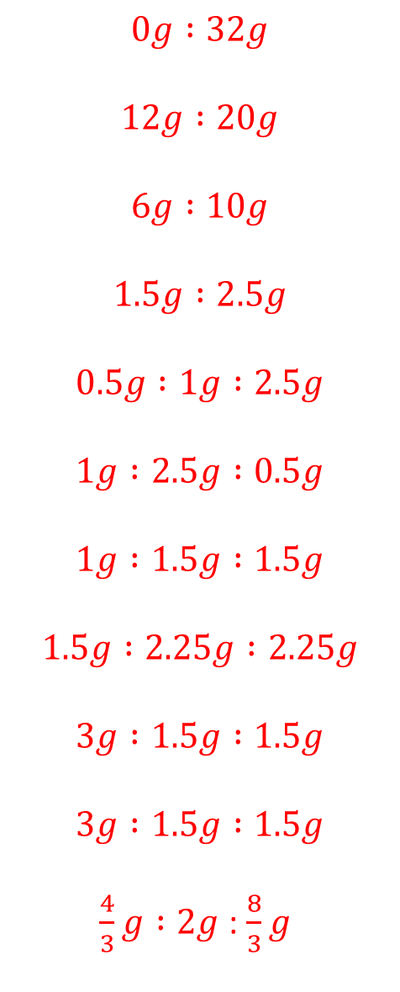
12. $32g$ in the ratio $0 :8$
13. $32g$ in the ratio $3 :5$
14. $16g$ in the ratio $3 :5$
15. $4g$ in the ratio $3 :5$
16. $4g$ in the ratio $1 :2 :5$
17. $4g$ in the ratio $2 :5 :1$
18. $4g$ in the ratio $2 :3 :3$
19. $6g$ in the ratio $2 :3 :3$
20. $6g$ in the ratio $2 :1 :1$
21. $6g$ in the ratio $46 :23 :23$
22. $6g$ in the ratio $2.4 :3.6 :4.8$
$$0g :32g$$
$$12g :20g$$
$$6g :10g$$
$$1.5g :2.5g$$
$$0.5g :1g :2.5g$$
$$1g :2.5g :0.5g$$
$$1g :1.5g :1.5g$$
$$1.5g :2.25g :2.25g$$
$$3g :1.5g :1.5g$$
$$3g :1.5g :1.5g$$
$\frac{4}{3}g :2g$ : $\frac{8}{3}g$

