Slide 1






Solving linear equations:
Variable on both sides and brackets
Silent
Teacher
Intelligent
Practice
Narration
Your Turn
$$2(x+3)=x+5$$
$$3(x+3)=2(x+5)$$
Practice

Slide 2

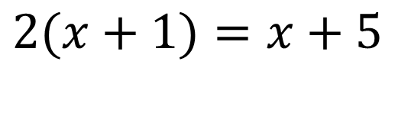
Worked Example
Your Turn
$$2(x+1)=x+5$$
$$3(x+1)=x+5$$
@mathsmiles_k

Slide 3
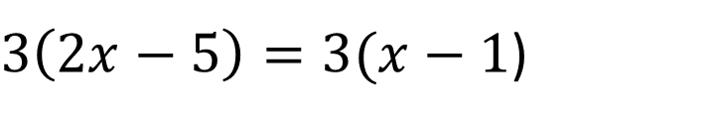
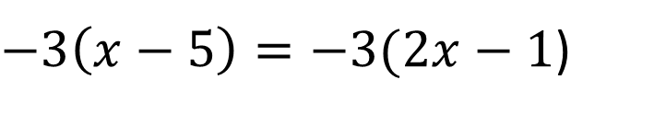
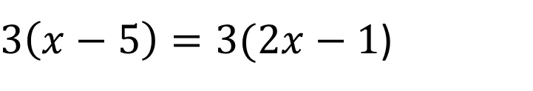
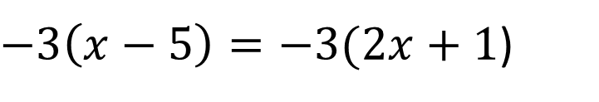
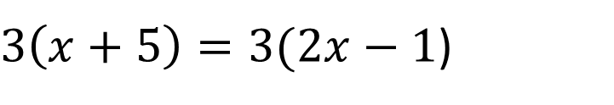
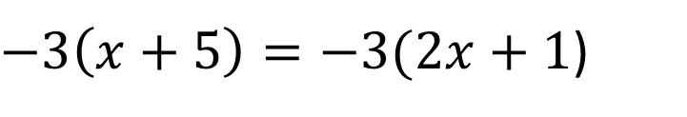
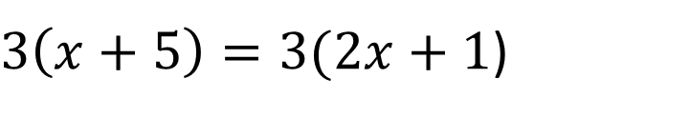
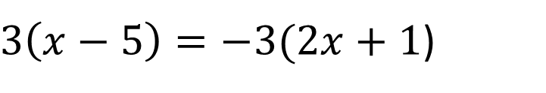
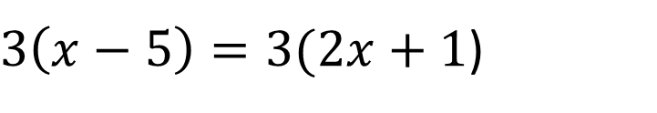
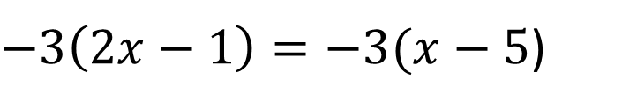
$$x+5=3\left(x+1\right)$$
1.
7.
$3\left(x−5\right)=3(2x+1$)
$$3\left(x+5\right)=x+1$$
2.
8.
$3\left(x−5\right)=−3(2x+1$)
3.
$3\left(x+5\right)=3(2x+1$)
9.
$−3\left(x+5\right)=−3(2x+1$)
4.
$3\left(x+5\right)=3(2x−1$)
$−3\left(x−5\right)=−3(2x+1$)
10.
5.
$3\left(x−5\right)=3(2x−1$)
11.
$−3\left(x−5\right)=−3(2x−1$)
6.
$3\left(2x−5\right)=3(x−1$)
$−3\left(2x−1\right)=−3(x−5$)
12.
@mathsmiles_k

Slide 4
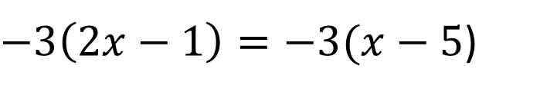


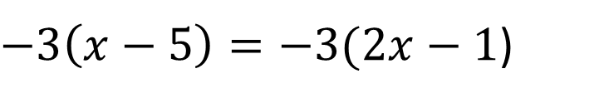
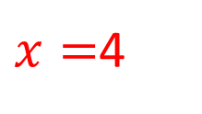


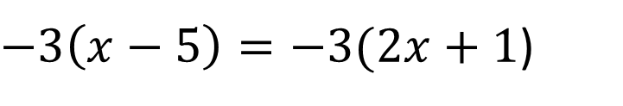
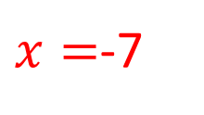


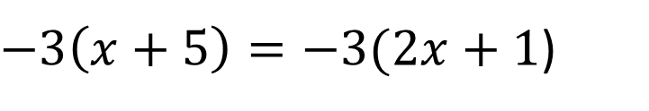
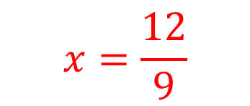
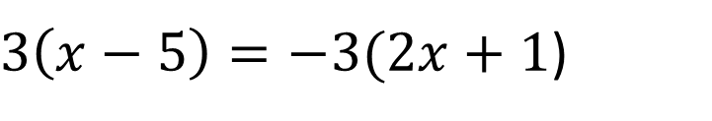


$$x+5=3\left(x+1\right)$$
$3\left(x−5\right)=−3(2x+1$)
$$x=1$$
$$x=−6$$
$$3\left(x+5\right)=x+1$$
$−3\left(x+5\right)=−3(2x+1$)
$x=$-7
$$x=\frac{12}{9}$$
$3\left(x+5\right)=3(2x+1$)
$x=$4
$−3\left(x−5\right)=−3(2x+1$)
$3\left(x+5\right)=3(2x−1$)
$$x=4$$
$$x=6$$
$−3\left(x−5\right)=−3(2x−1$)
$3\left(x−5\right)=3(2x−1$)
$$x=−4$$
$$x=−4$$
$−3\left(2x−1\right)=−3(x−5$)
$3\left(2x−5\right)=3(x−1$)
$$x=−4$$
$x=$4
@mathsmiles_k

