Slide 1
Fractions: Unit fractions of amounts
Silent
Teacher
Intelligent Practice
Narration
Your Turn
$$Find\frac{1}{3} of 18$$
$$If\frac{1}{3} is 5 find the whole$$
$$4 is what unit fraction of 12$$
Practice

Slide 2
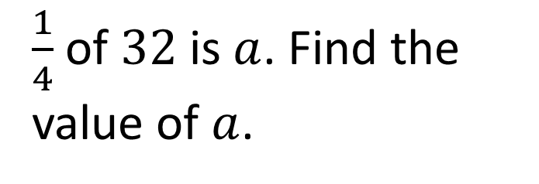
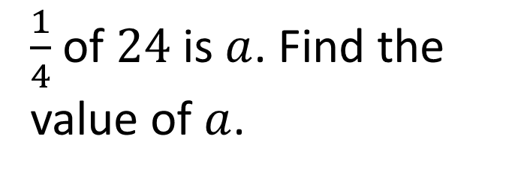
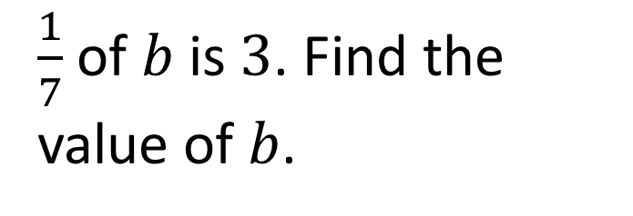
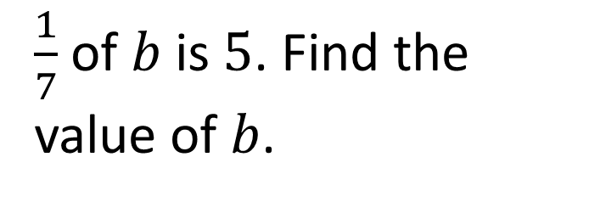
Worked Example
Your Turn
$\frac{1}{4}$ of $24$ is $a$. Find the value of $a$.
$\frac{1}{4}$ of $32$ is $a$. Find the value of $a$.
$\frac{1}{7}$ of $b$ is $5$. Find the value of $b$.
$\frac{1}{7}$ of $b$ is $3$. Find the value of $b$.

Slide 3
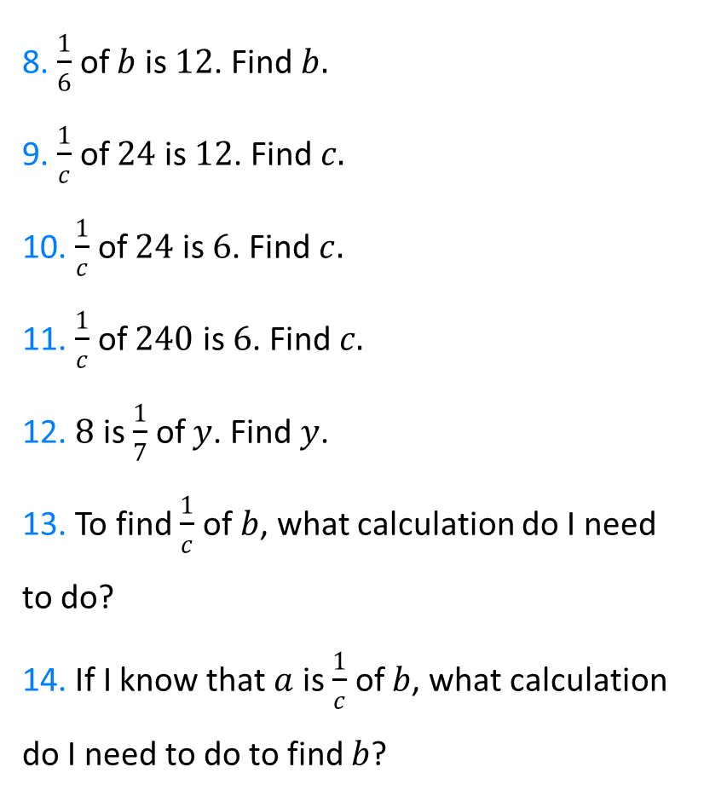
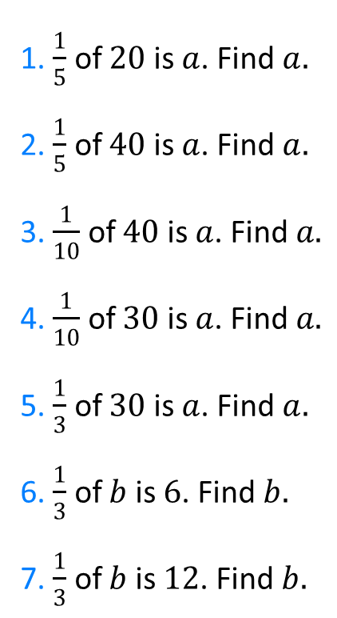
1. $\frac{1}{5}$ of $20$ is $a$. Find $a.$
2. $\frac{1}{5}$ of $40$ is $a$. Find $a.$
3. $\frac{1}{10}$ of $40$ is $a$. Find $a.$
4. $\frac{1}{10}$ of $30$ is $a$. Find $a.$
5. $\frac{1}{3}$ of $30$ is $a$. Find $a.$
6. $\frac{1}{3}$ of $b$ is $6$. Find $b.$
7. $\frac{1}{3}$ of $b$ is $12$. Find $b.$
8. $\frac{1}{6}$ of $b$ is $12$. Find $b.$
9. $\frac{1}{c}$ of $24$ is $12$. Find $c.$
10. $\frac{1}{c}$ of $24$ is $6$. Find $c.$
11. $\frac{1}{c}$ of $240$ is $6$. Find $c.$
12. $8$ is $\frac{1}{7}$ of $y$. Find $y$.
13. To find $\frac{1}{c}$ of $b$, what calculation do I need to do?
14. If I know that $a$ is $\frac{1}{c}$ of $b$, what calculation do I need to do to find $b$?

Slide 4
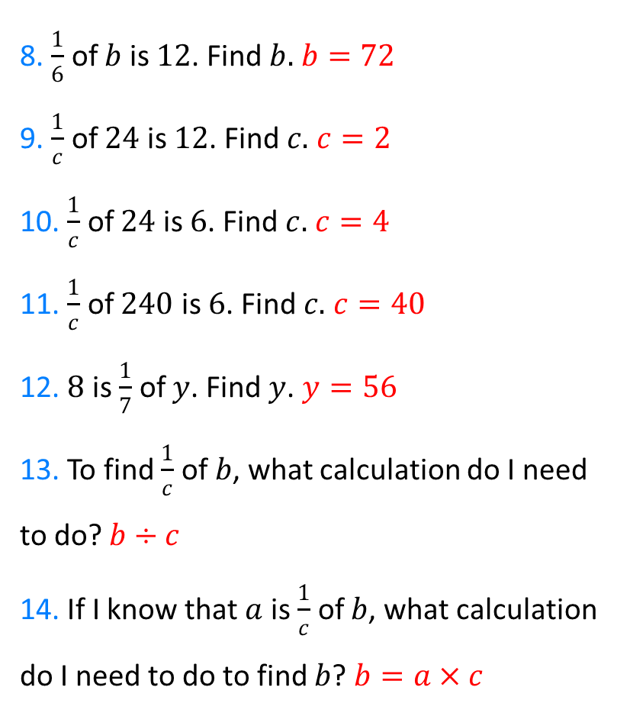
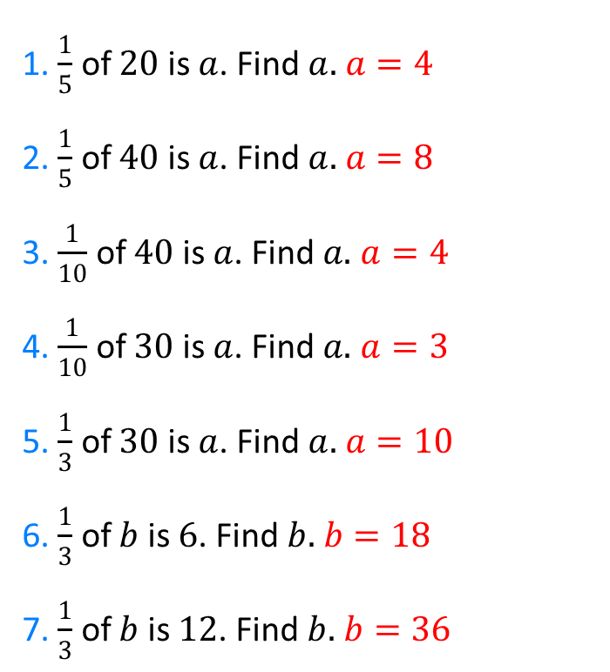
1. $\frac{1}{5}$ of $20$ is $a$. Find $a.$ $a=4$
2. $\frac{1}{5}$ of $40$ is $a$. Find $a.$ $a=8$
3. $\frac{1}{10}$ of $40$ is $a$. Find $a.$ $a=4$
4. $\frac{1}{10}$ of $30$ is $a$. Find $a.$ $a=3$
5. $\frac{1}{3}$ of $30$ is $a$. Find $a.$ $a=10$
6. $\frac{1}{3}$ of $b$ is $6$. Find $b.$ $b=18$
7. $\frac{1}{3}$ of $b$ is $12$. Find $b.$ $b=36$
8. $\frac{1}{6}$ of $b$ is $12$. Find $b.$ $b=72$
9. $\frac{1}{c}$ of $24$ is $12$. Find $c.$ $c=2$
10. $\frac{1}{c}$ of $24$ is $6$. Find $c.$ $c=4$
11. $\frac{1}{c}$ of $240$ is $6$. Find $c.$ $c=40$
12. $8$ is $\frac{1}{7}$ of $y$. Find $y$. $y=56$
13. To find $\frac{1}{c}$ of $b$, what calculation do I need to do? $b÷c$
14. If I know that $a$ is $\frac{1}{c}$ of $b$, what calculation do I need to do to find $b$? $b=a×c$

