Slide 1
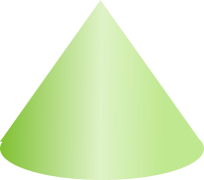
Volume: Volume of a cone
Silent
Teacher
Intelligent Practice
Narration
Your Turn
h
r
Practice

Slide 2
Worked Example
Your Turn
Find the volume. Give your answer correct to 2 decimal places.
Find the volume. Give your answer correct to 2 decimal places.
10 cm
10 cm
5 cm
8 cm
@beckyhall75

Slide 3
5 cm
10 cm
5 cm
20 cm
5 cm
10 cm
10 cm
10 cm
10 cm
5 cm
10 cm
10 cm
@ beckyhall75

Slide 4
V = 130.90 cm³
V = 1047.20 cm³
5 cm
10 cm
5 cm
20 cm
5 cm
V = 523.60 cm³
10 cm
V = 261.80 cm³
10 cm
10 cm
V = 1047.20 cm³
V = 130.90 cm³
10 cm
5 cm
10 cm
10 cm
@ beckyhall75

