Slide 1
Sequences: Finding the nth term rule
Silent
Teacher
Intelligent Practice
Narration
Your Turn
$$\text{4, 6, 8, 10...}$$
$$\text{5, 7, 9, 11...}$$
$$\text{6, 8, 10, 12...}$$
Practice

Slide 2
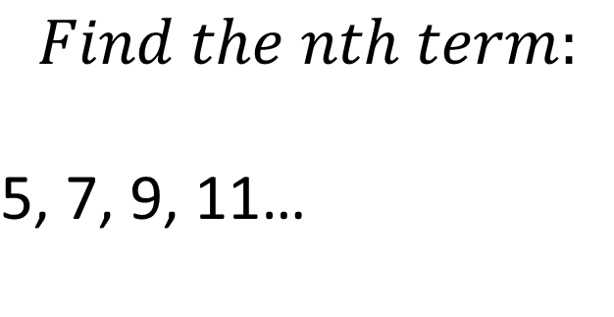
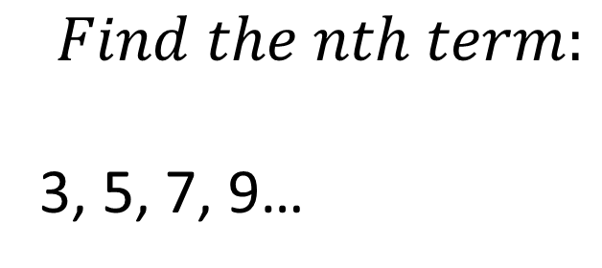
Worked Example
Your Turn
$$Find the nth term:$$
3, 5, 7, 9…
$$Find the nth term:$$
$$\text{5, 7, 9}\text{, 11}\text{…}$$

Slide 3
1. 4, 6, 8, 10...
2. 5, 7, 9, 11...
3. 6, 8, 10, 12...
4. 8, 10, 12, 14...
5. 8, 11, 14, 17...
6. 7, 10, 13, 16...
7. 6, 9, 12, 15...
8. 6, 10, 14, 18 ...
9. 5, 9, 13, 17...
10. 17, 13, 9, 5...
11. 0.5, 0.9, 1.3, 1.7…
12. 0.05, 0.09, 0.13, 0.17 ...
13. 0.5, 1, 1.5, 2 ...
14. 5x, 9x, 13x, 17x...

Slide 4
1. 4, 6, 8, 10...
2. 5, 7, 9, 11...
3. 6, 8, 10, 12...
4. 8, 10, 12, 14...
5. 8, 11, 14, 17...
6. 7, 10, 13, 16...
7. 6, 9, 12, 15...
2n + 2
2n + 3
2n + 4
2n + 6
3n + 5
3n + 4
3n + 3
8. 6, 10, 14, 18 ...
9. 5, 9, 13, 17...
10. 17, 13, 9, 5...
11. 0.5, 0.9, 1.3, 1.7…
12. 0.05, 0.09, 0.13, 0.17 ...
13. 0.5, 1, 1.5, 2 ...
14. 5x, 9x, 13x, 17x...
4n + 2
4n + 1
-4n + 21
0.4n + 0.1
0.04n + 0.01
0.5n
4xn + x

