Slide 1
Linear Equations: Which side?
True/false
Reflect
Your Turn
$$2x+5=x+8$$
$$x+5=2x+8$$
$$x+8=2x+5$$
Rule

Slide 2
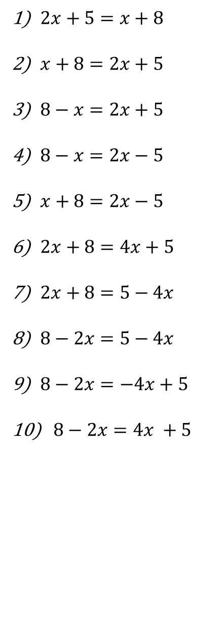
Eliminate from ?
LHS/RHS
LHS/RHS
LHS/RHS
LHS/RHS
LHS/RHS
LHS/RHS
LHS/RHS
LHS/RHS
LHS/RHS
LHS/RHS
@mathssmiles_k

Slide 3
Eliminate from ?
LHS/RHS
LHS/RHS
LHS/RHS
LHS/RHS
LHS/RHS
LHS/RHS
LHS/RHS
LHS/RHS
LHS/RHS
LHS/RHS
@mathsmiles_k

Slide 4
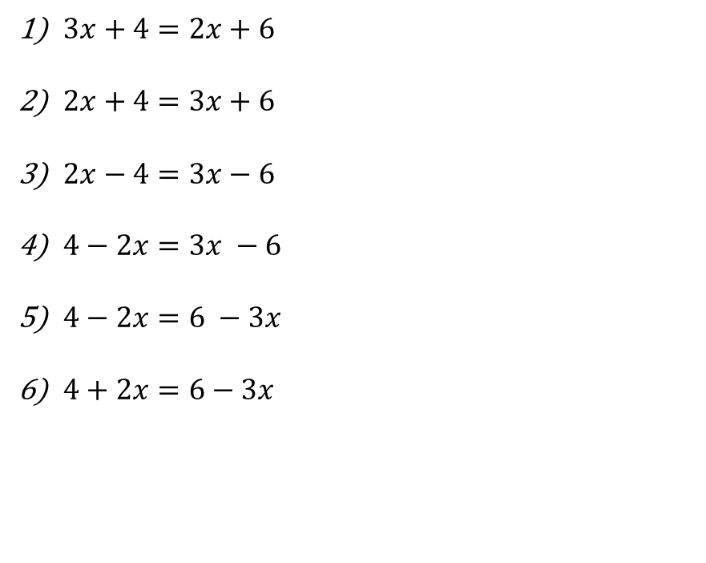
Your Turn
LHS/RHS
LHS/RHS
LHS/RHS
LHS/RHS
LHS/RHS
LHS/RHS
@mathsmiles_k

Slide 5
Your Turn
LHS/RHS
LHS/RHS
LHS/RHS
LHS/RHS
LHS/RHS
LHS/RHS
@mathsmiles_k

