Slide 1
Standard From: Adding in standard form
Silent
Teacher
Intelligent Practice
Narration
Your Turn
$$\left(5×{10}^{4}\right)+\left(4×{10}^{4}\right)$$
$$\left(15×{10}^{4}\right)+(4×{10}^{4})$$
$$\left(150×{10}^{4}\right)+\left(4×{10}^{4}\right)$$
Practice

Slide 2
Worked Examples
Your turn
$$\left(3×{10}^{4}\right)+(4×{10}^{4})$$
$$\left(3×{10}^{7}\right)+(2×{10}^{7})$$
$$\left(3×{10}^{4}\right)+(8×{10}^{4})$$
$$\left(3×{10}^{7}\right)+(9×{10}^{7})$$
$$\left(3×{10}^{5}\right)+(8×{10}^{4})$$
$$\left(3×{10}^{8}\right)+(9×{10}^{7})$$
@gjmcconnell88

Slide 3
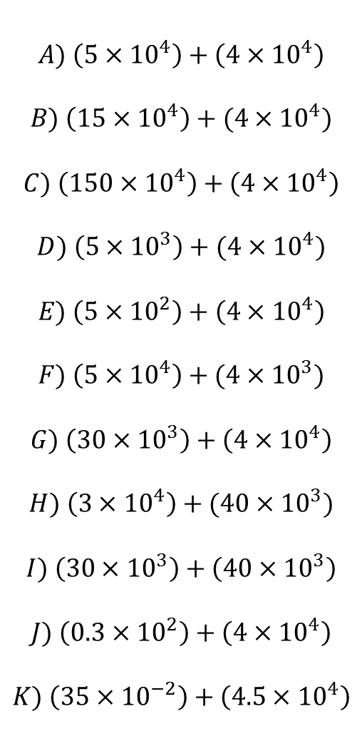
$$A) \left(5×{10}^{4}\right)+\left(4×{10}^{4}\right)$$
$$B) \left(15×{10}^{4}\right)+(4×{10}^{4})$$
$$C) \left(150×{10}^{4}\right)+\left(4×{10}^{4}\right)$$
$$D) \left(5×{10}^{3}\right)+(4×{10}^{4})$$
$$E) \left(5×{10}^{2}\right)+\left(4×{10}^{4}\right)$$
$$F) \left(5×{10}^{4}\right)+(4×{10}^{3})$$
$$G) \left(30×{10}^{3}\right)+\left(4×{10}^{4}\right)$$
$$H) \left(3×{10}^{4}\right)+(40×{10}^{3})$$
$$I) \left(30×{10}^{3}\right)+\left(40×{10}^{3}\right)$$
$$J) \left(0.3×{10}^{2}\right)+\left(4×{10}^{4}\right)$$
$$K) \left(35×{10}^{−2}\right)+\left(4.5×{10}^{4}\right)$$
@gjmcconnell88

Slide 4
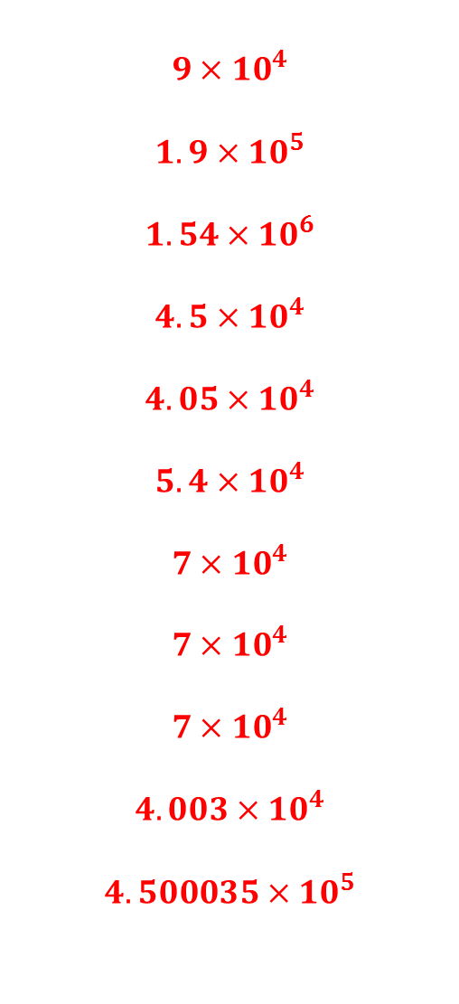
$$A) \left(5×{10}^{4}\right)+\left(4×{10}^{4}\right)$$
$$B) \left(15×{10}^{4}\right)+(4×{10}^{4})$$
$$C) \left(150×{10}^{4}\right)+\left(4×{10}^{4}\right)$$
$$D) \left(5×{10}^{3}\right)+(4×{10}^{4})$$
$$E) \left(5×{10}^{2}\right)+\left(4×{10}^{4}\right)$$
$$F) \left(5×{10}^{4}\right)+(4×{10}^{3})$$
$$G) \left(30×{10}^{3}\right)+\left(4×{10}^{4}\right)$$
$$H) \left(3×{10}^{4}\right)+(40×{10}^{3})$$
$$I) \left(30×{10}^{3}\right)+\left(40×{10}^{3}\right)$$
$$J) \left(0.3×{10}^{2}\right)+\left(4×{10}^{4}\right)$$
$$K) \left(35×{10}^{−2}\right)+\left(4.5×{10}^{4}\right)$$
$$9×{10}^{4}$$
$$1.9×{10}^{5}$$
$$1.54×{10}^{6}$$
$$4.5×{10}^{4}$$
$$4.05×{10}^{4}$$
$$5.4×{10}^{4}$$
$$7×{10}^{4}$$
$$7×{10}^{4}$$
$$7×{10}^{4}$$
$$4.003×{10}^{4}$$
$$4.500035×{10}^{5}$$
@gjmcconnell88

