Slide 1
Angles in Polygons: Fill in the gaps
Silent
Teacher
Intelligent Practice
Narration
Your Turn
Practice

Slide 2
Worked Example
Your Turn
What is the total of the interior angles of a 9- sided shape?
What is the total of the interior angles of a 14- sided shape?
Calculate the size of an interior angle in a regular octagon
Calculate the size of an interior angle in a regular pentagon
A regular polygon has an exterior angle of 12°.
How many sides does it have?
A regular polygon has an exterior angle of 10°.
How many sides does it have?

Slide 3
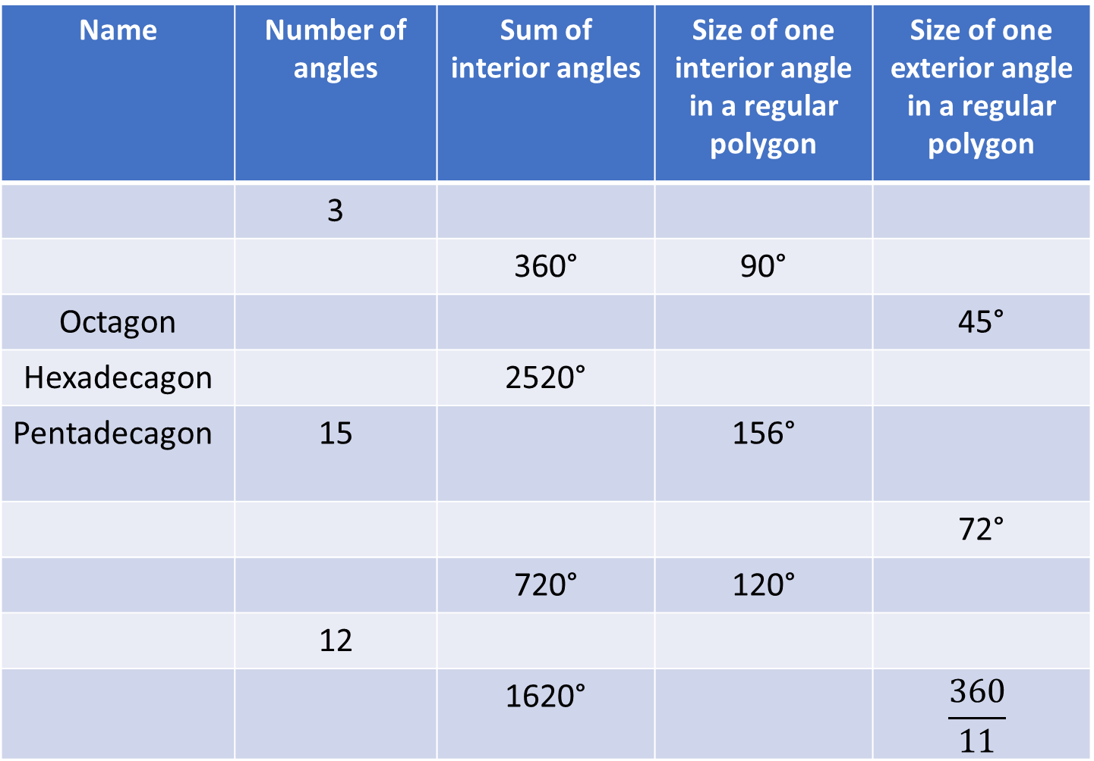
Name | Number of angles | Sum of interior angles | Size of one interior angle in a regular polygon | Size of one exterior angle in a regular polygon
 | 3
 |  | 360° | 90°
Octagon |  |  |  | 45°
Hexadecagon |  | 2520°
Pentadecagon | 15 |  | 156°
 |  |  |  | 72°
 |  | 720° | 120°
 | 12
 |  | 1620° |  | $$\frac{360}{11}$$

Slide 4
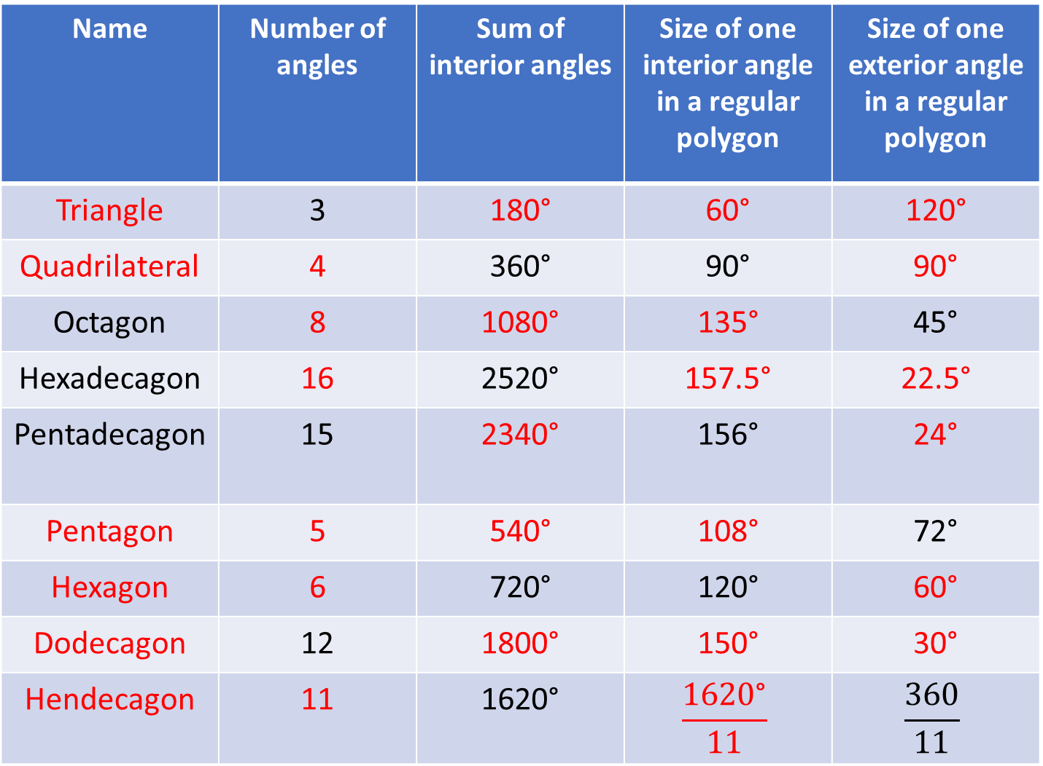
Name | Number of angles | Sum of interior angles | Size of one interior angle in a regular polygon | Size of one exterior angle in a regular polygon
Triangle | 3 | 180° | 60° | 120°
Quadrilateral | 4 | 360° | 90° | 90°
Octagon | 8 | 1080° | 135° | 45°
Hexadecagon | 16 | 2520° | 157.5° | 22.5°
Pentadecagon | 15 | 2340° | 156° | 24°
Pentagon | 5 | 540° | 108° | 72°
Hexagon | 6 | 720° | 120° | 60°
Dodecagon | 12 | 1800° | 150° | 30°
Hendecagon | 11 | 1620° | $$\frac{1620\text{°}}{11}$$ | $$\frac{360}{11}$$

