Slide 1
Distributive Law
Silent
Teacher
Intelligent Practice
Narration
Your Turn
$$3(5+10)$$
$$6(5+10)=$$
$$6(10+5)=$$
Practice

Slide 2
Worked Example
Your Turn
$3\left(5+10\right)=$
$$6\left(5+10\right)=$$
$$3×5+3×10=$$
$$6×5+6×10=$$
$$15+30=$$
$$30+60=$$
$$45$$
$$90$$
@mrdbusby

Slide 3
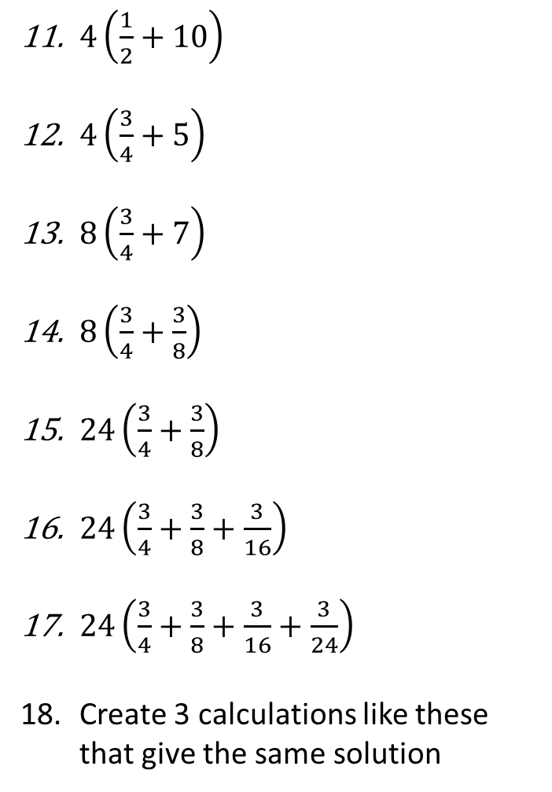
4(5 + 10)
4(3 + 10)
5(3 + 10)
5(3 + 7)
5(6 + 14)
10(6 + 14)
10(6 + 2.5)
4(4 + 2.5)
4(2.5 + 4)
8(4.3 + 2.8)
$4\left(\frac{1}{2}+10\right)$
$4\left(\frac{3}{4}+5\right)$
$8\left(\frac{3}{4}+7\right)$
$8\left(\frac{3}{4}+\frac{3}{8}\right)$
$24\left(\frac{3}{4}+\frac{3}{8}\right)$
$24\left(\frac{3}{4}+\frac{3}{8}+\frac{3}{16}\right)$
$24\left(\frac{3}{4}+\frac{3}{8}+\frac{3}{16}+\frac{3}{24}\right)$
Create 3 calculations like these that give the same solution
@mrdbusby

Slide 4
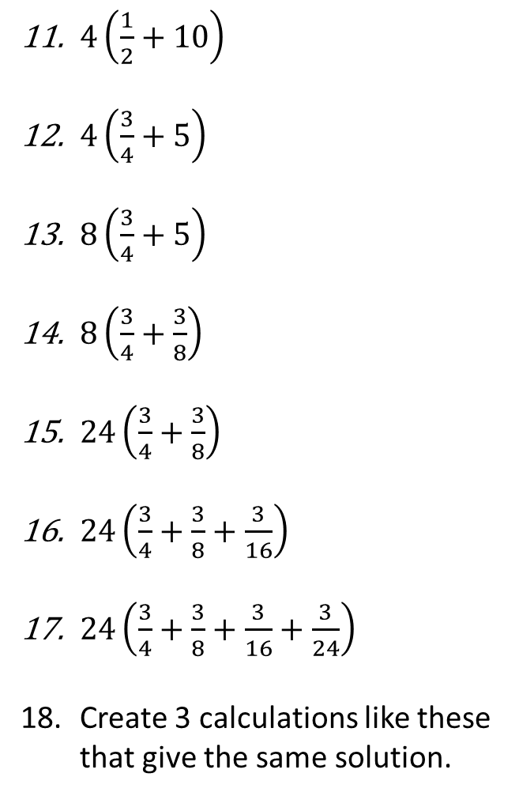
4(5 + 10)
4(3 + 10)
5(3 + 10)
5(3 + 7)
5(6 + 14)
10(6 + 14)
10(6 + 2.5)
4(4 + 2.5)
4(2.5 + 4)
8(4.3 + 2.8)
60
52
65
50
100
200
85
26
26
56.8
42
23
46
9
27
31.5
34.5
$4\left(\frac{1}{2}+10\right)$
$4\left(\frac{3}{4}+5\right)$
$8\left(\frac{3}{4}+5\right)$
$8\left(\frac{3}{4}+\frac{3}{8}\right)$
$24\left(\frac{3}{4}+\frac{3}{8}\right)$
$24\left(\frac{3}{4}+\frac{3}{8}+\frac{3}{16}\right)$
$24\left(\frac{3}{4}+\frac{3}{8}+\frac{3}{16}+\frac{3}{24}\right)$
Create 3 calculations like these that give the same solution.
@mrdbusby

