Slide 1
Fractions: Dividing fractions by integers
Silent
Teacher
Intelligent Practice
Narration
Your Turn
$\frac{2}{5}$÷ 3
$\frac{3}{5}$÷ 3
Practice

Slide 2
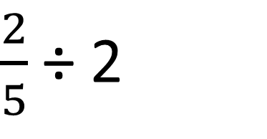
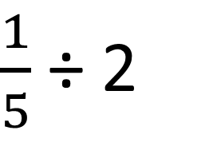
Worked Example
Your Turn
$\frac{1}{5}$ ÷ 2
$\frac{2}{5}$÷ 2

Slide 3
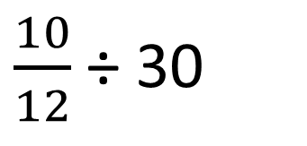
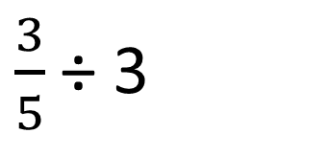
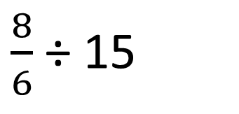
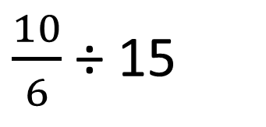
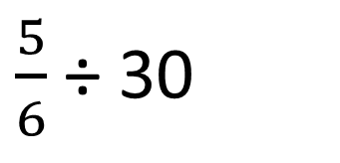
$\frac{2}{5}$÷
$\frac{10}{12}$ ÷ 30
1.
3
7.
$\frac{3}{5}$÷ 3
2.
$\frac{5}{6}$ ÷ 30
8.
$\frac{5}{3}$÷
3.
3
$\frac{5}{6}$ ÷
$\frac{3}{6}$÷
9.
15
4.
3
$\frac{5}{6}$÷
$\frac{10}{6}$ ÷ 15
5.
3
10.
$\frac{10}{12}$÷
$\frac{8}{6}$ ÷ 15
6.
3
11.

Slide 4


$\frac{2}{5}$÷
$\frac{10}{12}$ ÷ 30
$\frac{10}{360}$
= $\frac{1}{36}$
1.
3
$$\frac{2}{15}$$
7.
$\frac{3}{5}$÷ 3
$$\frac{3}{15}$$
= $\frac{1}{5}$
2.
$\frac{5}{6}$ ÷ 30
8.
$\frac{5}{180}$
= $\frac{1}{36}$
$\frac{5}{3}$÷
3.
3
$$\frac{5}{9}$$
$\frac{5}{6}$ ÷
$\frac{3}{6}$÷
9.
15
$\frac{5}{90}$
= $\frac{1}{18}$
4.
3
$$\frac{3}{18}$$
= $\frac{1}{6}$
$\frac{5}{6}$÷
$\frac{10}{6}$ ÷ 15
5.
3
10.
$$\frac{10}{90}$$
= $\frac{1}{9}$
$$\frac{5}{18}$$
$\frac{10}{12}$÷
$\frac{8}{6}$ ÷ 15
6.
3
$$\frac{10}{36}$$
11.
$$\frac{8}{90}$$
=$\frac{4}{45}$
= $\frac{5}{18}$

