Slide 1
Fractions: Dividing integers by fractions
Silent
Teacher
Intelligent Practice
Narration
Your Turn
3 ÷ $\frac{2}{5}$
3 ÷ $\frac{3}{5}$
Practice

Slide 2
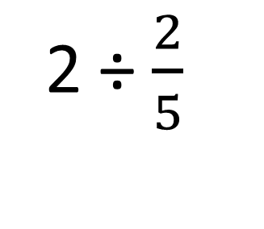
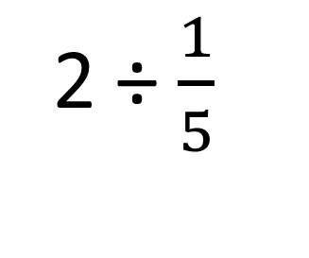
Worked Example
Your Turn
2 ÷ $\frac{1}{5}$
2 ÷ $\frac{2}{5}$

Slide 3
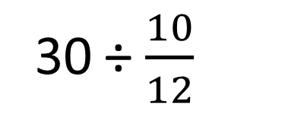

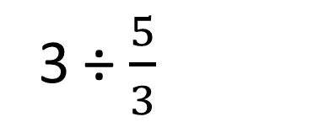
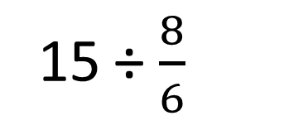

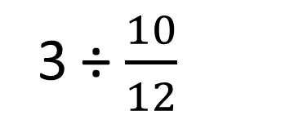
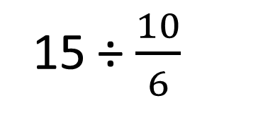
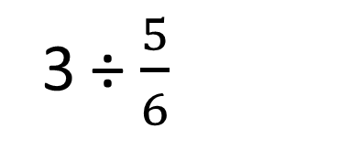
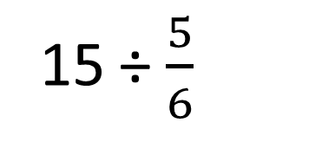

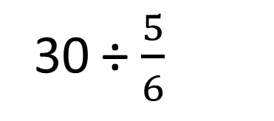
3 ÷ $\frac{2}{5}$
30 ÷ $\frac{10}{12}$
1.
7.
3 ÷ $\frac{3}{5}$
2.
30 ÷ $\frac{5}{6}$
8.
3 ÷ $\frac{5}{3}$
3.
15 ÷ $\frac{5}{6}$
3 ÷ $\frac{3}{6}$
9.
4.
3 ÷ $\frac{5}{6}$
15 ÷ $\frac{10}{6}$
5.
10.
3 ÷ $\frac{10}{12}$
15 ÷ $\frac{8}{6}$
6.
11.

Slide 4
3 ÷ $\frac{2}{5}$
30 ÷ $\frac{10}{12}$
$$\frac{15}{2}$$
$$36$$
1.
7.
3 ÷ $\frac{3}{5}$
2.
$$5$$
30 ÷ $\frac{5}{6}$
8.
36
3 ÷ $\frac{5}{3}$
3.
$$\frac{9}{5}$$
15 ÷ $\frac{5}{6}$
3 ÷ $\frac{3}{6}$
9.
$$18$$
4.
$$6$$
3 ÷ $\frac{5}{6}$
15 ÷ $\frac{10}{6}$
$$\frac{18}{5}$$
$$9$$
5.
10.
3 ÷ $\frac{10}{12}$
15 ÷ $\frac{8}{6}$
$$\frac{36}{10}$$
11.
$$\frac{90}{8}$$
= $\frac{45}{4}$
6.

