Slide 1
Percentages: Fill in the gaps
Silent
Teacher
Intelligent Practice
Narration
Your Turn
Practice

Slide 2
Worked Example
Your Turn
Original Amount: 40
Percentage: 24%
Original Amount: 40
Percentage: 72%
As a fraction:
Multiplier:
Percentage of…:
Increased by…:
Decreased by…:
As a fraction:
Multiplier:
Percentage of…:
Increased by…:
Decreased by…:

Slide 3
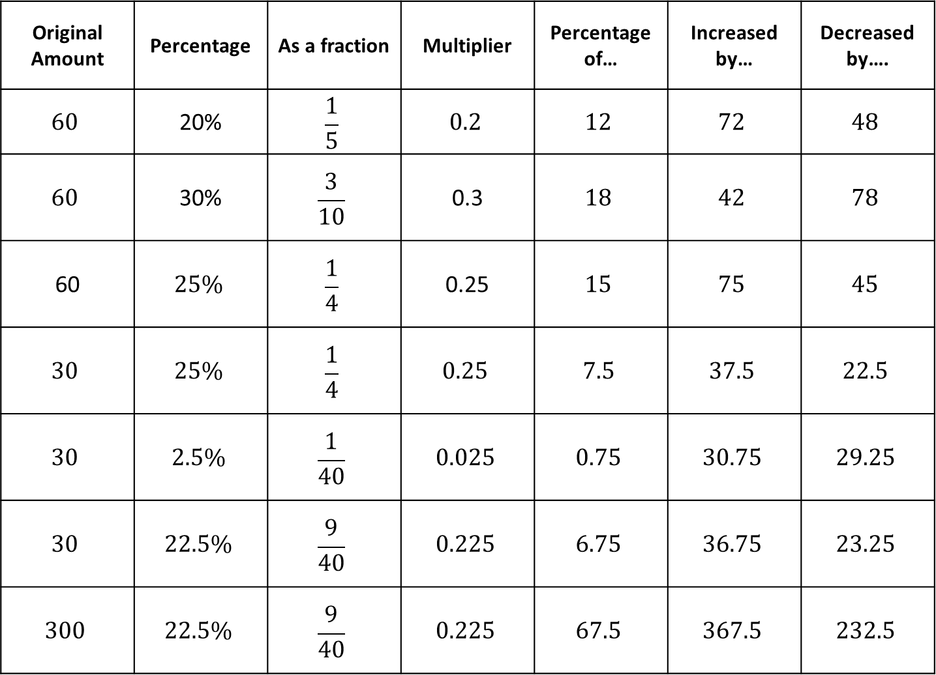
Original Amount | Percentage | As a fraction | Multiplier | Percentage of… | Increased by… | Decreased by….
$$60$$ | 20% | $$\frac{1}{5}$$ | $$0.2$$ | $$12$$ | $$72$$ | $$48$$
$$60$$ | 30% | $$\frac{3}{10}$$ | 0.3 | $$18$$ | $$42$$ | $$78$$
60 | $$25\%$$ | $$\frac{1}{4}$$ | 0.25 | $$15$$ | $$75$$ | $$45$$
$$30$$ | $$25\%$$ | $$\frac{1}{4}$$ | $$0.25$$ | $$7.5$$ | $$37.5$$ | $$22.5$$
$$30$$ | $$2.5\%$$ | $$\frac{1}{40}$$ | $$0.025$$ | $$0.75$$ | $$30.75$$ | $$29.25$$
$$30$$ | $$22.5\%$$ | $$\frac{9}{40}$$ | $$0.225$$ | $$6.75$$ | $$36.75$$ | $$23.25$$
$$300$$ | $$22.5\%$$ | $$\frac{9}{40}$$ | $$0.225$$ | $$67.5$$ | $$367.5$$ | $$232.5$$
$$1.$$
$$2.$$
$$3.$$
$$4.$$
$$5.$$
$$6.$$
$$7.$$

Slide 4
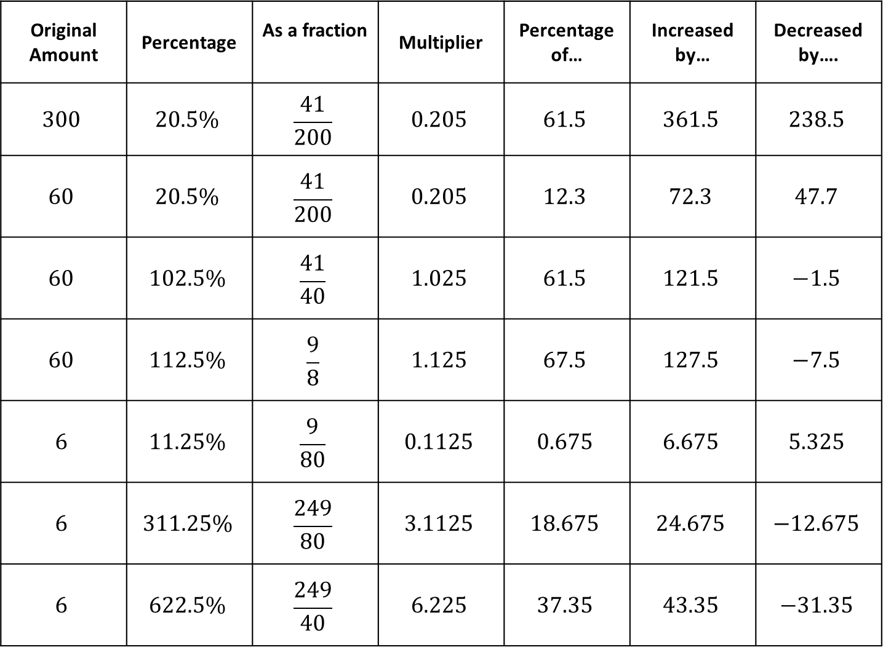
Original Amount | Percentage | As a fraction | Multiplier | Percentage of… | Increased by… | Decreased by….
$$300$$ | $$20.5\%$$ | $$\frac{41}{200}$$ | $$0.205$$ | $$61.5$$ | $$361.5$$ | $$238.5$$
$$60$$ | $$20.5\%$$ | $$\frac{41}{200}$$ | $$0.205$$ | $$12.3$$ | $$72.3$$ | $$47.7$$
$$60$$ | $$102.5\%$$ | $$\frac{41}{40}$$ | $$1.025$$ | $$61.5$$ | $$121.5$$ | $$−1.5$$
$$60$$ | $$112.5\%$$ | $$\frac{9}{8}$$ | $$1.125$$ | $$67.5$$ | $$127.5$$ | $$−7.5$$
$$6$$ | $$11.25\%$$ | $$\frac{9}{80}$$ | $$0.1125$$ | $$0.675$$ | $$6.675$$ | $$5.325$$
$$6$$ | $$311.25\%$$ | $$\frac{249}{80}$$ | $$3.1125$$ | $$18.675$$ | $$24.675$$ | $$−12.675$$
$$6$$ | $$622.5\%$$ | $$\frac{249}{40}$$ | $$6.225$$ | $$37.35$$ | $$43.35$$ | $$−31.35$$
$$8.$$
$$9.$$
$$10.$$
$$11.$$
$$12.$$
$$13.$$
$$14.$$

Slide 5
Original Amount | Percentage | As a fraction | Multiplier | Percentage of… | Increased by… | Decreased by….
$$60$$ | 20% | $$\frac{1}{5}$$ | $$0.2$$ | $$12$$ | $$72$$ | $$48$$
$$60$$ | 30% | $$\frac{3}{10}$$ | 0.3 | $$18$$ | $$42$$ | $$78$$
60 | $$25\%$$ | $$\frac{1}{4}$$ | 0.25 | $$15$$ | $$75$$ | $$45$$
$$30$$ | $$25\%$$ | $$\frac{1}{4}$$ | $$0.25$$ | $$7.5$$ | $$37.5$$ | $$22.5$$
$$30$$ | $$2.5\%$$ | $$\frac{1}{40}$$ | $$0.025$$ | $$0.75$$ | $$30.75$$ | $$29.25$$
$$30$$ | $$22.5\%$$ | $$\frac{9}{40}$$ | $$0.225$$ | $$6.75$$ | $$36.75$$ | $$23.25$$
$$300$$ | $$22.5\%$$ | $$\frac{9}{40}$$ | $$0.225$$ | $$67.5$$ | $$367.5$$ | $$232.5$$
$$1.$$
$$2.$$
$$3.$$
$$4.$$
$$5.$$
$$6.$$
$$7.$$

Slide 6
Original Amount | Percentage | As a fraction | Multiplier | Percentage of… | Increased by… | Decreased by….
$$300$$ | $$20.5\%$$ | $$\frac{41}{200}$$ | $$0.205$$ | $$61.5$$ | $$361.5$$ | $$238.5$$
$$60$$ | $$20.5\%$$ | $$\frac{41}{200}$$ | $$0.205$$ | $$12.3$$ | $$72.3$$ | $$47.7$$
$$60$$ | $$102.5\%$$ | $$\frac{41}{40}$$ | $$1.025$$ | $$61.5$$ | $$121.5$$ | $$−1.5$$
$$60$$ | $$112.5\%$$ | $$\frac{9}{8}$$ | $$1.125$$ | $$67.5$$ | $$127.5$$ | $$−7.5$$
$$6$$ | $$11.25\%$$ | $$\frac{9}{80}$$ | $$0.1125$$ | $$0.675$$ | $$6.675$$ | $$5.325$$
$$6$$ | $$311.25\%$$ | $$\frac{249}{80}$$ | $$3.1125$$ | $$18.675$$ | $$24.675$$ | $$−12.675$$
$$6$$ | $$622.5\%$$ | $$\frac{249}{40}$$ | $$6.225$$ | $$37.35$$ | $$43.35$$ | $$−31.35$$
$$8.$$
$$9.$$
$$10.$$
$$11.$$
$$12.$$
$$13.$$
$$14.$$

