Slide 1
Powers and indices: Converting powers to a different base
Silent
Teacher
Intelligent Practice
Narration
Your Turn
Write 8 as a power of 2
$$2×2×2=8$$
So $8= 2^{3}$
Practice

Slide 2
Worked Example
Your Turn
Write 27 as a power of 3
Write 8 as a power of 2
$$2×2×2=8$$
So $8= 2^{3}$
Write 27$x$ as a power of 3
Write 8$x$ as a power of 2
$$8^{x}={(2^{3})}^{x}=2^{3x}$$
Write 8$2x$ as a power of 2
Write 8$3x$ as a power of 2
$$8^{3x}={(2^{3})}^{3x}=2^{9x}$$
@gjmcconnell88

Slide 3
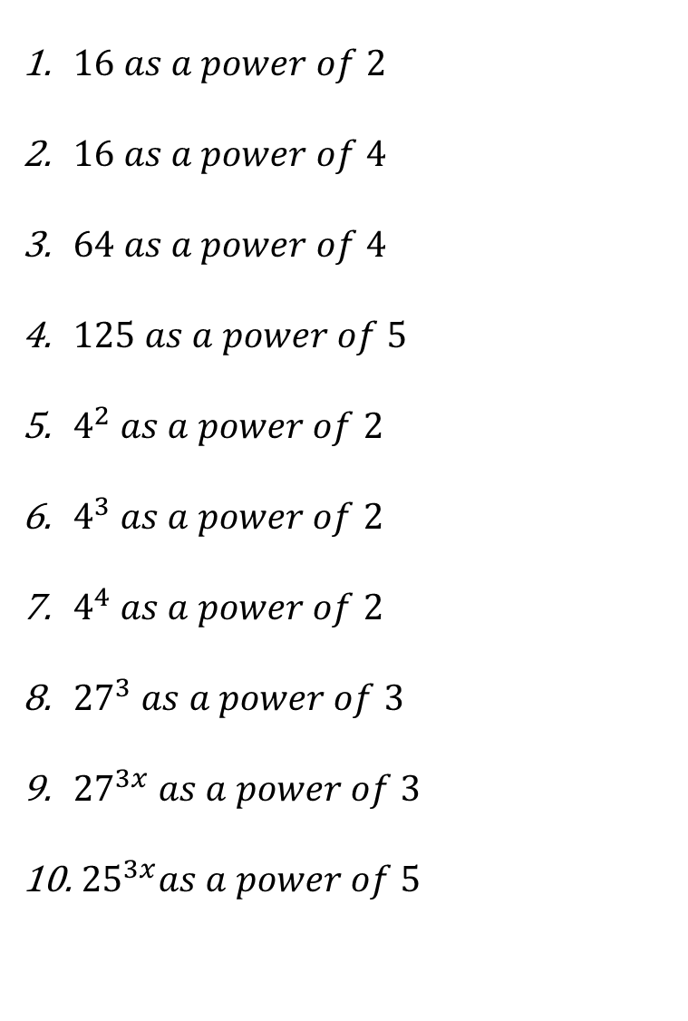
For each question, write in terms of the given number:
$16 as a power of 2$
$16 as a power of 4$
$64 as a power of 4$
$125 as a power of 5$
$4^{2} as a power of 2$
$4^{3} as a power of 2$
$4^{4} as a power of 2$
${27}^{3} as a power of 3$
${27}^{3x} as a power of 3$
${ 25}^{3x}as a power of 5$
@gjmcconnell88

Slide 4

For each question, write in terms of the given number:
$$2^{4}$$
$$4^{2}$$
$$4^{3}$$
$$5^{3}$$
$$2^{4}$$
$$2^{6}$$
$$2^{8}$$
$$3^{9}$$
$$3^{9x}$$
$${ 5}^{6x}$$
$16 as a power of 2$
$16 as a power of 4$
$64 as a power of 4$
$125 as a power of 5$
$4^{2} as a power of 2$
$4^{3} as a power of 2$
$4^{4} as a power of 2$
${27}^{3} as a power of 3$
${27}^{3x} as a power of 3$
${ 25}^{3x}as a power of 5$
@gjmcconnell88

