Slide 1
Ratio: Fractions and Linear Equations Fill in the gaps
Silent
Teacher
Intelligent Practice
Narration
Your Turn
Practice

Slide 2
Worked Example
Your Turn
Find the ratio of Green to Blue
Find the ratio of Green to Blue
Write green as a fraction of the whole bar
Write green as a fraction of the whole bar
Write blue as a fraction of the whole bar
Write blue as a fraction of the whole bar
Write green as a fraction of blue
Write green as a fraction of blue
Write blue as a fraction of green
Write blue as a fraction of green
Form a linear equation linking green and blue
Form a linear equation linking green and blue
Green =
Green =
Blue =
Blue =

Slide 3
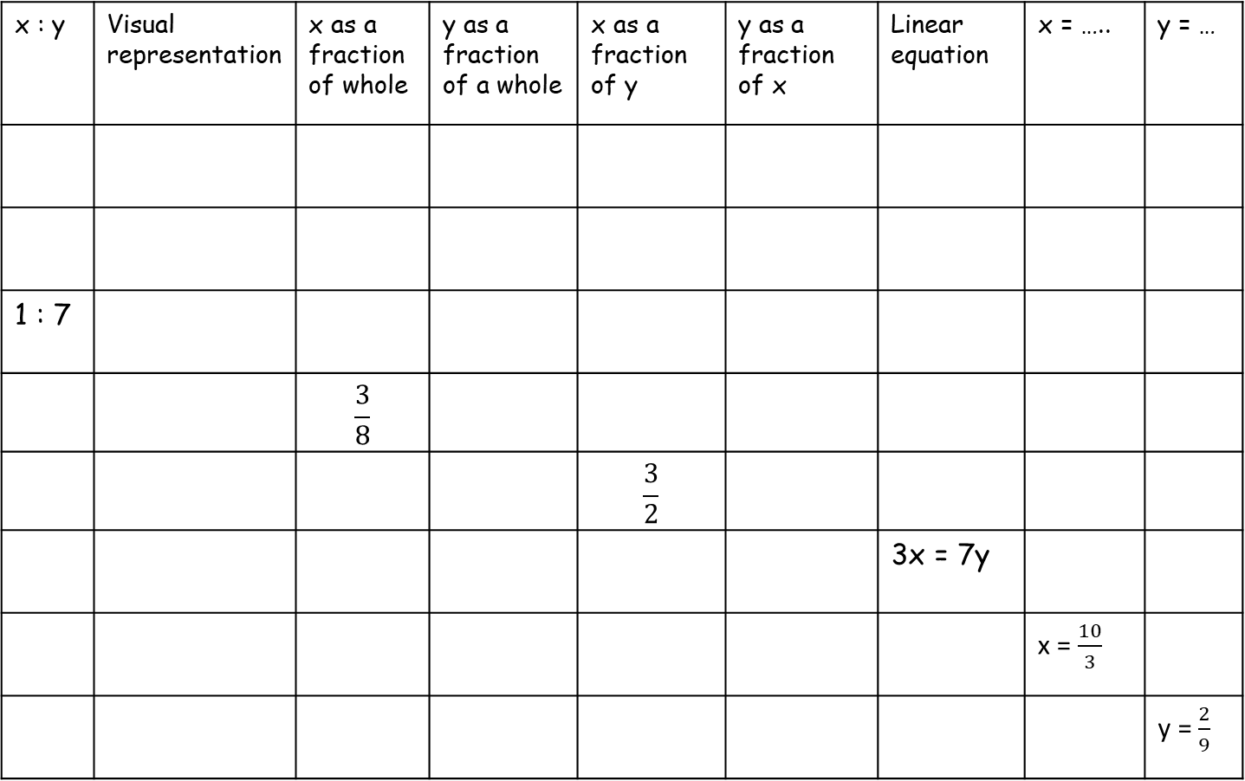
x : y | Visual representation | x as a fraction of whole | y as a fraction of a whole | x as a fraction of y | y as a fraction of x | Linear equation | x = ….. | y = …
1 : 7
 |  | $$\frac{3}{8}$$
 |  |  |  | $$\frac{3}{2}$$
 |  |  |  |  |  | 3x = 7y
 |  |  |  |  |  |  | x = $\frac{10}{3}$
 |  |  |  |  |  |  |  | y = $\frac{2}{9}$

Slide 4
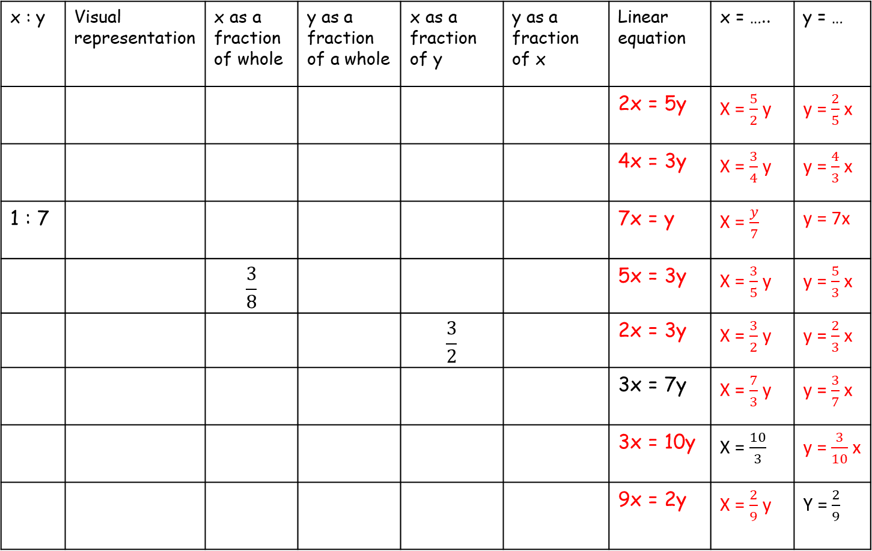
x : y | Visual representation | x as a fraction of whole | y as a fraction of a whole | x as a fraction of y | y as a fraction of x | Linear equation | x = ….. | y = …
 |  |  |  |  |  | 2x = 5y | X = $\frac{5}{2}$ y | y = $\frac{2}{5}$ x
 |  |  |  |  |  | 4x = 3y | X = $\frac{3}{4}$ y | y = $\frac{4}{3}$ x
1 : 7 |  |  |  |  |  | 7x = y | X = $\frac{y}{7}$ | y = 7x
 |  | $$\frac{3}{8}$$ |  |  |  | 5x = 3y | X = $\frac{3}{5}$ y | y = $\frac{5}{3}$ x
 |  |  |  | $$\frac{3}{2}$$ |  | 2x = 3y | X = $\frac{3}{2}$ y | y = $\frac{2}{3}$ x
 |  |  |  |  |  | 3x = 7y | X = $\frac{7}{3}$ y | y = $\frac{3}{7}$ x
 |  |  |  |  |  | 3x = 10y | X = $\frac{10}{3}$ | y = $\frac{3}{10}$ x
 |  |  |  |  |  | 9x = 2y | X = $\frac{2}{9}$ y | Y = $\frac{2}{9}$
$$\frac{5}{7}$$
$$\frac{2}{7}$$
$$\frac{5}{2}$$
$$\frac{2}{5}$$
5 : 2
3 : 4
$$\frac{3}{7}$$
$$\frac{4}{7}$$
$$\frac{3}{4}$$
$$\frac{4}{3}$$
:
$$\frac{1}{8}$$
$$\frac{7}{8}$$
$$\frac{1}{7}$$
$$\frac{7}{1}$$
$$\frac{5}{8}$$
$$\frac{3}{5}$$
$$\frac{5}{3}$$
3 : 5
:
:
$$\frac{3}{5}$$
$$\frac{2}{5}$$
$$\frac{2}{3}$$
3 : 2
$$\frac{7}{10}$$
$$\frac{3}{10}$$
$$\frac{7}{3}$$
$$\frac{3}{7}$$
7 : 3
:
 |  | s
:
$$\frac{10}{13}$$
$$\frac{3}{13}$$
$$\frac{10}{3}$$
$$\frac{3}{10}$$
10 :3
$$\frac{2}{11}$$
$$\frac{9}{11}$$
$$\frac{2}{9}$$
$$\frac{9}{2}$$
2 : 9
:
 |  | s

