Slide 1
Ratio in different forms: Fill in the gaps
Silent
Teacher
Intelligent Practice
Narration
Your Turn
$$1 :5$$
Practice

Slide 2
Worked Example
Your Turn
$a$ : $b$
7 : 1
$a$ : $b$
8 : 1
𝑎 as a fraction of the whole:
𝑎 as a fraction of 𝑏:
In the form $1 : n$
In the form $n : 1$
How many times bigger than 𝑎 is 𝑏?
𝑎 as a function of 𝑏:
𝑎 as a fraction of the whole:
𝑎 as a fraction of 𝑏:
In the form $1 : n$
In the form $n : 1$
How many times bigger than 𝑎 is 𝑏?
𝑎 as a function of 𝑏:

Slide 3
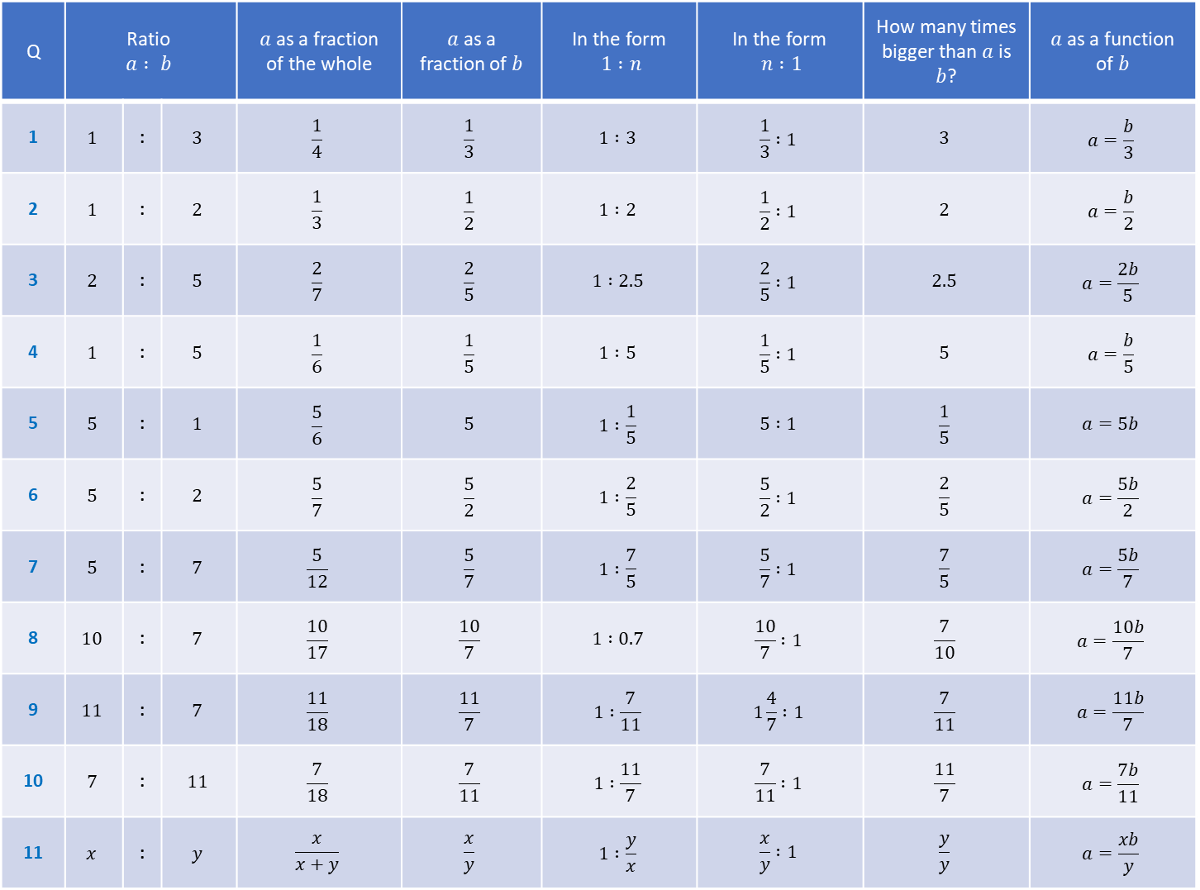
Q | Ratio $$a : b$$ |  |  | $a$ as a fraction of the whole | $a$ as a fraction of $b$ | In the form $1 :n$ | In the form $n :1$ | How many times bigger than $a$ is $b$? | $a$ as a function of $b$
1 | $$1$$ | : | $$3$$ | $$\frac{1}{4}$$ | $$\frac{1}{3}$$ | $$1 :3$$ | $$\frac{1}{3} :1$$ | $$3$$ | $$a=\frac{b}{3}$$
2 | $$1$$ | : | $$2$$ | $$\frac{1}{3}$$ | $$\frac{1}{2}$$ | $$1 :2$$ | $$\frac{1}{2} :1$$ | $$2$$ | $$a=\frac{b}{2}$$
3 | $$2$$ | : | $$5$$ | $$\frac{2}{7}$$ | $$\frac{2}{5}$$ | $$1 :2.5$$ | $$\frac{2}{5} :1$$ | $$2.5$$ | $$a=\frac{2b}{5}$$
4 | $$1$$ | : | $$5$$ | $$\frac{1}{6}$$ | $$\frac{1}{5}$$ | $$1 :5$$ | $$\frac{1}{5} :1$$ | $$5$$ | $$a=\frac{b}{5}$$
5 | $$5$$ | : | $$1$$ | $$\frac{5}{6}$$ | $$5$$ | $$1 :\frac{1}{5}$$ | $$5 :1$$ | $$\frac{1}{5}$$ | $$a=5b$$
6 | $$5$$ | : | $$2$$ | $$\frac{5}{7}$$ | $$\frac{5}{2}$$ | $$1 :\frac{2}{5}$$ | $$\frac{5}{2} :1$$ | $$\frac{2}{5}$$ | $$a=\frac{5b}{2}$$
7 | $$5$$ | : | $$7$$ | $$\frac{5}{12}$$ | $$\frac{5}{7}$$ | $$1 :\frac{7}{5}$$ | $$\frac{5}{7} :1$$ | $$\frac{7}{5}$$ | $$a=\frac{5b}{7}$$
8 | $$10$$ | : | $$7$$ | $$\frac{10}{17}$$ | $$\frac{10}{7}$$ | $$1 :0.7$$ | $$\frac{10}{7} :1$$ | $$\frac{7}{10}$$ | $$a=\frac{10b}{7}$$
9 | $$11$$ | : | $$7$$ | $$\frac{11}{18}$$ | $$\frac{11}{7}$$ | $$1 :\frac{7}{11}$$ | $$1\frac{4}{7} :1$$ | $$\frac{7}{11}$$ | $$a=\frac{11b}{7}$$
10 | $$7$$ | : | $$11$$ | $$\frac{7}{18}$$ | $$\frac{7}{11}$$ | $$1 :\frac{11}{7}$$ | $$\frac{7}{11} :1$$ | $$\frac{11}{7}$$ | $$a=\frac{7b}{11}$$
11 | $$x$$ | : | $$y$$ | $$\frac{x}{x+y}$$ | $$\frac{x}{y}$$ | $$1 :\frac{y}{x}$$ | $$\frac{x}{y} :1$$ | $$\frac{y}{y}$$ | $$a=\frac{xb}{y}$$

Slide 4
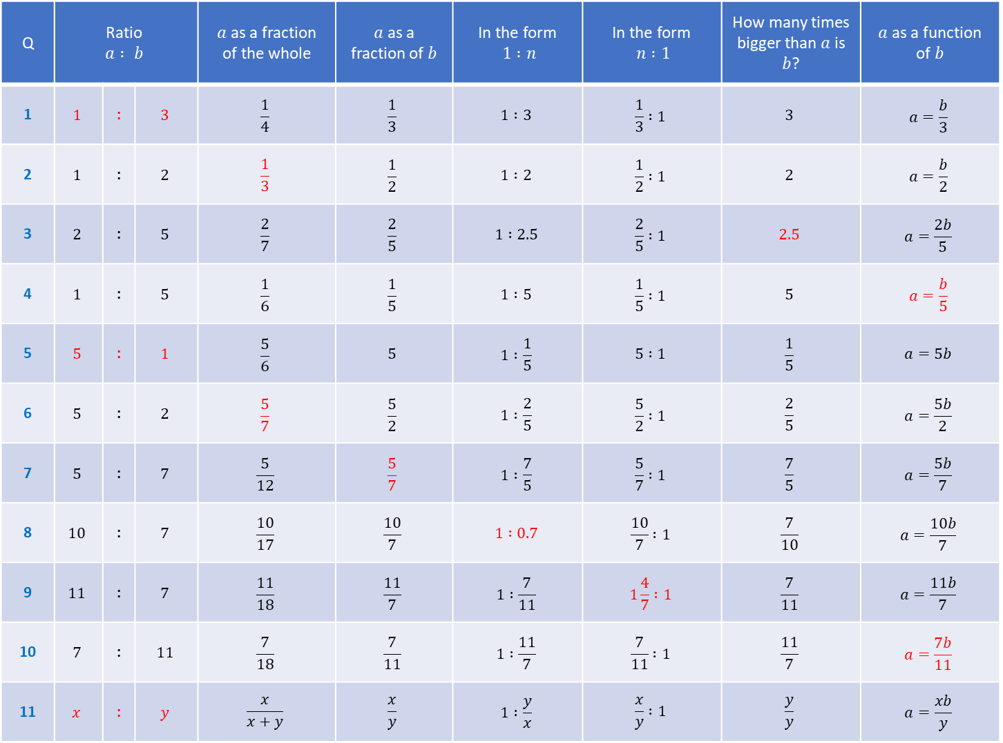
Q | Ratio $$a : b$$ |  |  | $a$ as a fraction of the whole | $a$ as a fraction of $b$ | In the form $1 :n$ | In the form $n :1$ | How many times bigger than $a$ is $b$? | $a$ as a function of $b$
1 | $$1$$ | : | $$3$$ | $$\frac{1}{4}$$ | $$\frac{1}{3}$$ | $$1 :3$$ | $$\frac{1}{3} :1$$ | $$3$$ | $$a=\frac{b}{3}$$
2 | $$1$$ | : | $$2$$ | $$\frac{1}{3}$$ | $$\frac{1}{2}$$ | $$1 :2$$ | $$\frac{1}{2} :1$$ | $$2$$ | $$a=\frac{b}{2}$$
3 | $$2$$ | : | $$5$$ | $$\frac{2}{7}$$ | $$\frac{2}{5}$$ | $$1 :2.5$$ | $$\frac{2}{5} :1$$ | $$2.5$$ | $$a=\frac{2b}{5}$$
4 | $$1$$ | : | $$5$$ | $$\frac{1}{6}$$ | $$\frac{1}{5}$$ | $$1 :5$$ | $$\frac{1}{5} :1$$ | $$5$$ | $$a=\frac{b}{5}$$
5 | $$5$$ | : | $$1$$ | $$\frac{5}{6}$$ | $$5$$ | $$1 :\frac{1}{5}$$ | $$5 :1$$ | $$\frac{1}{5}$$ | $$a=5b$$
6 | $$5$$ | : | $$2$$ | $$\frac{5}{7}$$ | $$\frac{5}{2}$$ | $$1 :\frac{2}{5}$$ | $$\frac{5}{2} :1$$ | $$\frac{2}{5}$$ | $$a=\frac{5b}{2}$$
7 | $$5$$ | : | $$7$$ | $$\frac{5}{12}$$ | $$\frac{5}{7}$$ | $$1 :\frac{7}{5}$$ | $$\frac{5}{7} :1$$ | $$\frac{7}{5}$$ | $$a=\frac{5b}{7}$$
8 | $$10$$ | : | $$7$$ | $$\frac{10}{17}$$ | $$\frac{10}{7}$$ | $$1 :0.7$$ | $$\frac{10}{7} :1$$ | $$\frac{7}{10}$$ | $$a=\frac{10b}{7}$$
9 | $$11$$ | : | $$7$$ | $$\frac{11}{18}$$ | $$\frac{11}{7}$$ | $$1 :\frac{7}{11}$$ | $$1\frac{4}{7} :1$$ | $$\frac{7}{11}$$ | $$a=\frac{11b}{7}$$
10 | $$7$$ | : | $$11$$ | $$\frac{7}{18}$$ | $$\frac{7}{11}$$ | $$1 :\frac{11}{7}$$ | $$\frac{7}{11} :1$$ | $$\frac{11}{7}$$ | $$a=\frac{7b}{11}$$
11 | $$x$$ | : | $$y$$ | $$\frac{x}{x+y}$$ | $$\frac{x}{y}$$ | $$1 :\frac{y}{x}$$ | $$\frac{x}{y} :1$$ | $$\frac{y}{y}$$ | $$a=\frac{xb}{y}$$

