Slide 1
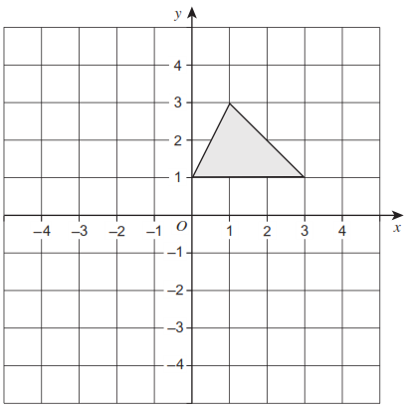
Translation by Vector
Silent
Teacher
Intelligent Practice
Narration
Your Turn
Practice
Translate by vector $\left({1 \atop 2}\right)$

Slide 2
Worked Example 1
Your Turn
Translate by $\left({2 \atop 1}\right)$
Translate by $\left({1 \atop 2}\right)$
@MrBayew

Slide 3
Worked Example 2
Your Turn
Translate by $\left({−2 \atop 1}\right)$
Translate by $\left({−1 \atop 2}\right)$
@MrBayew

Slide 4
Worked Example 3
Your Turn
Translate by $\left({2 \atop −1}\right)$
Translate by $\left({1 \atop −2}\right)$
@MrBayew

Slide 5
Worked Example 4
Your Turn
Translate by $\left({−2 \atop −1}\right)$
Translate by $\left({−1 \atop −2}\right)$
@MrBayew

Slide 6
Worked Example 5
Your Turn
Translate by $\left({2 \atop 0}\right)$
Translate by $\left({1 \atop 0}\right)$
@MrBayew

Slide 7
Worked Example 6
Your Turn
Translate by $\left({0 \atop 1}\right)$
Translate by $\left({0 \atop 2}\right)$
@MrBayew

Slide 8
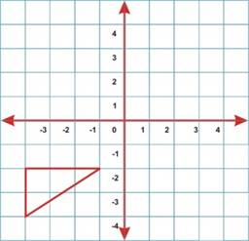
Practice 1:
Translate by $\left({2 \atop 3}\right)$
Translate by $\left({0 \atop 3}\right)$
Translate by $\left({−1 \atop 3}\right)$
Translate by $\left({2 \atop −1}\right)$
@MrBayew

Slide 9
Practice 2:
Translate by $\left({2 \atop 0}\right)$
Translate by $\left({−1 \atop −1}\right)$
Translate by $\left({−1 \atop 4}\right)$
Translate by $\left({3 \atop −1}\right)$
@MrBayew

Slide 10
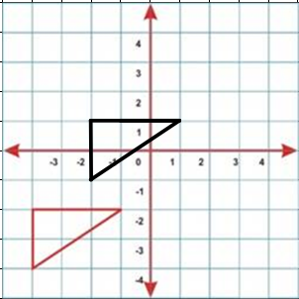
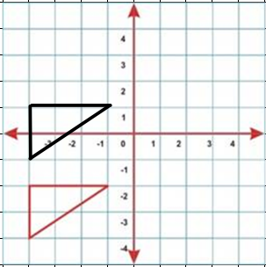
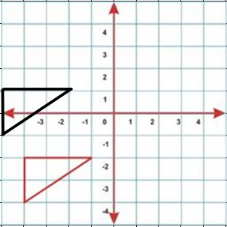
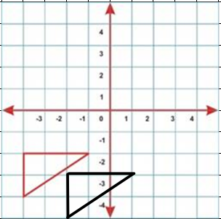
Answers 1:
Translate by $\left({2 \atop 3}\right)$
Translate by $\left({0 \atop 3}\right)$
Translate by $\left({−1 \atop 3}\right)$
Translate by $\left({2 \atop −1}\right)$
@MrBayew

Slide 11
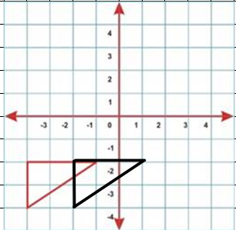
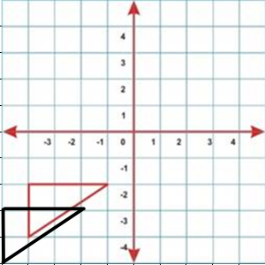
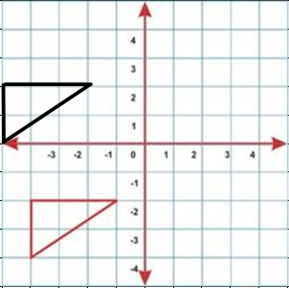
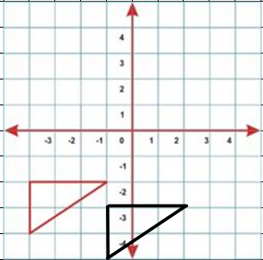
Answers 2:
Translate by $\left({2 \atop 0}\right)$
Translate by $\left({−1 \atop −1}\right)$
Translate by $\left({−1 \atop 4}\right)$
Translate by $\left({3 \atop −1}\right)$
@MrBayew

