Slide 1
Using exact trigonometric values to find angles
Silent
Teacher
Intelligent Practice
Narration
Your Turn
Practice

Slide 2
Worked Example
Your Turn
2
$$1$$
4
2
x°
x°
@mrbartonmaths

Slide 3
1.
4.
7.
4
$$2\sqrt{2}$$
1
x°
x°
x°
2
2
$$\sqrt{3}$$
2.
5.
8.
2
$$2\sqrt{2}$$
2
x°
x°
$$\sqrt{3}$$
x°
1
1
3.
6.
9.
$$\sqrt{2}$$
$$\sqrt{2}$$
1
x°
x°
$$\sqrt{3}$$
x°
1
1

Slide 4

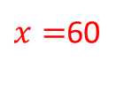
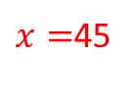

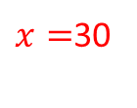
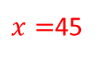
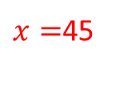
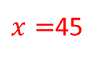

1.
4.
7.
4
$$2\sqrt{2}$$
$x=$45
$x=$30
$$x=60$$
1
x°
x°
x°
2
2
$$\sqrt{3}$$
2.
5.
8.
2
$$2\sqrt{2}$$
2
$$x=60$$
$x=$45
x°
x°
$$\sqrt{3}$$
$x=$60
x°
1
1
3.
6.
9.
$$\sqrt{2}$$
$$\sqrt{2}$$
1
x°
$x=$45
$x=$45
x°
$$\sqrt{3}$$
$$x=30$$
x°
1
1

