Slide 1
Fractions: Adding and Subtracting mixed numbers
Silent
Teacher
Intelligent Practice
Narration
Your Turn
$$2\frac{1}{2}+2\frac{1}{5}$$
$$2\frac{1}{7}− 1\frac{1}{3}$$
Practice
@gjmcconnell88

Slide 2
Worked Example
Your Turn
Calculate:
$$2\frac{1}{2} + 3\frac{2}{5}$$
Calculate:
$$2\frac{1}{3} + 3\frac{2}{5}$$
Calculate:
$$2\frac{1}{2} − 1\frac{2}{5}$$
Calculate:
$$2\frac{1}{3} − 1\frac{2}{5}$$
@gjmcconnell88

Slide 3
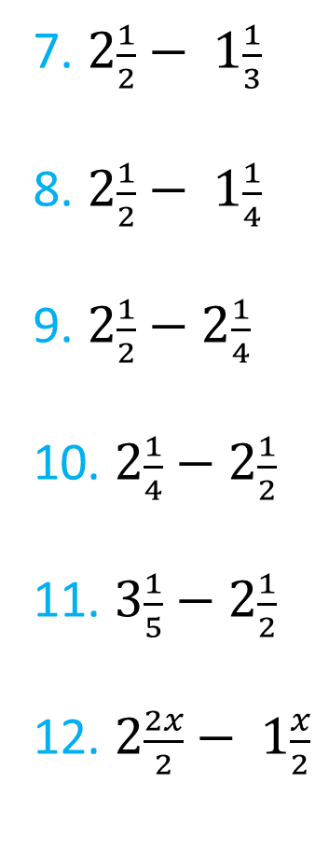
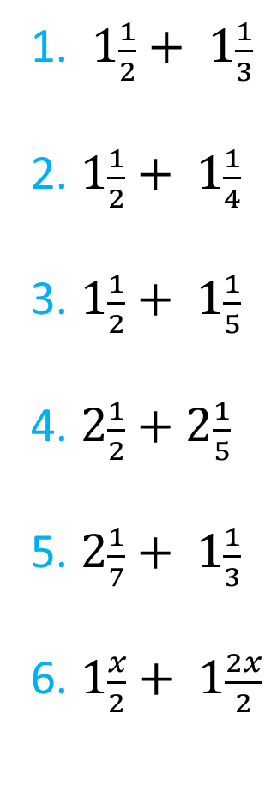
1. $1\frac{1}{2}+ 1\frac{1}{3}$
2. $1\frac{1}{2}+ 1\frac{1}{4}$
3. $1\frac{1}{2}+ 1\frac{1}{5}$
4. $2\frac{1}{2}+2\frac{1}{5}$
5. $2\frac{1}{7}+ 1\frac{1}{3}$
6. $1\frac{x}{2}+ 1\frac{2x}{2}$
7. $2\frac{1}{2}− 1\frac{1}{3}$
8. $2\frac{1}{2}− 1\frac{1}{4}$
9. $2\frac{1}{2}−2\frac{1}{4}$
10. $2\frac{1}{4}−2\frac{1}{2}$
11. $3\frac{1}{5}−2\frac{1}{2}$
12. $2\frac{2x}{2}− 1\frac{x}{2}$
@gjmcconnell88

Slide 4

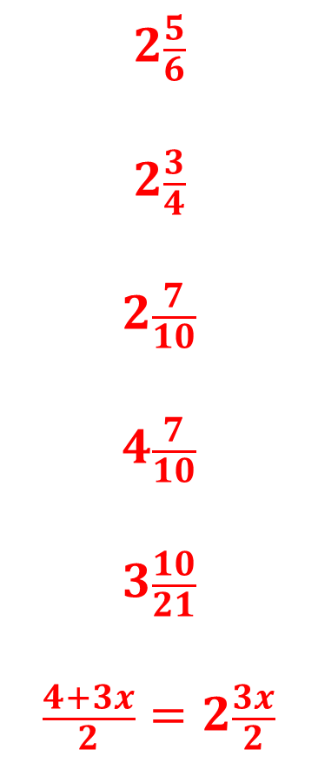
1. $1\frac{1}{2}+ 1\frac{1}{3}$
2. $1\frac{1}{2}+ 1\frac{1}{4}$
3. $1\frac{1}{2}+ 1\frac{1}{5}$
4. $2\frac{1}{2}+2\frac{1}{5}$
5. $2\frac{1}{7}+ 1\frac{1}{3}$
6. $1\frac{x}{2}+ 1\frac{2x}{2}$
$$2\frac{5}{6}$$
$$2\frac{3}{4}$$
$$2\frac{7}{10}$$
$$4\frac{7}{10}$$
$$3\frac{10}{21}$$
$$\frac{4+3x}{2}=2\frac{3x}{2}$$
7. $2\frac{1}{2}− 1\frac{1}{3}$
8. $2\frac{1}{2}− 1\frac{1}{4}$
9. $2\frac{1}{2}−2\frac{1}{4}$
10. $2\frac{1}{4}−2\frac{1}{2}$
11. $3\frac{1}{5}−2\frac{1}{2}$
12. $2\frac{2x}{2}− 1\frac{x}{2}$
$$1\frac{1}{6}$$
$$1\frac{1}{4}$$
$$\frac{1}{4}$$
$$−\frac{1}{4}$$
$$\frac{7}{10}$$
$$\frac{2+x}{2}=1\frac{x}{2}$$
@gjmcconnell88

