Slide 1
Linear sequences: Fill in the gaps
Silent
Teacher
Intelligent Practice
Narration
Your Turn
$$4n−7$$
Practice

Slide 2
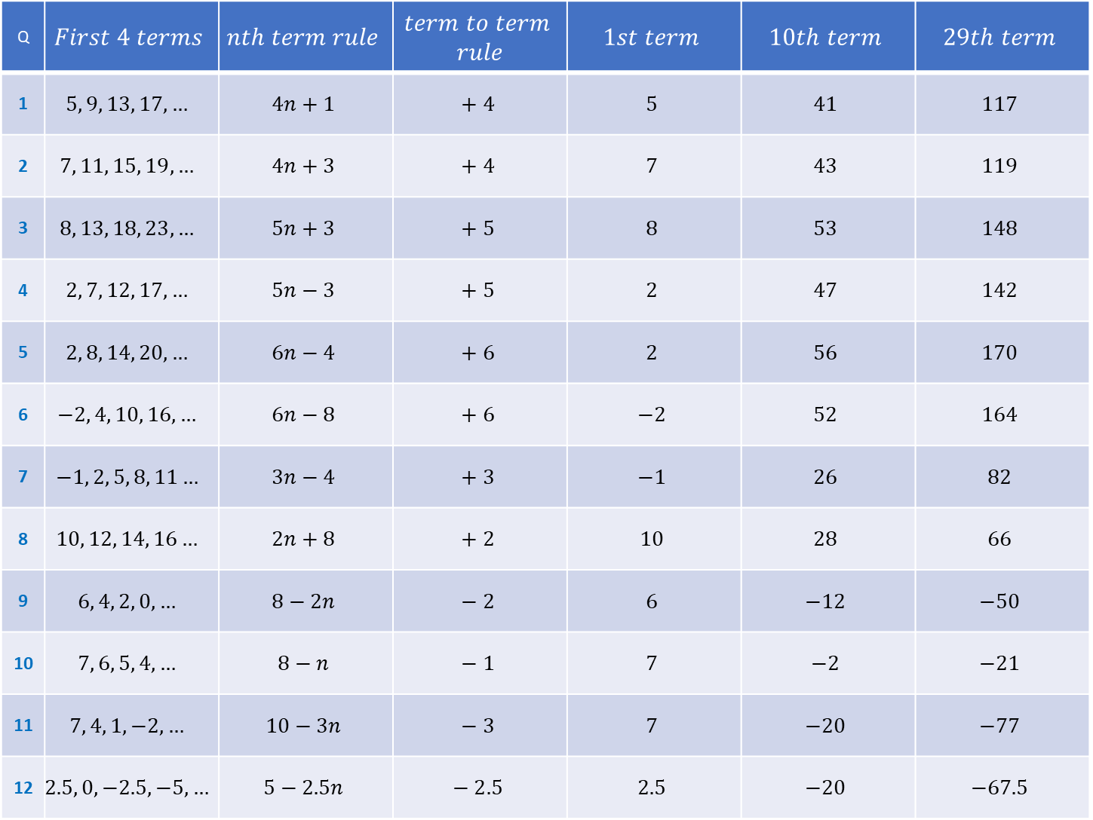
Q | $$First 4 terms$$ | $$nth term rule$$ | $$term to term$$ $$rule$$ | $$1st term$$ | $$10th term$$ | $$29th term$$
1 | $$5, 9, 13, 17,…$$ | $$4n+1$$ | $$+ 4$$ | $$5$$ | $$41$$ | $$117$$
2 | $$7, 11, 15, 19,…$$ | $$4n+3$$ | $$+ 4$$ | $$7$$ | $$43$$ | $$119$$
3 | $$8, 13, 18, 23,…$$ | $$5n+3$$ | $$+ 5$$ | $$8$$ | $$53$$ | $$148$$
4 | $$2, 7, 12, 17,…$$ | $$5n−3$$ | $$+ 5$$ | $$2$$ | $$47$$ | $$142$$
5 | $$2, 8, 14, 20,…$$ | $$6n−4$$ | $$+ 6$$ | $$2$$ | $$56$$ | $$170$$
6 | $$−2, 4, 10, 16,…$$ | $$6n−8$$ | $$+ 6$$ | $$−2$$ | $$52$$ | $$164$$
7 | $$−1, 2, 5, 8, 11…$$ | $$3n−4$$ | $$+ 3$$ | $$−1$$ | $$26$$ | $$82$$
8 | $$10, 12, 14, 16…$$ | $$2n+8$$ | $$+ 2$$ | $$10$$ | $$28$$ | $$66$$
9 | $$6, 4, 2, 0,…$$ | $$8−2n$$ | $$− 2$$ | $$6$$ | $$−12$$ | $$−50$$
10 | $$7, 6, 5, 4,…$$ | $$8−n$$ | $$− 1$$ | $$7$$ | $$−2$$ | $$−21$$
11 | $$7, 4, 1, −2,…$$ | $$10−3n$$ | $$− 3$$ | $$7$$ | $$−20$$ | $$−77$$
12 | $$2.5, 0, −2.5, −5,…$$ | $$5−2.5n$$ | $$− 2.5$$ | $$2.5$$ | $$−20$$ | $$−67.5$$

Slide 3
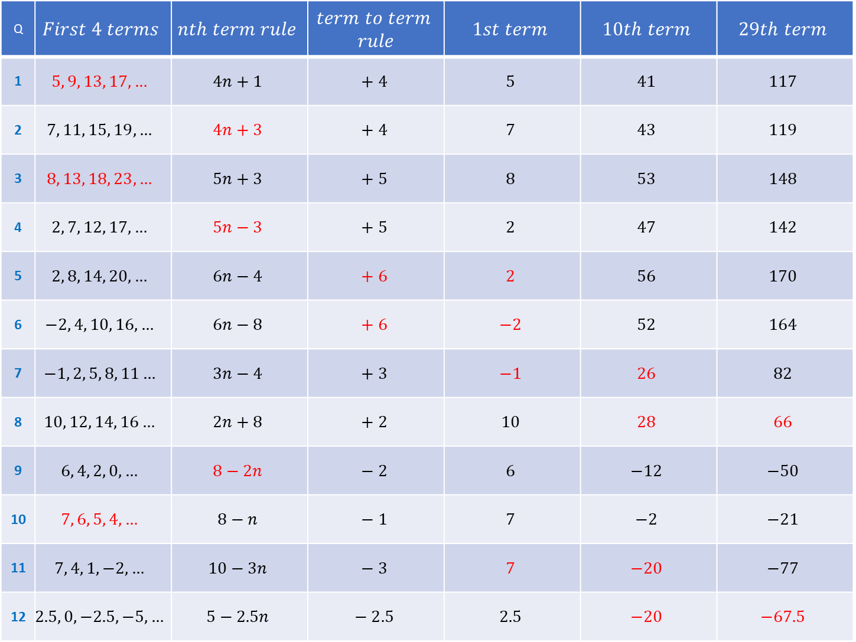
Q | $$First 4 terms$$ | $$nth term rule$$ | $$term to term$$ $$rule$$ | $$1st term$$ | $$10th term$$ | $$29th term$$
1 | $$5, 9, 13, 17,…$$ | $$4n+1$$ | $$+ 4$$ | $$5$$ | $$41$$ | $$117$$
2 | $$7, 11, 15, 19,…$$ | $$4n+3$$ | $$+ 4$$ | $$7$$ | $$43$$ | $$119$$
3 | $$8, 13, 18, 23,…$$ | $$5n+3$$ | $$+ 5$$ | $$8$$ | $$53$$ | $$148$$
4 | $$2, 7, 12, 17,…$$ | $$5n−3$$ | $$+ 5$$ | $$2$$ | $$47$$ | $$142$$
5 | $$2, 8, 14, 20,…$$ | $$6n−4$$ | $$+ 6$$ | $$2$$ | $$56$$ | $$170$$
6 | $$−2, 4, 10, 16,…$$ | $$6n−8$$ | $$+ 6$$ | $$−2$$ | $$52$$ | $$164$$
7 | $$−1, 2, 5, 8, 11…$$ | $$3n−4$$ | $$+ 3$$ | $$−1$$ | $$26$$ | $$82$$
8 | $$10, 12, 14, 16…$$ | $$2n+8$$ | $$+ 2$$ | $$10$$ | $$28$$ | $$66$$
9 | $$6, 4, 2, 0,…$$ | $$8−2n$$ | $$− 2$$ | $$6$$ | $$−12$$ | $$−50$$
10 | $$7, 6, 5, 4,…$$ | $$8−n$$ | $$− 1$$ | $$7$$ | $$−2$$ | $$−21$$
11 | $$7, 4, 1, −2,…$$ | $$10−3n$$ | $$− 3$$ | $$7$$ | $$−20$$ | $$−77$$
12 | $$2.5, 0, −2.5, −5,…$$ | $$5−2.5n$$ | $$− 2.5$$ | $$2.5$$ | $$−20$$ | $$−67.5$$

