Slide 1
Similar triangles: Missing sides with other triangles
Silent
Teacher
Intelligent Practice
Narration
Your Turn
Practice

Slide 2
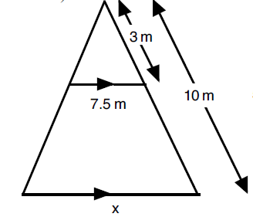
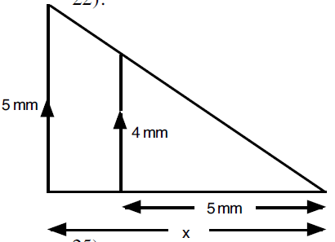
Similar triangles within other shapes
Triangles not drawn to scale
Example
Your turn
6m
8mm
x2
6m
4mm
3m
x2
8mm
5mm
7.5m
7.5x2 = 15m
x
x
5x2 = 10cm

Slide 3
Intelligent Practice – Find the length of every missing side
Triangles not drawn to scale
1.
2.
12mm
x
20mm
3.
4.
6mm
6mm
x
x
6mm
10mm
12mm

Slide 4
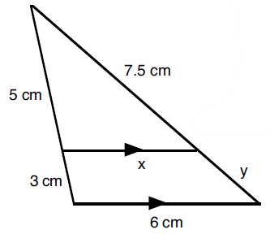
Intelligent Practice – Find the length of every missing side
Triangles not drawn to scale
5.
6.
8mm
6mm
6mm
x
3mm
6mm
12mm

Slide 5
Practice – Find the length of every missing side
Triangles not drawn to scale
1.
2.
x3
x4
4x4=16mm
12mm
x
5x3=15mm
20mm
3.
4.
x3
6mm
x2
6mm
x
x
6÷2=3mm
6÷3=2mm
6mm
10mm
12mm

Slide 6
Practice – Find the length of every missing side
Triangles not drawn to scale
5.
6.
x1.5
x1.5
8mm
6mm
6mm
x
8x1.5=12mm
6÷1.5=4mm
12-8 = 4mm
3mm
6÷1.5=4mm
6mm
12mm

