Slide 1
Pie Charts:
Fill in the Gaps
Silent
Teacher
Intelligent Practice
Narration
Your Turn
Q | $$Frequency$$ | $$Total Frequency$$ | $$Fraction$$ | $$Angle$$
Practice

Slide 2
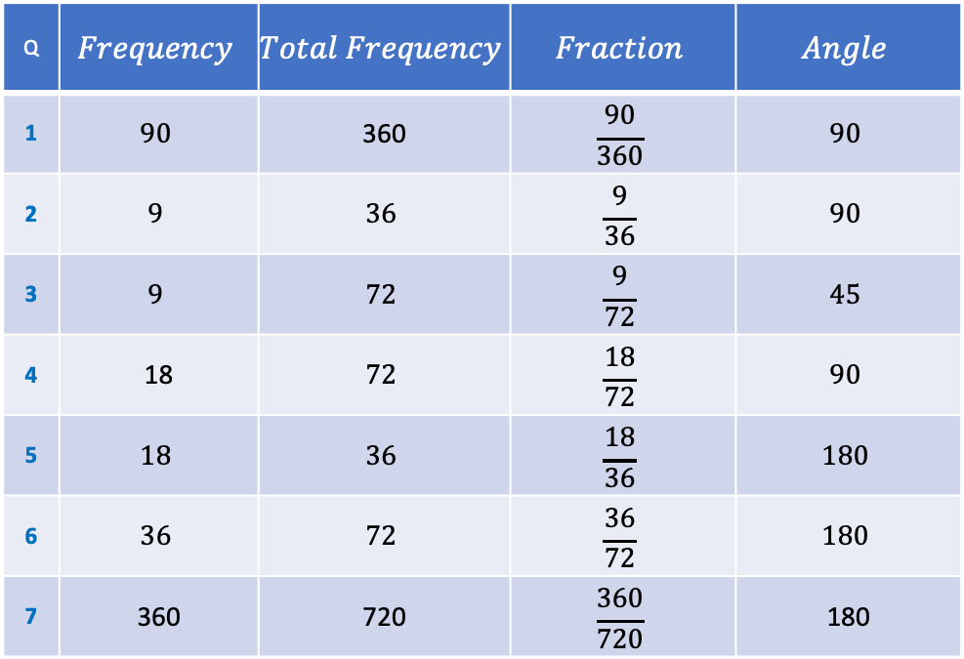
Q | $$Frequency$$ | $$Total Frequency$$ | $$Fraction$$ | $$Angle$$
1 | $$90$$ | 360 | $$\frac{90}{360}$$ | $$90$$
2 | $$9$$ | $$36$$ | $$\frac{9}{36}$$ | $$90$$
3 | $$9$$ | $$72$$ | $$\frac{9}{72}$$ | $$45$$
4 | 18 | $$72$$ | $$\frac{18}{72}$$ | $$90$$
5 | $$18$$ | $$36$$ | $$\frac{18}{36}$$ | $$180$$
6 | $$36$$ | $$72$$ | $$\frac{36}{72}$$ | $$180$$
7 | 360 | 720 | $$\frac{360}{720}$$ | 180

Slide 3
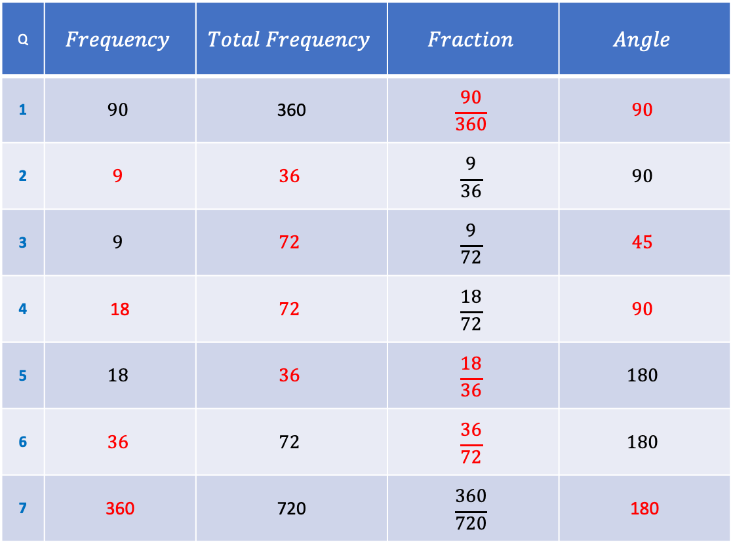
Q | $$Frequency$$ | $$Total Frequency$$ | $$Fraction$$ | $$Angle$$
1 | $$90$$ | 360 | $$\frac{90}{360}$$ | $$90$$
2 | $$9$$ | $$36$$ | $$\frac{9}{36}$$ | $$90$$
3 | $$9$$ | $$72$$ | $$\frac{9}{72}$$ | $$45$$
4 | 18 | $$72$$ | $$\frac{18}{72}$$ | $$90$$
5 | $$18$$ | $$36$$ | $$\frac{18}{36}$$ | $$180$$
6 | $$36$$ | $$72$$ | $$\frac{36}{72}$$ | $$180$$
7 | 360 | 720 | $$\frac{360}{720}$$ | 180

