Slide 1
Finding the radius and diameter from Area
Silent
Teacher
Intelligent Practice
Narration
Your Turn
$Area\text{ =}$ 181.5 m² What’s the radius?
$Area\text{ =}$ 18150 cm² What’s the radius?
$Area\text{ =}$ 452.39cm² What’s the radius?
$Area\text{ =}$ 452.39cm² What’s the diameter?
Practice

Slide 2
Worked Example
Your Turn
Area = 30.2 cm²
What’s the radius?
Area = 47.8 cm²
What’s the radius?

Slide 3
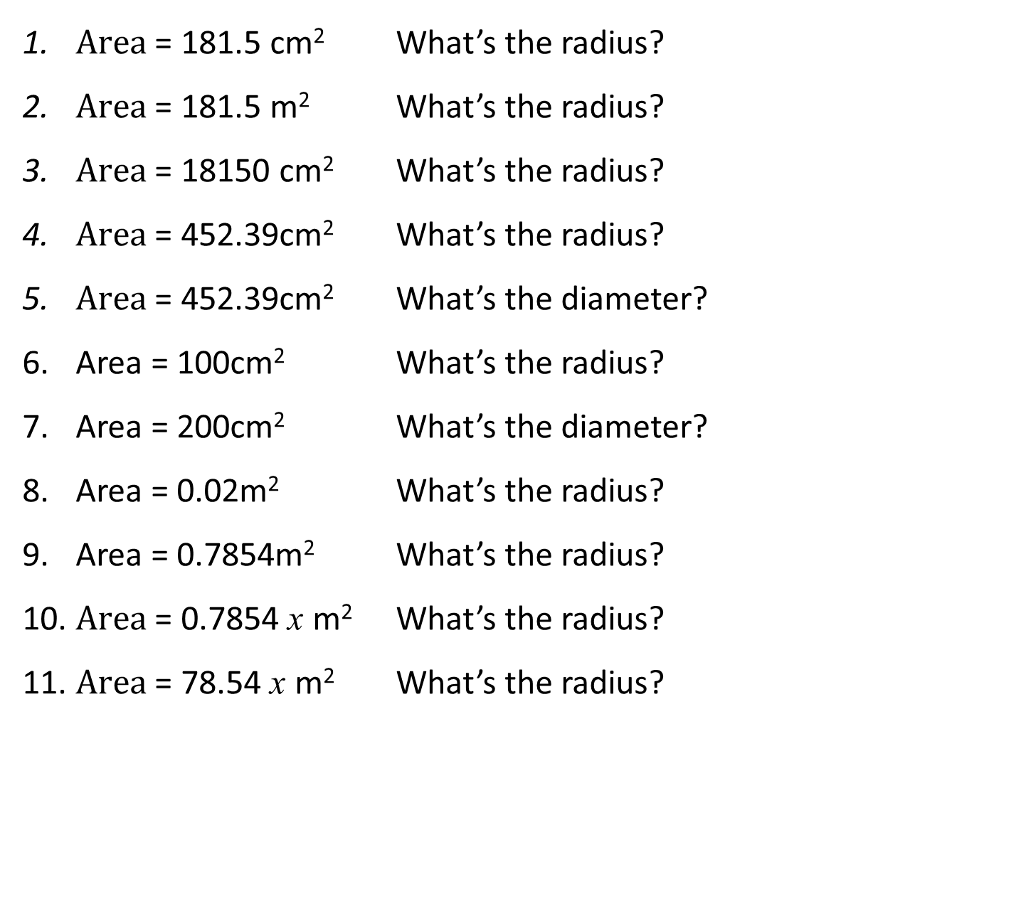
Give your answers to 3sf
$Area\text{ =}$ 181.5 cm² What’s the radius?
$Area\text{ =}$ 181.5 m² What’s the radius?
$Area\text{ =}$ 18150 cm² What’s the radius?
$Area\text{ =}$ 452.39cm² What’s the radius?
$Area\text{ =}$ 452.39cm² What’s the diameter?
Area = 100cm² What’s the radius?
Area = 200cm² What’s the diameter?
Area = 0.02m² What’s the radius?
Area = 0.7854m² What’s the radius?
$Area\text{ =}$ 0.7854 x m² What’s the radius?
$Area\text{ =}$ 78.54 x m² What’s the radius?

Slide 4
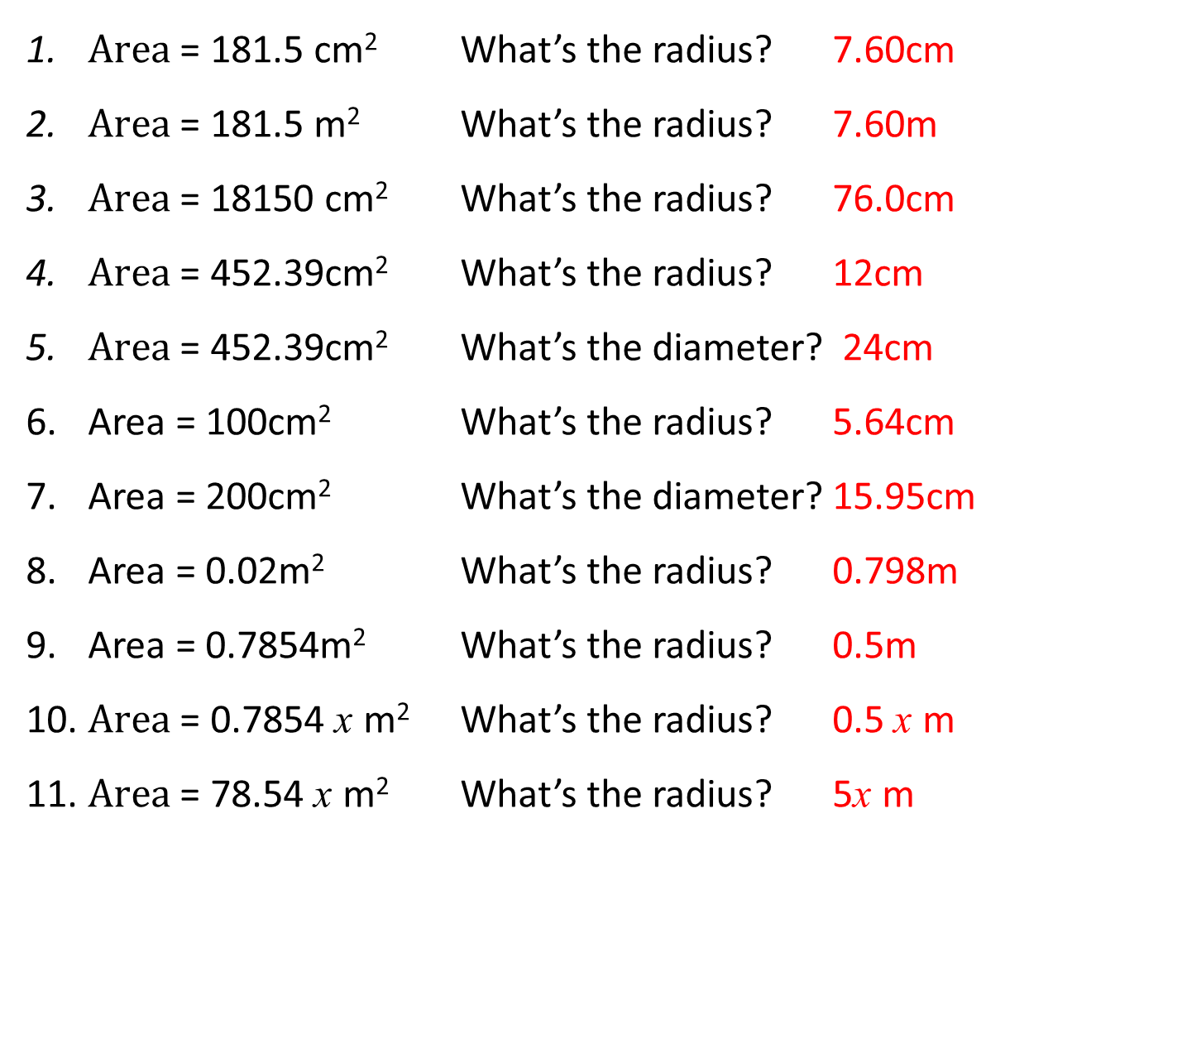
Give your answers to 3sf
$Area\text{ =}$ 181.5 cm² What’s the radius? 7.60cm
$Area\text{ =}$ 181.5 m² What’s the radius? 7.60m
$Area\text{ =}$ 18150 cm² What’s the radius? 76.0cm
$Area\text{ =}$ 452.39cm² What’s the radius? 12cm
$Area\text{ =}$ 452.39cm² What’s the diameter? 24cm
Area = 100cm² What’s the radius? 5.64cm
Area = 200cm² What’s the diameter? 15.95cm
Area = 0.02m² What’s the radius? 0.798m
Area = 0.7854m² What’s the radius? 0.5m
$Area\text{ =}$ 0.7854 x m² What’s the radius? 0.5 x m
$Area\text{ =}$ 78.54 x m² What’s the radius? 5x m

