Slide 1
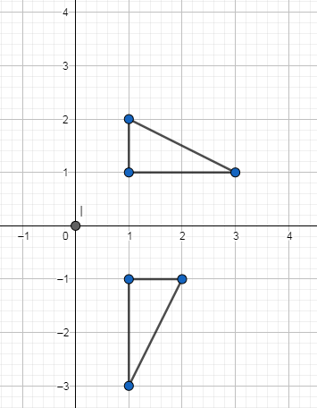
Rotation: 90$°$about the origin
Silent
Teacher
Intelligent Practice
Narration
Your Turn
Practice

Slide 2
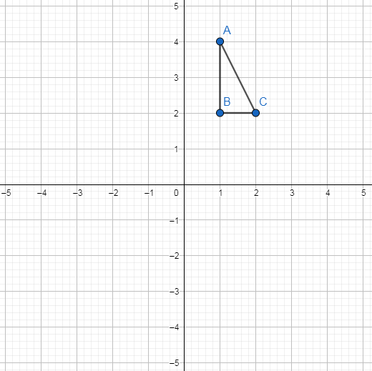
Worked Example
Your turn
Rotate triangle ABC 90⁰ anticlockwise about (0,0)
Rotate triangle ABC 90⁰ clockwise about (0,0)

Slide 3
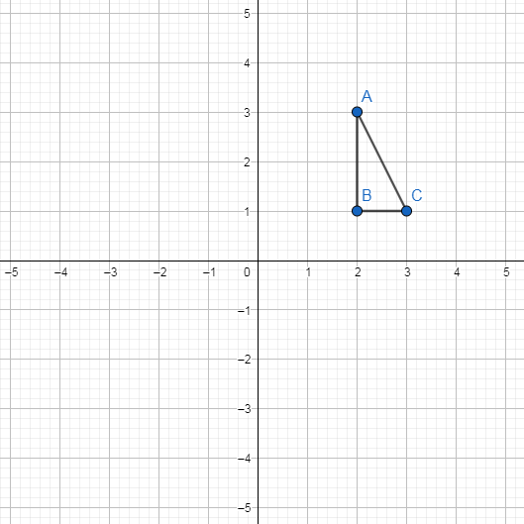
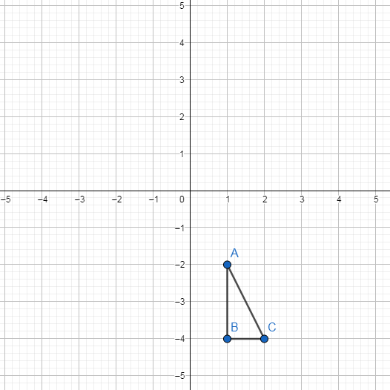
1)
3)
Rotate triangle ABC 90⁰ anticlockwise about (0,0)
Rotate triangle ABC 90⁰ clockwise about (0,0)
2)
4)
Rotate triangle ABC 90⁰ clockwise about (0,0)
Rotate triangle ABC 90⁰ anticlockwise about (0,0)

Slide 4
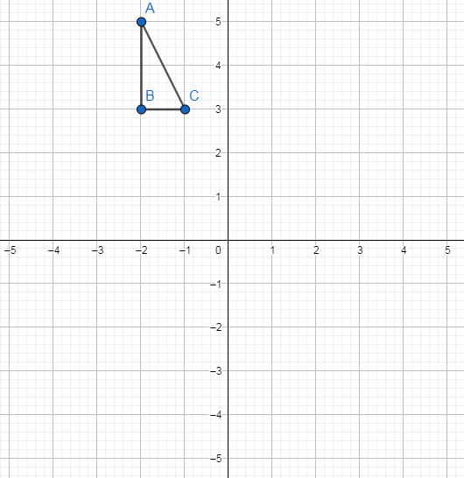
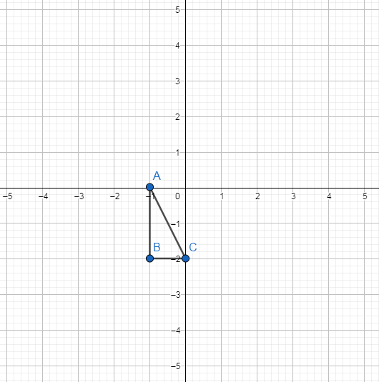
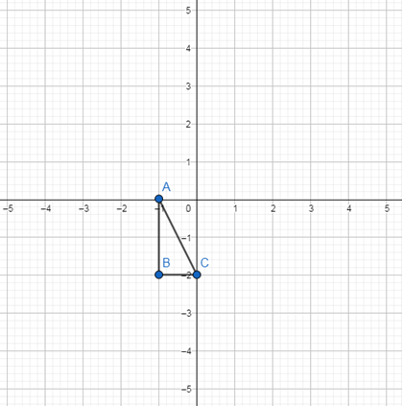
5)
7)
Rotate triangle ABC 90⁰ clockwise about (0,0)
Rotate triangle ABC 90⁰ clockwise about (0,0)
6)
8)
Rotate triangle ABC 90⁰ anticlockwise about (0,0)
Rotate triangle ABC 90⁰ anticlockwise about (0,0)

Slide 5
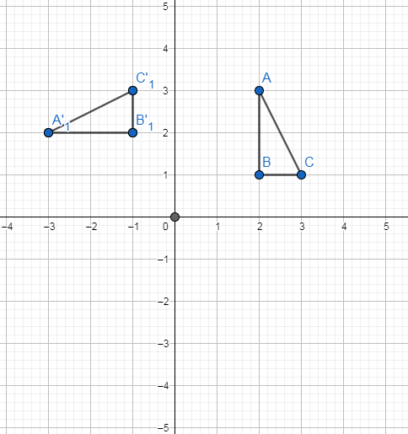
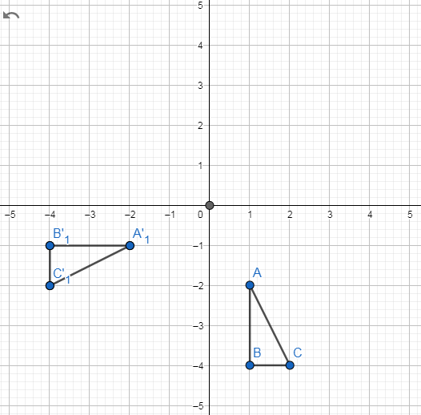
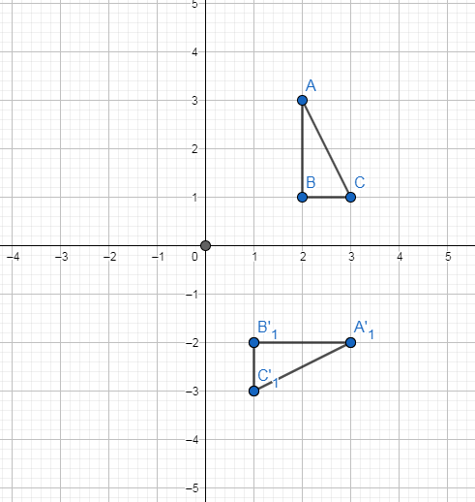
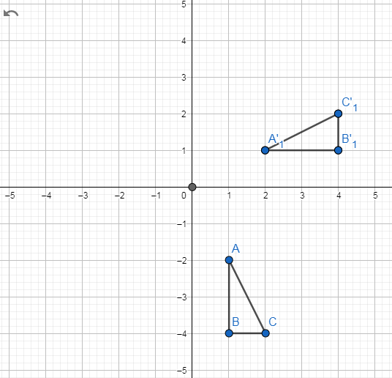
1)
3)
Answers
Rotate triangle ABC 90⁰ anticlockwise about (0,0)
Rotate triangle ABC 90⁰ clockwise about (0,0)
2)
4)
Rotate triangle ABC 90⁰ clockwise about (0,0)
Rotate triangle ABC 90⁰ anticlockwise about (0,0)

Slide 6
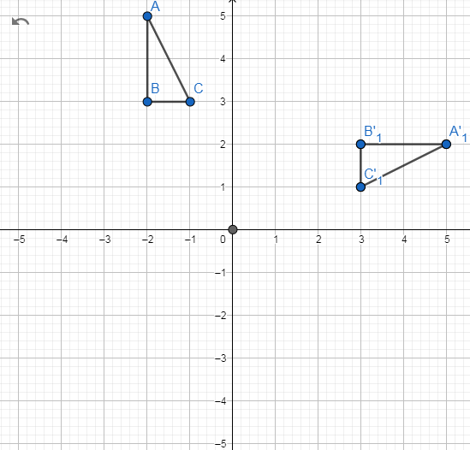
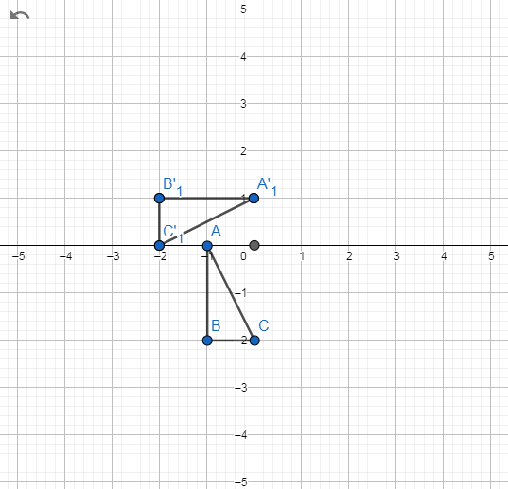
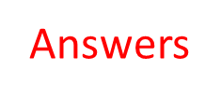
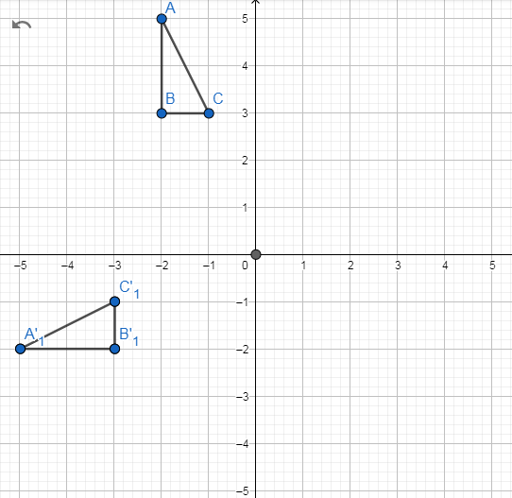
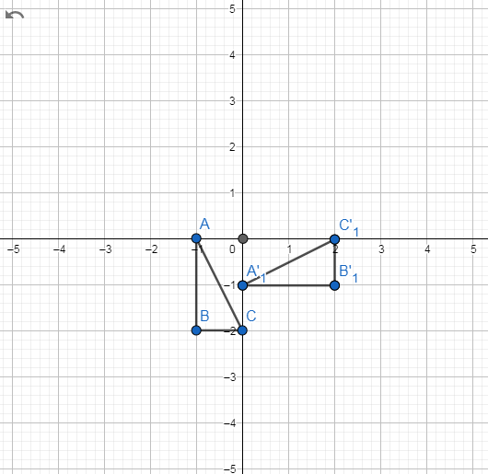
5)
7)
Rotate triangle ABC 90⁰ clockwise about (0,0)
Rotate triangle ABC 90⁰ clockwise about (0,0)
6)
8)
Rotate triangle ABC 90⁰ anticlockwise about (0,0)
Rotate triangle ABC 90⁰ anticlockwise about (0,0)

