Slide 1
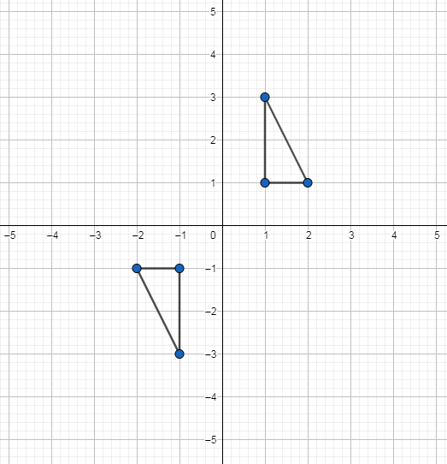
Transformations: Rotating a shape 180$°$about the origin
Silent
Teacher
Intelligent Practice
Narration
Your Turn
Practice

Slide 2
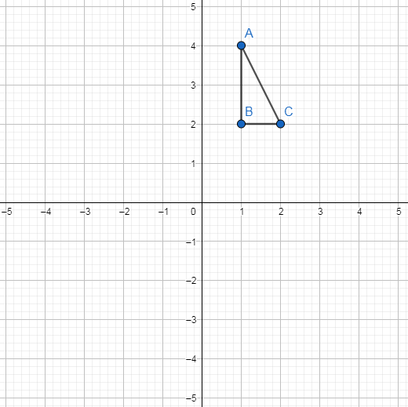
Worked Example
Your turn
Rotate triangle ABC 180⁰ anticlockwise about (0,0)
Rotate triangle ABC 180⁰ clockwise about (0,0)
Notes:
What do the students notice about these two examples?
Amend your copy by crossing out clockwise/anticlockwise.

Slide 3
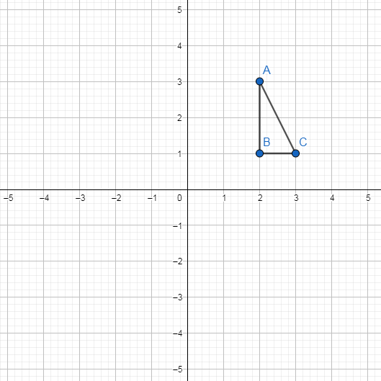
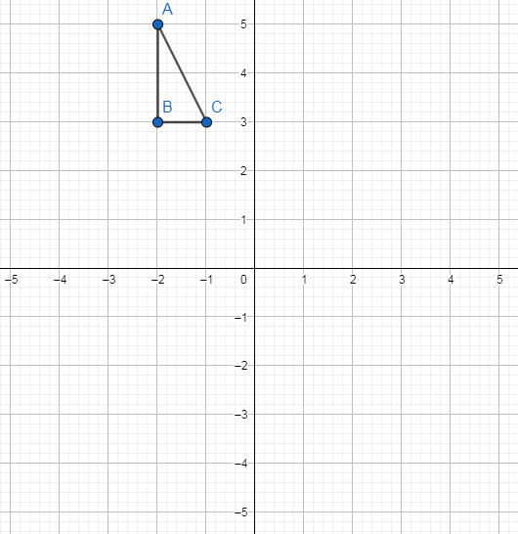
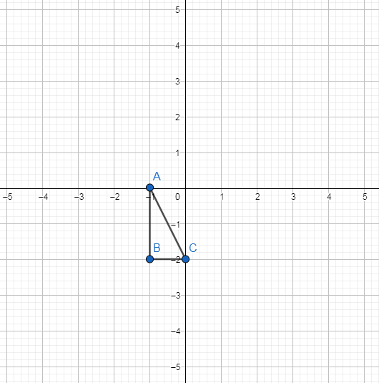
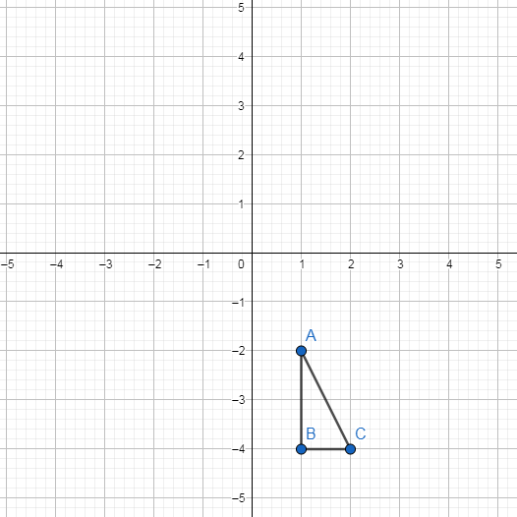
1)
3)
Rotate triangle ABC 180⁰ about (0,0)
Rotate triangle ABC 180⁰ about (0,0)
2)
4)
Rotate triangle ABC 180⁰ about (0,0)
Rotate triangle ABC 180⁰ about (0,0)

Slide 4
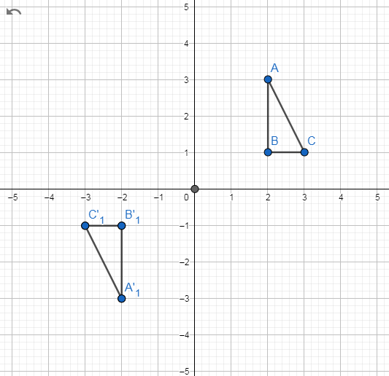
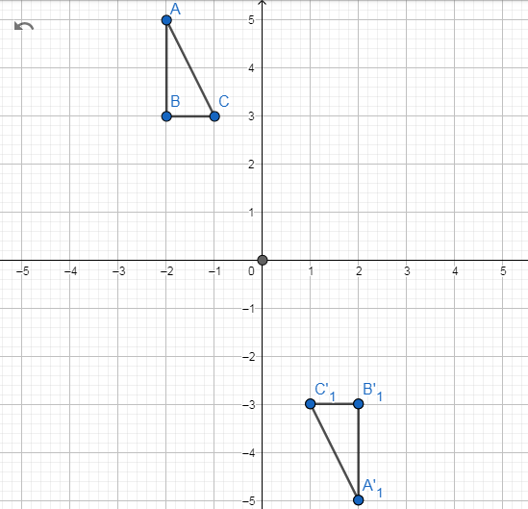
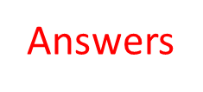
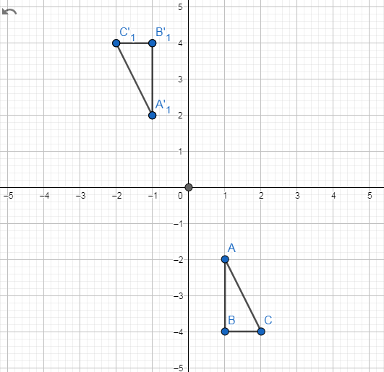
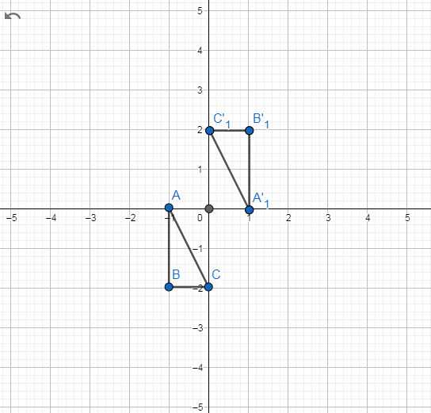
1)
3)
Rotate triangle ABC 180⁰ about (0,0)
Rotate triangle ABC 180⁰ about (0,0)
2)
4)
Rotate triangle ABC 180⁰ about (0,0)
Rotate triangle ABC 180⁰ about (0,0)

