Slide 1
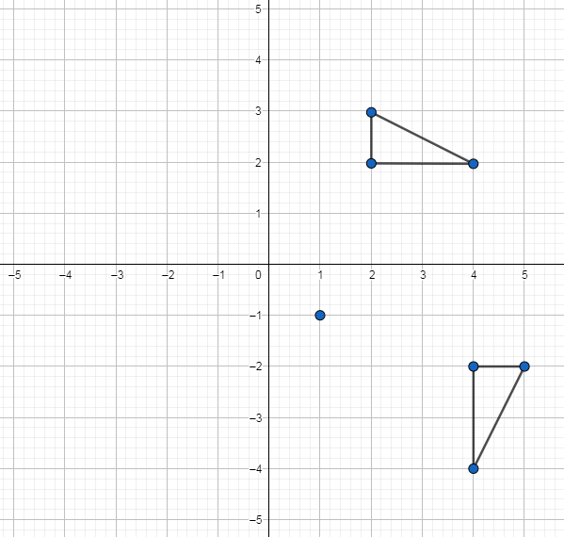
Rotation: 90$°$about a point $(x,y)$
Silent
Teacher
Intelligent Practice
Narration
Your Turn
Practice

Slide 2
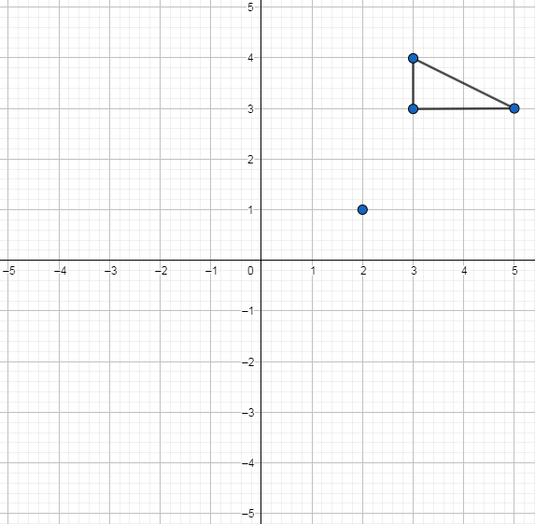
Worked Example
Your turn
Rotate triangle ABC 90⁰ anticlockwise about (2,1)
Rotate triangle ABC 90⁰ clockwise about (2,1)

Slide 3
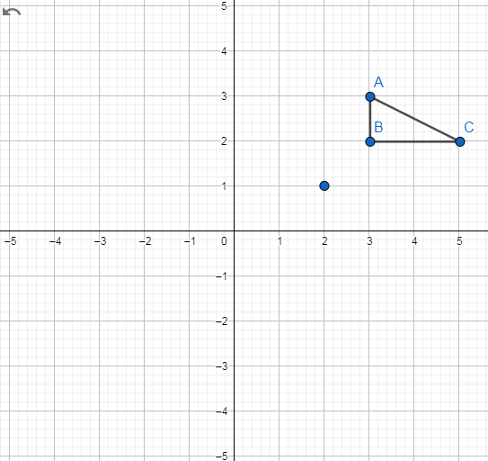
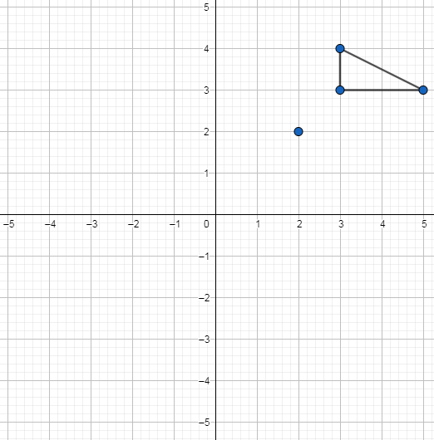
1)
3)
Rotate triangle ABC 90⁰ anticlockwise about (2,1)
Rotate triangle ABC 90⁰ clockwise about (2,2)
2)
4)
Rotate triangle ABC 90⁰ clockwise about (2,1)
Rotate triangle ABC 90⁰ anticlockwise about (2,2)

Slide 4
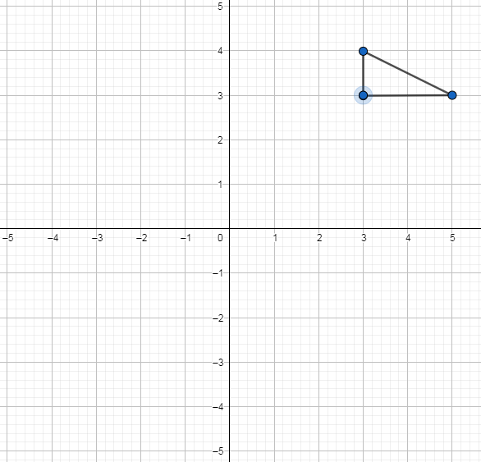
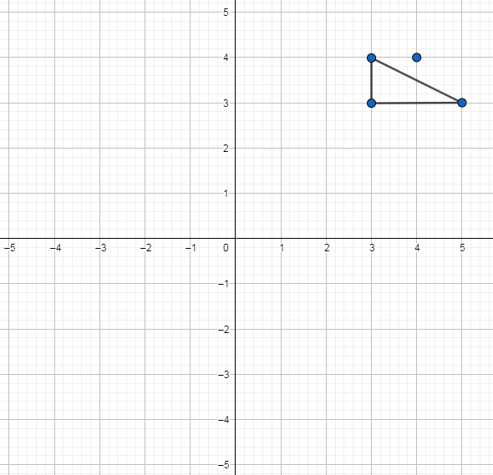
5)
7)
Rotate triangle ABC 90⁰ clockwise about (3,3)
Rotate triangle ABC 90⁰ clockwise about (4,4)
6)
8)
Rotate triangle ABC 90⁰ anticlockwise about (3,3)
Rotate triangle ABC 90⁰ anticlockwise about (4,4)

Slide 5
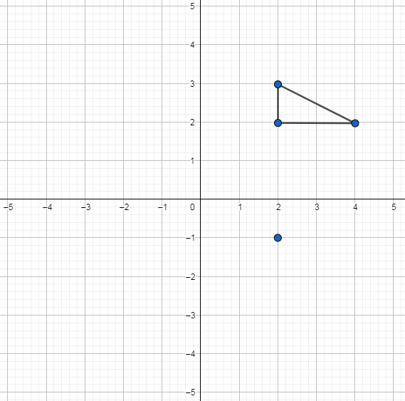
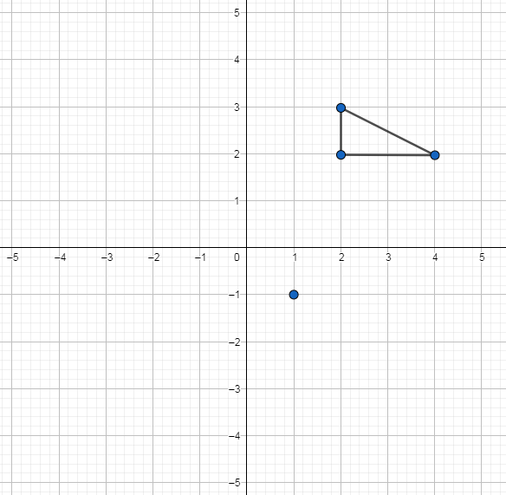
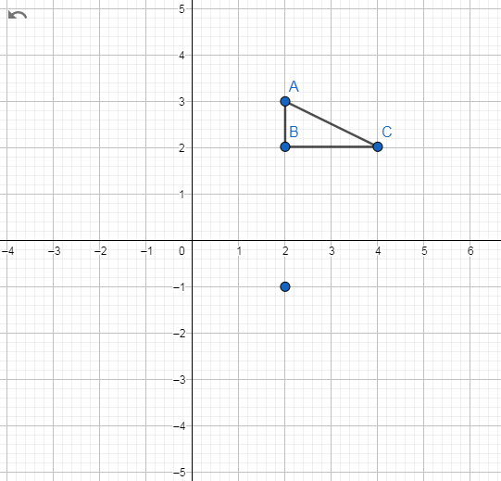
9)
11)
Rotate triangle ABC 90⁰ anticlockwise about (2,-1)
Rotate triangle ABC 90⁰ clockwise about (1,-1)
10)
12)
Rotate triangle ABC 90⁰ clockwise about (2,-1)
Rotate triangle ABC 90⁰ anticlockwise about (1,-1)

Slide 6
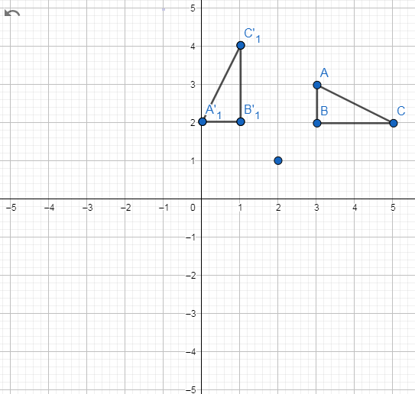
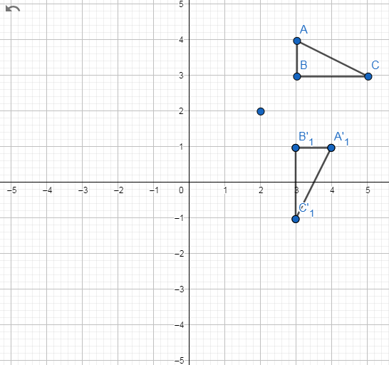
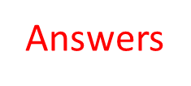
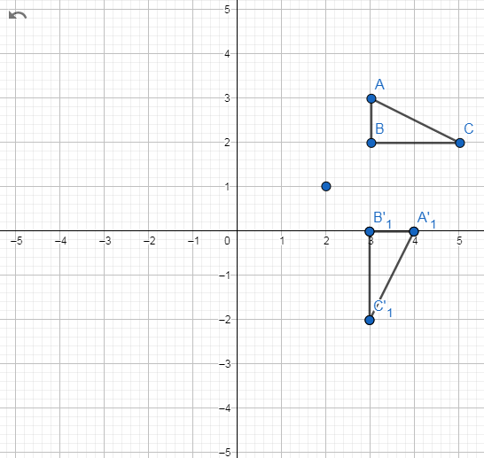
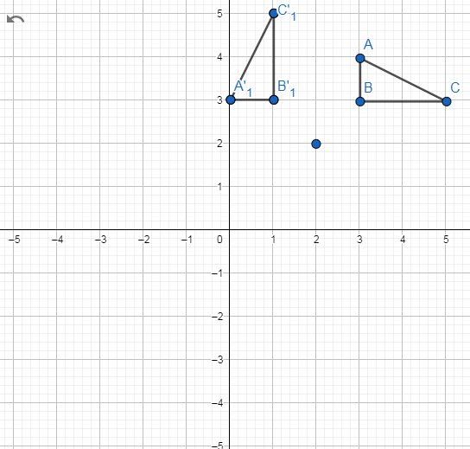
1)
3)
Rotate triangle ABC 90⁰ anticlockwise about (2,1)
Rotate triangle ABC 90⁰ clockwise about (2,2)
2)
4)
Rotate triangle ABC 90⁰ clockwise about (2,1)
Rotate triangle ABC 90⁰ anticlockwise about (2,2)

Slide 7
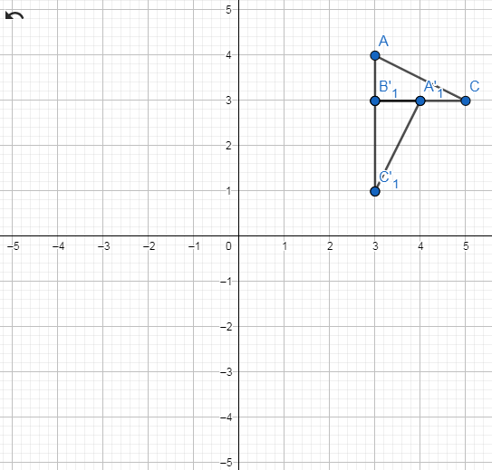
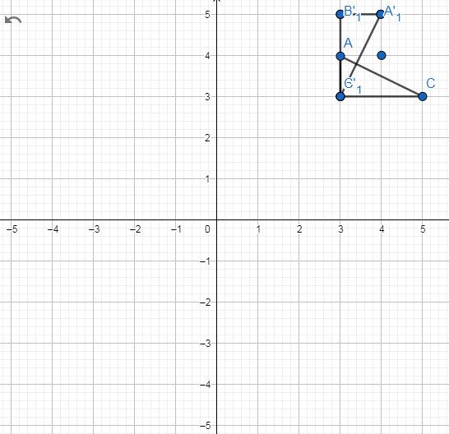
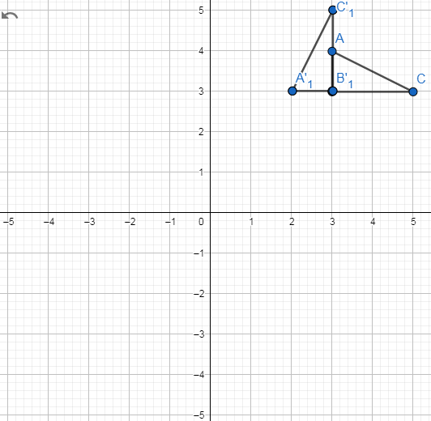
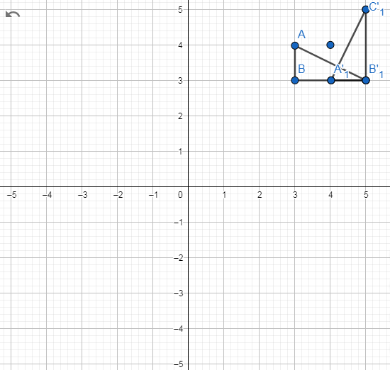
5)
7)
Rotate triangle ABC 90⁰ clockwise about (3,3)
Rotate triangle ABC 90⁰ clockwise about (4,4)
6)
8)
Rotate triangle ABC 90⁰ anticlockwise about (3,3)
Rotate triangle ABC 90⁰ anticlockwise about (4,4)

Slide 8
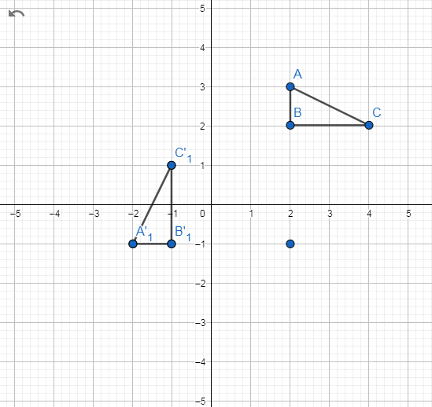
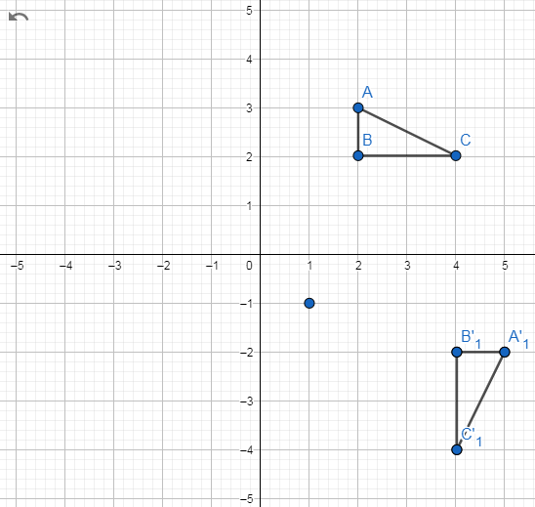
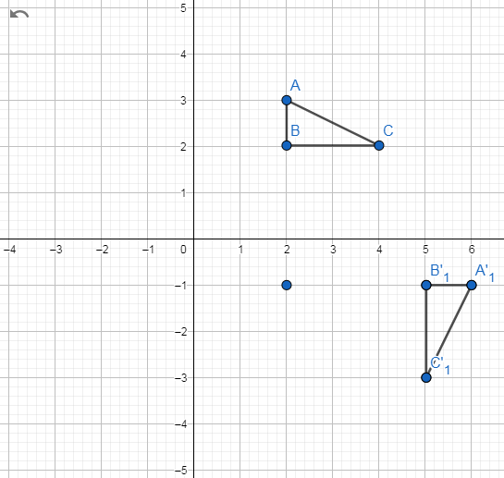
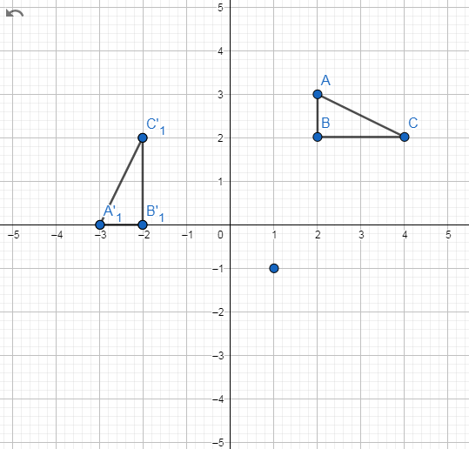
9)
11)
Rotate triangle ABC 90⁰ anticlockwise about (2,-1)
Rotate triangle ABC 90⁰ clockwise about (1,-1)
10)
12)
Rotate triangle ABC 90⁰ clockwise about (2,-1)
Rotate triangle ABC 90⁰ anticlockwise about (1,-1)

