Slide 1
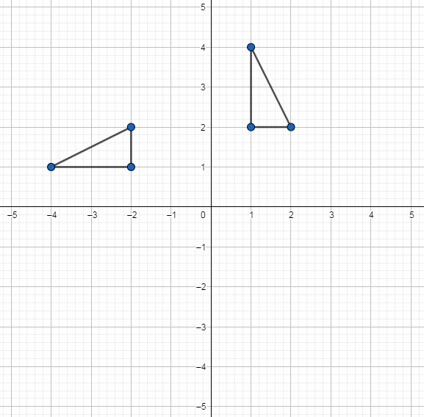
Transformations: Rotating a shape 180$°$about a point $(x,y)$
Silent
Teacher
Intelligent Practice
Narration
Your Turn
Practice

Slide 2
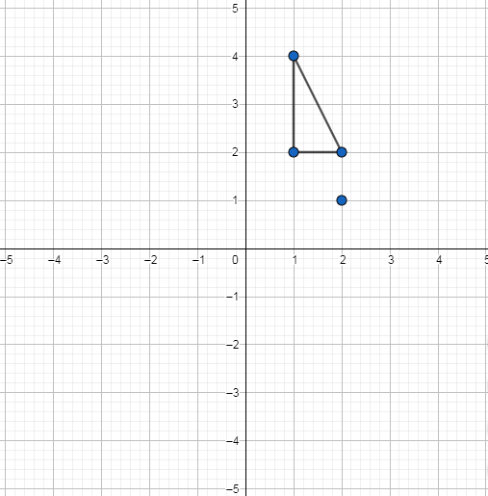
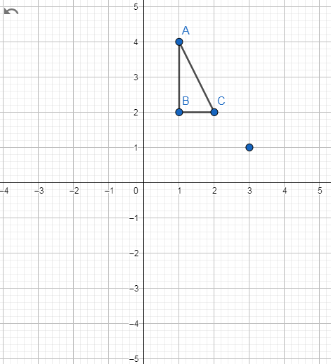
Worked Example
Your turn
A
A
B
B
Rotate triangle ABC 180⁰ about (2,1)
Rotate triangle ABC 180⁰ about (3,1)
Notes:
Pause after worked example to ask whether we need to do the “Your turn”.
If not, alter it to ‘Rotate triangle ABC 180⁰ clockwise about (3,1)

Slide 3
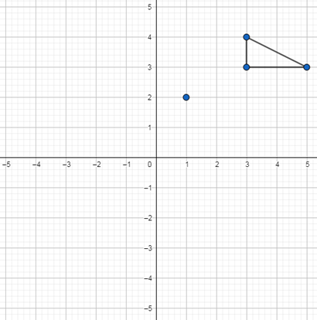
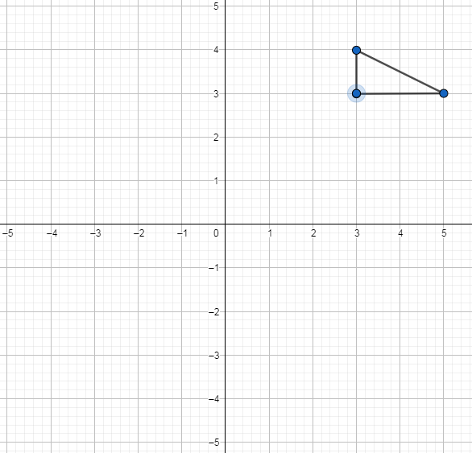
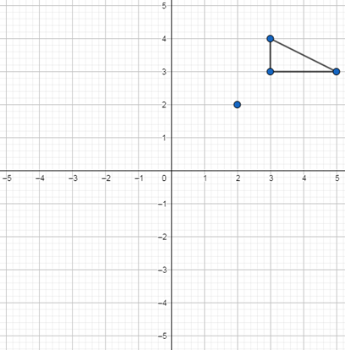
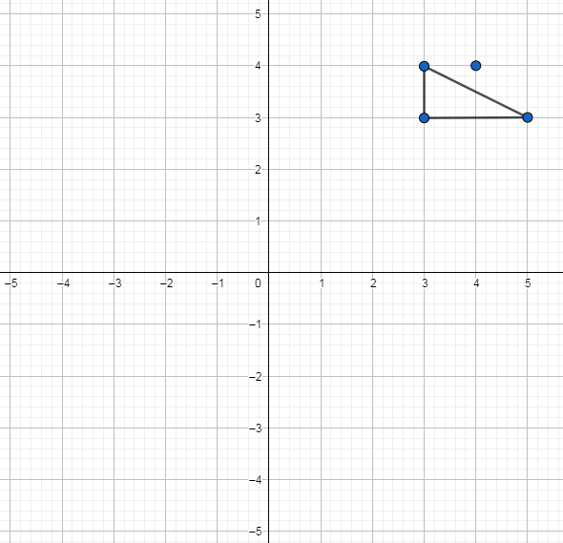
1)
3)
Rotate triangle ABC 180⁰ about (1,2)
Rotate triangle ABC 180⁰ about (3,3)
2)
4)
Rotate triangle ABC 180⁰ about (4,4)
Rotate triangle ABC 180⁰ about (2,2)

Slide 4
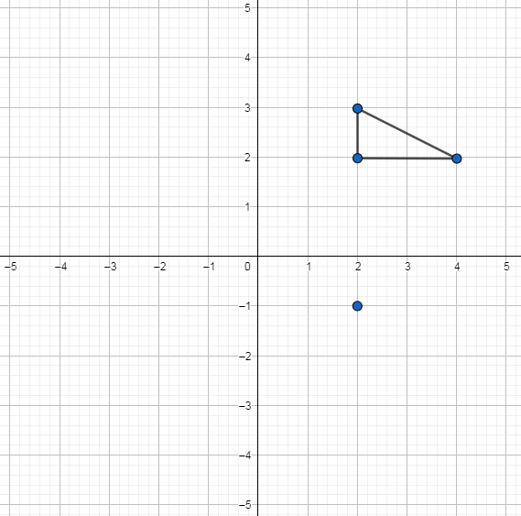
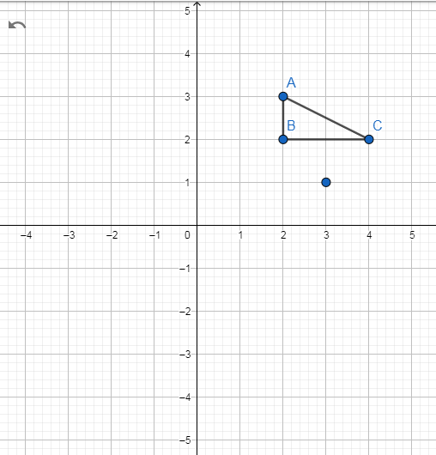
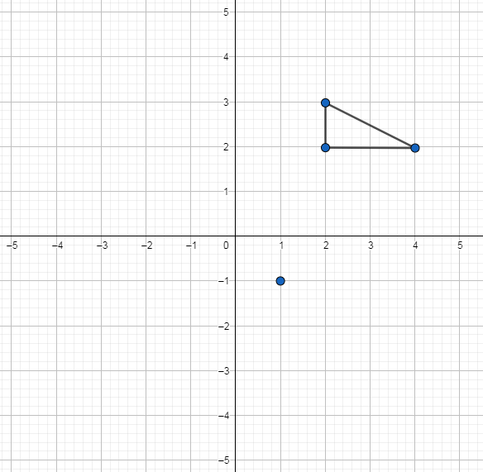
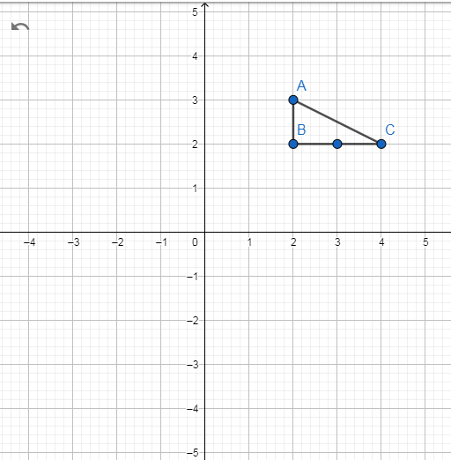
5)
7)
Rotate triangle ABC 180⁰ about (2,-1)
Rotate triangle ABC 180⁰ about (3,1)
6)
8)
Rotate triangle ABC 180⁰ about (1,-1)
Rotate triangle ABC 180⁰ about (3,2)

Slide 5
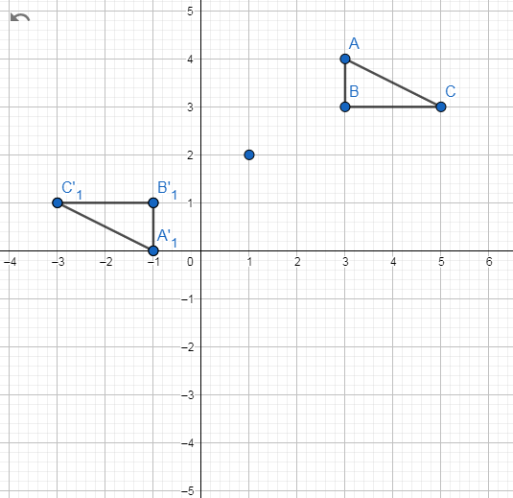
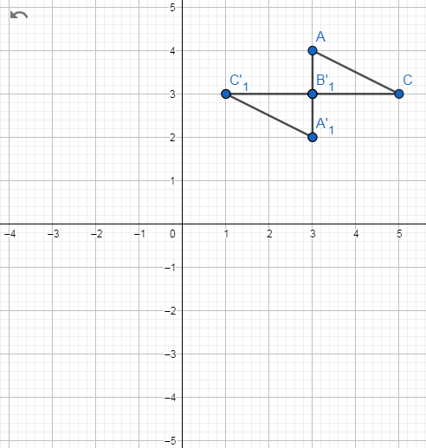
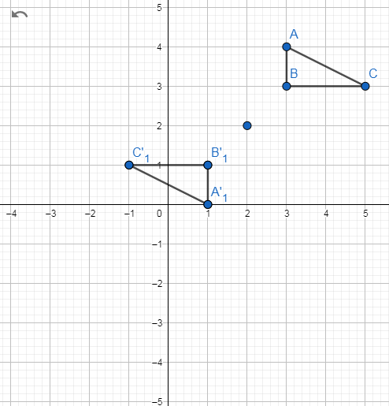
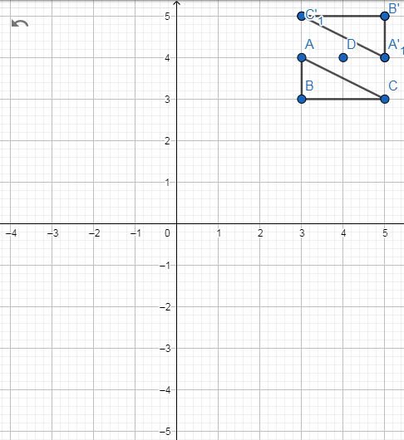
1)
3)
Rotate triangle ABC 180⁰ about (1,2)
Rotate triangle ABC 180⁰ about (3,3)
2)
4)
Rotate triangle ABC 180⁰ about (2,2)
Rotate triangle ABC 180⁰ about (4,4)

Slide 6
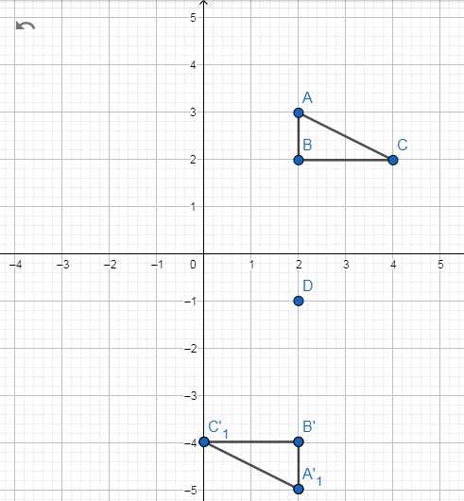
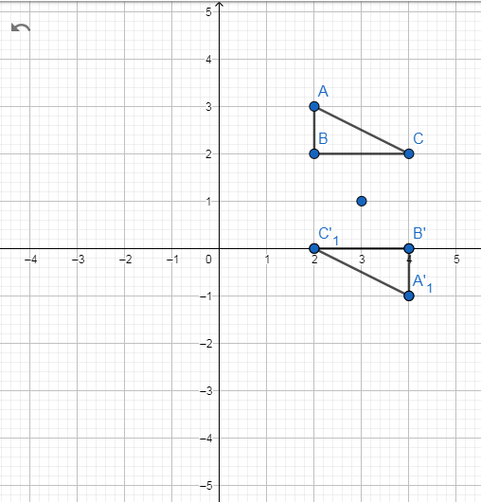
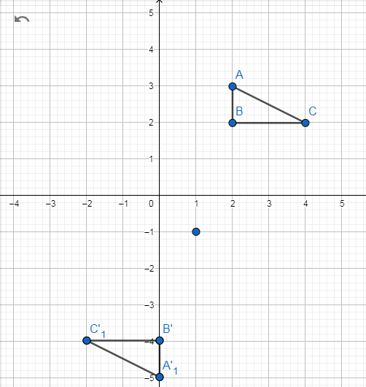
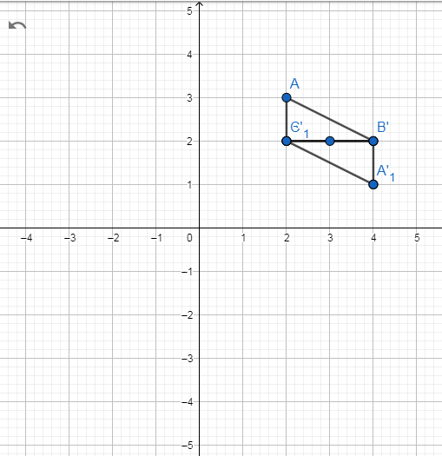
5)
7)
Rotate triangle ABC 180⁰ about (2,-1)
Rotate triangle ABC 180⁰ about (3,1)
6)
8)
Rotate triangle ABC 180⁰ about (1,-1)
Rotate triangle ABC 180⁰ about (3,2)

