Slide 1
Re-arranging trigonometric equations
Silent
Teacher
Intelligent Practice
Narration
Your Turn
Sin$\left(30\right)=\frac{x}{5}$
Sin$\left(15\right)=\frac{5}{x}$
Sin$\left(x\right)=\frac{1}{2}$
Practice

Slide 2
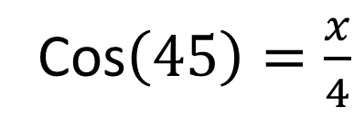
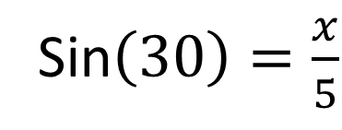
Worked Example
Your Turn
Sin$\left(30\right)=\frac{x}{5}$
Cos$\left(45\right)=\frac{x}{4}$
@mrlindsaymaths

Slide 3
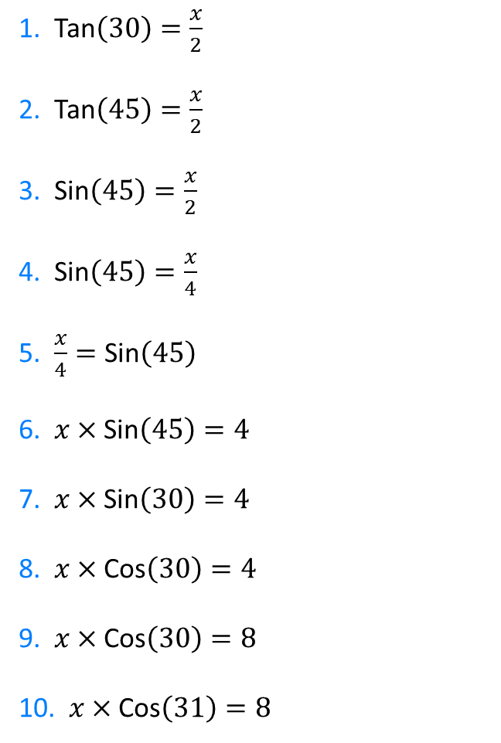
Find ‘$x$’. Give your solution to 2 decimal places.
1. Tan$\left(30\right)=\frac{x}{2}$
2. Tan$\left(45\right)=\frac{x}{2}$
3. Sin$\left(45\right)=\frac{x}{2}$
4. Sin$\left(45\right)=\frac{x}{4}$
5. $\frac{x}{4}=\text{Sin}\left(45\right)$
6. $x×$ Sin$\left(45\right)=4$
7. $x×$ Sin$\left(30\right)=4$
8. $x×$ Cos$\left(30\right)=4$
9. $x×$ Cos$\left(30\right)=8$
10. $x×$ Cos$\left(31\right)=8$
@mrlindsaymaths

Slide 4
Find ‘$x$’. Give your solution to 2 decimal places.
1. Tan$\left(30\right)=\frac{x}{2}$
2. Tan$\left(45\right)=\frac{x}{2}$
3. Sin$\left(45\right)=\frac{x}{2}$
4. Sin$\left(45\right)=\frac{x}{4}$
5. $\frac{x}{4}=\text{Sin}\left(45\right)$
6. $x×$ Sin$\left(45\right)=4$
7. $x×$ Sin$\left(30\right)=4$
8. $x×$ Cos$\left(30\right)=4$
9. $x×$ Cos$\left(30\right)=8$
10. $x×$ Cos$\left(31\right)=8$
$$x=1.15$$
$$x=2$$
$$x=1.41$$
$$x=2.82$$
$$x=2.82$$
$$x=5.65$$
$$x=8$$
$$x=4.61$$
$$x=9.24$$
$$x=9.33$$
@mrlindsaymaths

Slide 5
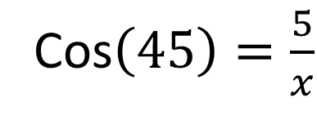
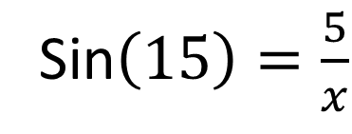
Worked Example
Your Turn
Sin$\left(15\right)=\frac{5}{x}$
Cos$\left(45\right)=\frac{5}{x}$
@mrlindsaymaths

Slide 6

Find ‘$x$’. Give your solution to 2 decimal places.
1. Cos$\left(30\right)=\frac{2}{x}$
2. Cos$\left(45\right)=\frac{2}{x}$
3. Sin$\left(45\right)=\frac{2}{x}$
4. Sin$\left(45\right)=\frac{4}{x}$
5. Sin$\left(45\right)=\frac{8}{x}$
6. Tan$\left(45\right)=\frac{8}{x}$
7. Tan$\left(45\right)=\frac{x}{8}$
8. Cos$\left(45\right)=\frac{x}{8}$
9. Cos$\left(45\right)=\frac{8}{x}$
10. $\frac{8}{x}=\text{Cos}\left(45\right)$
@mrlindsaymaths

Slide 7
Find ‘$x$’. Give your solution to 2 decimal places.
1. Cos$\left(30\right)=\frac{2}{x}$
2. Cos$\left(45\right)=\frac{2}{x}$
3. Sin$\left(45\right)=\frac{2}{x}$
4. Sin$\left(45\right)=\frac{4}{x}$
5. Sin$\left(45\right)=\frac{8}{x}$
6. Tan$\left(45\right)=\frac{8}{x}$
7. Tan$\left(45\right)=\frac{x}{8}$
8. Cos$\left(45\right)=\frac{x}{8}$
9. Cos$\left(45\right)=\frac{8}{x}$
10. $\frac{8}{x}=\text{Cos}\left(45\right)$
$$x=2.31$$
$$x=2.83$$
$$x=2.83$$
$$x=5.66$$
$$x=11.31$$
$$x=8$$
$$x=8$$
$$x=5.66$$
$$x=11.31$$
$$x=11.31$$
@mrlindsaymaths

Slide 8
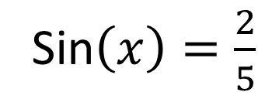
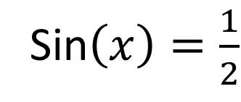
Worked Example
Your Turn
Sin$\left(x\right)=\frac{1}{2}$
Sin$\left(x\right)=\frac{2}{5}$
@mrlindsaymaths

Slide 9


Find ‘$x$’. Give your solution to 2 decimal places.
1. S$in\left(x\right)=0$
2. $\text{S}in\left(x\right)=\frac{1}{5}$
3. $\text{S}in\left(x\right)=\frac{2}{5}$
4. $\text{S}in\left(x\right)=\frac{3}{5}$
5. $\text{S}in\left(x\right)=\frac{4}{5}$
6. $\text{S}in\left(x\right)=1$
7. $Cos\left(x\right)=0$
8. $Cos\left(x\right)=\frac{1}{5}$
9. $Cos\left(x\right)=\frac{2}{5}$
10. $Cos\left(x\right)=\frac{3}{5}$
11. $Cos\left(x\right)=\frac{4}{5}$
12. $Cos\left(x\right)=1$
@mrlindsaymaths

Slide 10
Find ‘$x$’. Give your solution to 2 decimal places.
$$x=90$$
1. S$in\left(x\right)=0$
2. $\text{S}in\left(x\right)=\frac{1}{5}$
3. $\text{S}in\left(x\right)=\frac{2}{5}$
4. $\text{S}in\left(x\right)=\frac{3}{5}$
5. $\text{S}in\left(x\right)=\frac{4}{5}$
6. $\text{S}in\left(x\right)=1$
7. $Cos\left(x\right)=0$
8. $Cos\left(x\right)=\frac{1}{5}$
9. $Cos\left(x\right)=\frac{2}{5}$
10. $Cos\left(x\right)=\frac{3}{5}$
11. $Cos\left(x\right)=\frac{4}{5}$
12. $Cos\left(x\right)=1$
$$x=0$$
$$x=11.54$$
$$x=78.46$$
$$x=23.58$$
$$x=66.42$$
$$x=36.87$$
$$x=53.13$$
$$x=53.13$$
$$x=36.87$$
$$x=90$$
$$x=0$$
@mrlindsaymaths

