Slide 1
Using de Moivre’s Theorem: Indices to coefficient form
Silent
Teacher
Intelligent Practice
Narration
Your Turn
cos³θ$=$
sin³θ$=$
sin⁵θ$=$
Practice

Slide 2
Worked Example
Your Turn
cos³θ
cos⁵θ

Slide 3
cos⁴θ =
sin⁴θ =
sin⁶θ =
sin³θ =
sin⁵θ =

Slide 4
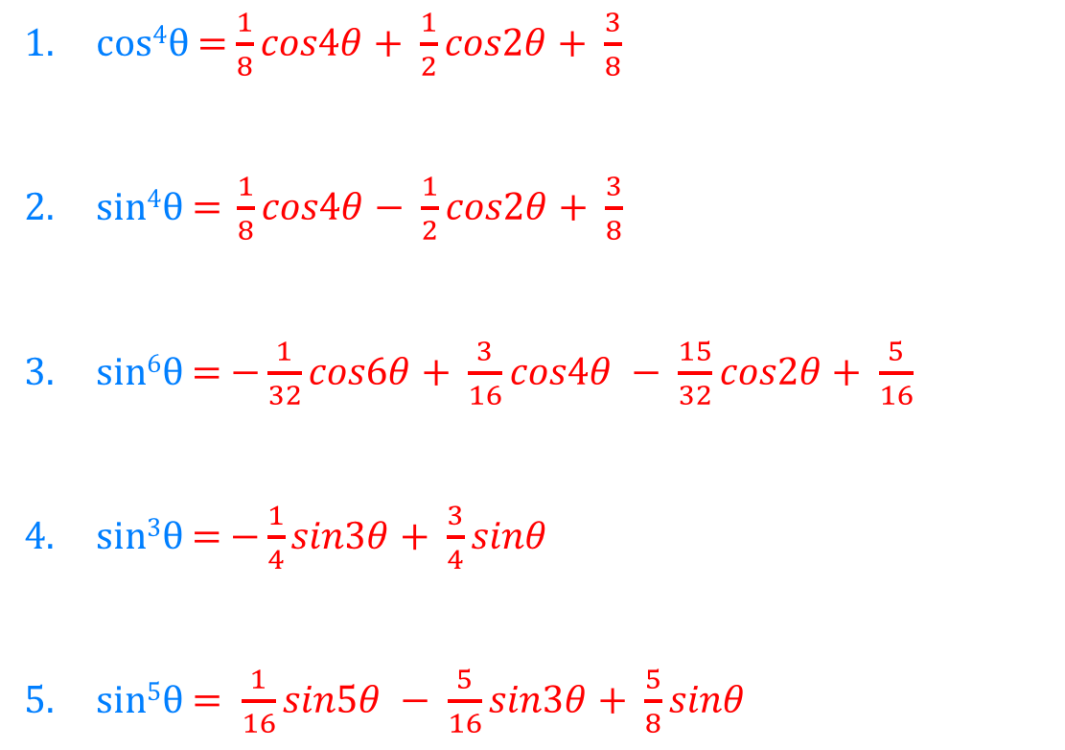
cos⁴θ = $\frac{1}{8}cos4θ+ \frac{1}{2}cos2θ+ \frac{3}{8}$
sin⁴θ $\text{= }\frac{1}{8}cos4θ− \frac{1}{2}cos2θ+ \frac{3}{8}$
sin⁶θ = $−\frac{1}{32}cos6θ+ \frac{3}{16}cos4θ − \frac{15}{32}cos2θ+ \frac{5}{16}$
sin³θ = $−\frac{1}{4}sin3θ+ \frac{3}{4}sinθ$
sin⁵θ $= \frac{1}{16}sin5θ − \frac{5}{16}sin3θ+ \frac{5}{8}sinθ$

