Slide 1
Chain Rule
Pattern spot
Reflect
Your Turn
$$\frac{d}{dx}{\left(4x^{2}−3\sqrt{x}\right)}^{2}= ?$$
$$\frac{d}{dx}(\sin\left(4x^{2}−3\sqrt{x} \right)= ?$$
Pattern

Slide 2
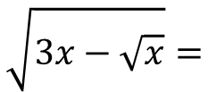
$$\sin{(2x^{2}−3)}=$$
$$\sin{(3x−\sqrt{x})}=$$
$$\cos\left(2x^{2}−3\right)=$$
$$\cos\left(3x−\sqrt{x}\right)=$$
$$\ln\left(2x^{2}−3\right)=$$
$$\ln\left(3x−\sqrt{x}\right)=$$
$$e^{2x^{2}−3} =$$
$$e^{3x−\sqrt{x}} =$$
$${\left(2x^{2}−3\right)}^{\frac{5}{2}}=$$
$$\sqrt{3x−\sqrt{x}}=$$
@DrChris_Baker

Slide 3
$$\sin{(2x^{2}−3)}= 4x\cos{(2x^{2}−3)}$$
$$\cos\left(2x^{2}−3\right)=−4x\sin{(2x^{2}−3)}$$
$$\ln\left(2x^{2}−3\right)=\frac{4x}{2x^{2}−3}$$
$$e^{2x^{2}−3} =4xe^{2x^{2}−3}$$
$${\left(2x^{2}−3\right)}^{\frac{5}{2}}=10x{\left(2x^{2}−3\right)}^{\frac{3}{2}}$$
@DrChris_Baker

Slide 4
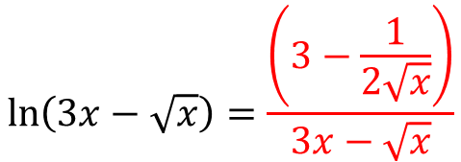
$$\sin{(3x−\sqrt{x})}=\left(3−\frac{1}{2\sqrt{x}}\right)\sin\left(3x−\sqrt{x}\right)$$
$$\cos\left(3x−\sqrt{x}\right)=−\left(3−\frac{1}{2\sqrt{x}}\right)\cos\left(3x−\sqrt{x}\right)$$
$$\ln\left(3x−\sqrt{x}\right)=\frac{\left(3−\frac{1}{2\sqrt{x}}\right)}{3x−\sqrt{x}}$$
$$e^{3x−\sqrt{x}} =\left(3−\frac{1}{2\sqrt{x}}\right)e^{3x−\sqrt{x}}{ }$$
$$\sqrt{3x−\sqrt{x}} =\frac{3−\frac{1}{2√x}}{\sqrt{3x−\sqrt{x}}}=\frac{6\sqrt{x}−1}{2\sqrt{x}\sqrt{3x−\sqrt{x}}}$$
@DrChris_Baker

Slide 5
Your Turn
$$\sin\left(5x^{2}−8x−2\right)=$$
$$\cos\left(5x^{2}−8x−2\right)=$$
$$e^{5x^{2}−8x−2}{=}$$
$$\ln\left(5x^{2}−8x−2\right)=$$
$$\sqrt[3]{5x^{2}−8x−2}=$$
@DrChris_Baker

Slide 6
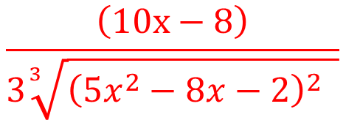
Your Turn
$$\sin\left(5x^{2}−8x−2\right)=$$
$(10x−8)\cos\left(5x^{2}−8x−2\right)$
$$\cos\left(5x^{2}−8x−2\right)=$$
$−(10x−8)\sin\left(5x^{2}−8x−2\right)$
$$e^{5x^{2}−8x−2}{=}$$
$(10x−8)e^{5x^{2}−8x−2}{ }$
$$\ln\left(5x^{2}−8x−2\right)=$$
$\frac{10x−8}{5x^{2}−8x−2}$
$$\sqrt[3]{5x^{2}−8x−2}=$$
$${\frac{\left(10x−8\right)}{3\sqrt[3]{{\left(5x^{2}−8x−2\right)}^{2} }}}^{ }$$
@DrChris_Baker

