Slide 1
Chain Rule
Silent
Teacher
Intelligent Practice
Narration
Your Turn
$$\frac{d}{dx}{\left(3x^{2}−2x+1\right)}^{4}$$
$$\frac{d}{dx}{\left(3x^{4}−1\right)}^{\frac{3}{2}}$$
Practice

Slide 2
Worked Example
Your Turn
Find $\frac{dy}{dx}$ of $e^{2x−1}$
Find $\frac{dy}{dx}$ of $\sin\left(2x−1\right)$
Differentiate $log⁡(2x−1)$
Differentiate $log⁡(3x+2)$
@DrChris_Baker

Slide 3
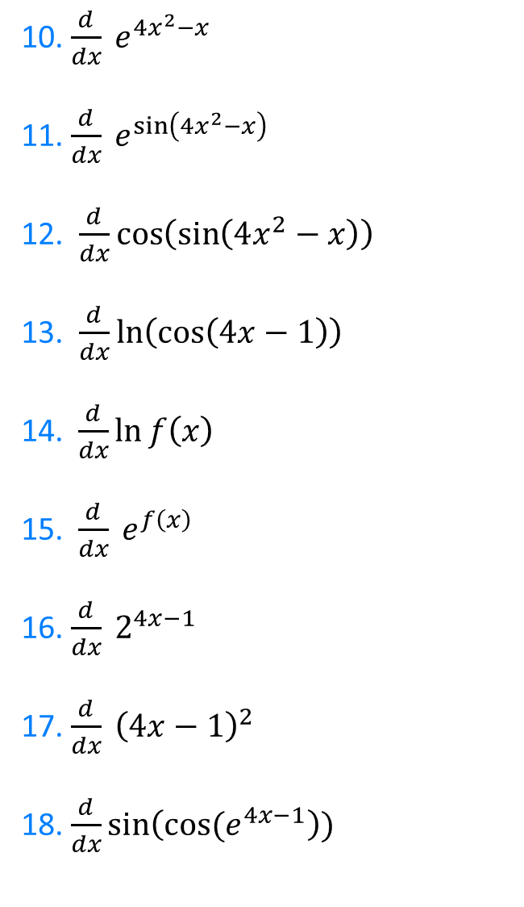

1. $\frac{d}{dx} (4x−1)$
2. $\frac{d}{dx} e^{4x−1}$
3. $\frac{d}{dx} sin⁡(4x−1)$
4. $\frac{d}{dx} cos⁡(4x−1)$
5. $\frac{d}{dx}\tan\left(4x−1\right)$
6.$\frac{d}{dx}\cot{(4x−1)}$
7. $\frac{d}{dx} cosec (4x−1)$
8. $\frac{d}{dt} cosec(4x^{2}−x)$
9. $\frac{d}{dx}\ln\left(4x^{2}−x\right)$
10. $\frac{d}{dx} e^{4x^{2}−x}$
11. $\frac{d}{dx} e^{\sin\left(4x^{2}−x\right)}$
12. $\frac{d}{dx}\cos\left(\sin\left(4x^{2}−x\right)\right)$
13. $\frac{d}{dx}\ln\left(\cos\left(4x−1\right)\right)$
14. $\frac{d}{dx}\ln{f\left(x\right)}$
15.$\frac{d}{dx} e^{f\left(x\right)}$
16. $\frac{d}{dx} 2^{4x−1}$
17. $\frac{d}{dx} {\left(4x−1\right)}^{2}$
18. $\frac{d}{dx}\sin\left(\cos{(e^{4x−1}}\right))$
@DrChris_Baker

Slide 4

1. $\frac{d}{dx} (4x−1)$ $=4$
2. $\frac{d}{dx} e^{4x−1}$ $=4e^{4x−1}$
3. $\frac{d}{dx} sin⁡(4x−1)$ $=4\cos{(4x−1)}$
4. $\frac{d}{dx} cos⁡(4x−1)$ $=−4\sin{(4x−1)}$
5. $\frac{d}{dx}\tan\left(4x−1\right)$ $=4\sec^{2}{(4x−1)}$
6.$\frac{d}{dx}\cot{(4x−1)}$ $=−4{cosec}^{2}\left(4x−1\right)$
7. $\frac{d}{dx} cosec (4x−1)$ $=−4\operatorname{cosec}\left(4x−1\right)\cot{(4x−1)}$
8. $\frac{d}{dt} cosec(4x^{2}−x)$ $=−(8x−1)\operatorname{cosec}\left(4x^{2}−x\right)\cot{(4x^{2}−x)}$
9. $\frac{d}{dx}\ln\left(4x^{2}−x\right)$ $=\frac{8x−1}{4x^{2}−x}$
@DrChris_Baker

Slide 5
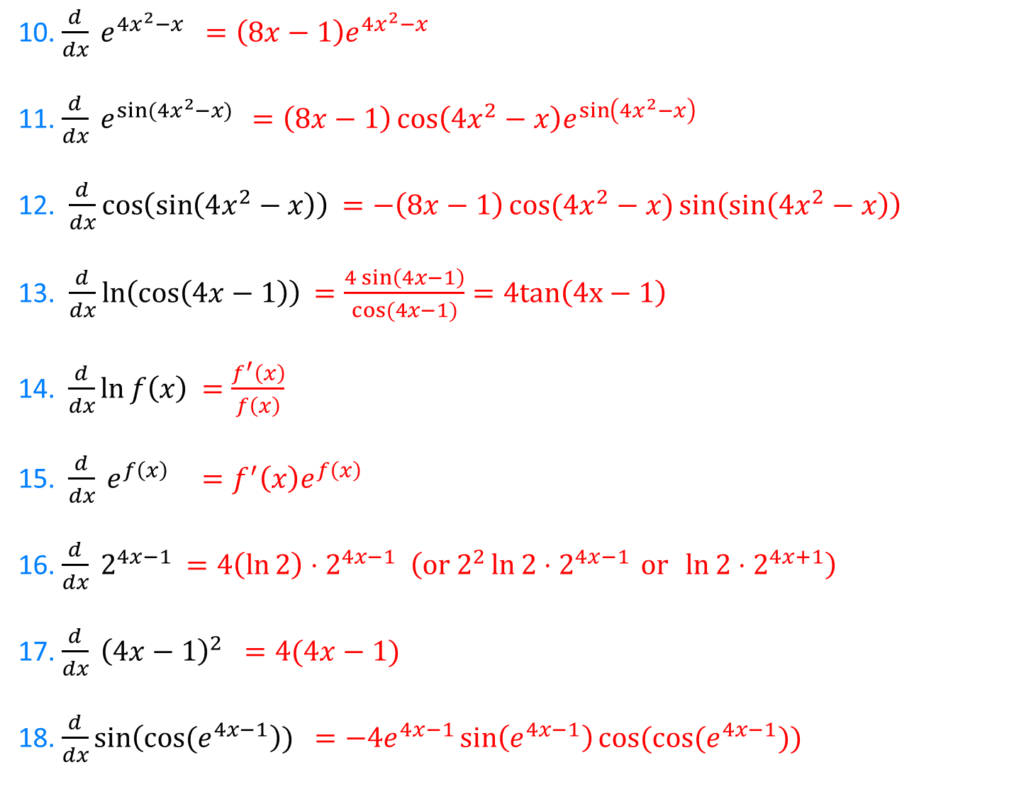
10. $\frac{d}{dx} e^{4x^{2}−x}$ $=\left(8x−1\right)e^{4x^{2}−x}$
11. $\frac{d}{dx} e^{\sin{(4x^{2}−x)} }$ $=\left(8x−1\right)\cos\left(4x^{2}−x\right)e^{\sin\left(4x^{2}−x\right)}$
12. $\frac{d}{dx}\cos\left(\sin\left(4x^{2}−x\right)\right)$ $=−\left(8x−1\right)\cos{(4x^{2}−x)}\sin\left(\sin\left(4x^{2}−x\right)\right)$
13. $\frac{d}{dx}\ln\left(\cos\left(4x−1\right)\right)$ $=\frac{4\sin\left(4x−1\right)}{cos⁡(4x−1)}=4tan\left(4x−1\right)$
14. $\frac{d}{dx}\ln{f\left(x\right)}$ $=\frac{f^{′}\left(x\right)}{f\left(x\right)}$
15.$\frac{d}{dx} e^{f\left(x\right)}$ $=f^{′}\left(x\right)e^{f\left(x\right)}$
16. $\frac{d}{dx} 2^{4x−1}$ $=4\left(\ln{2}\right)⋅2^{4x−1} \left(or 2^{2}\ln{2}⋅2^{4x−1 }or \ln{2}⋅2^{4x+1}\right)$
17. $\frac{d}{dx} {\left(4x−1\right)}^{2}$ $=4(4x−1)$
18. $\frac{d}{dx}\sin\left(\cos{(e^{4x−1}}\right)) =−4e^{4x−1}\sin\left(e^{4x−1}\right)cos⁡(\cos{(e^{4x−1}}))$
@DrChris_Baker

