Slide 1
Chain Rule
Silent
Teacher
Intelligent Practice
Narration
Your Turn
$$\frac{d}{dx}{\left(3x^{2}−2x+1\right)}^{4}$$
$$\frac{d}{dx}{\left(3x^{4}−1\right)}^{\frac{3}{2}}$$
Practice

Slide 2
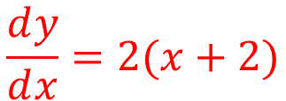
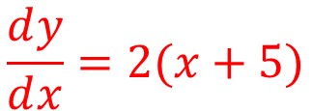
Worked Example
Your Turn
Find $\frac{dy}{dx}$ of ${\left(x+2\right)}^{2}$
Find $\frac{dy}{dx}$ of ${\left(x+5\right)}^{2}$
$$\frac{ⅆy}{ⅆx}=2(x+2)×1$$
$$\frac{ⅆy}{ⅆx}=2(x+5)×1$$
$$\frac{ⅆy}{ⅆx}=2(x+2)$$
$$\frac{ⅆy}{ⅆx}=2(x+5)$$
Differentiate ${\left(2x+2\right)}^{4}$
Differentiate ${\left(x^{2}+2x\right)}^{4}$
$$\frac{ⅆy}{ⅆx}=4{(2x+2)}^{3}×2$$
$$\frac{ⅆy}{ⅆx}=4{(x^{2}+2x)}^{3}×\left(2x+2\right)$$
$$\frac{ⅆy}{ⅆx}=8{(2x+2)}^{3}$$
$$\frac{ⅆy}{ⅆx}=4\left(2x+2\right){(x^{2}+2x)}^{3}$$
@DrChris_Baker

Slide 3
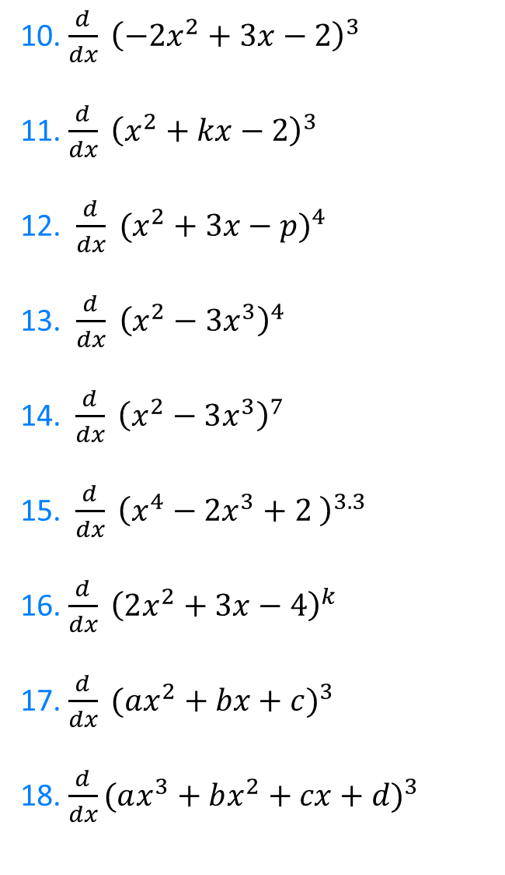

1. $\frac{d}{dx} {\left(3x+5\right)}^{3}$
2. $\frac{d}{dx} {\left(5x−2\right)}^{3}$
3. $\frac{d}{dx} {\left(2x+3\right)}^{3}$
4. $\frac{d}{dx} {\left(2x^{2}+3x\right)}^{3}$
5. $\frac{d}{dx} {\left(2x^{2}+3x−2\right)}^{3}$
6.$\frac{d}{dx} {\left(2x^{2}+3x−2\right)}^{5}$
7. $\frac{d}{dx} {\left(2x^{2}+3x−2\right)}^{\frac{5}{2}}$
8. $\frac{d}{dt} {\left(2t^{2}+3t−2\right)}^{\frac{5}{2}}$
9. $\frac{d}{dx} {\left(2x^{2}−3x+2\right)}^{\frac{5}{2}}$
10. $\frac{d}{dx} {\left(−2x^{2}+3x−2\right)}^{3}$
11. $\frac{d}{dx} {\left(x^{2}+kx−2\right)}^{3}$
12. $\frac{d}{dx} {(x^{2}+3x−p)}^{4}$
13. $\frac{d}{dx} {\left(x^{2}−3x^{3}\right)}^{4}$
14. $\frac{d}{dx} {\left(x^{2}−3x^{3}\right)}^{7}$
15.$\frac{d}{dx} {\left(x^{4}−2x^{3}+2 \right)}^{3.3}$
16. $\frac{d}{dx} {\left(2x^{2}+3x−4\right)}^{k}$
17. $\frac{d}{dx} {(ax^{2}+bx+c)}^{3}$
18. $\frac{d}{dx}{(ax^{3}+bx^{2}+cx+d)}^{3}$
@DrChris_Baker

Slide 4

1. $\frac{d}{dx} {\left(3x+5\right)}^{3}$
2. $\frac{d}{dx} {\left(5x−2\right)}^{3}$
3. $\frac{d}{dx} {\left(2x+3\right)}^{3}$
4. $\frac{d}{dx} {\left(2x^{2}+3x\right)}^{3}$
5. $\frac{d}{dx} {\left(2x^{2}+3x−2\right)}^{3}$
6.$\frac{d}{dx} {\left(2x^{2}+3x−2\right)}^{5}$
7. $\frac{d}{dx} {\left(2x^{2}+3x−2\right)}^{\frac{5}{2}}$
8. $\frac{d}{dt} {\left(2t^{2}+3t−2\right)}^{\frac{5}{2}}$
9. $\frac{d}{dx} {\left(2x^{2}−3x+2\right)}^{\frac{5}{2}}$
$$=9{\left(3x+5\right)}^{2}$$
$$=15{\left(5x−2\right)}^{2}$$
$$=6{\left(2x+3\right)}^{2}$$
$$=3\left(4x+3\right){\left(2x^{2}+3x\right)}^{2}$$
$=3\left(4x+3\right){\left(2x^{2}+3x−2\right)}^{2}$
$$=5\left(4x+3\right){\left(2x^{2}+3x−2\right)}^{4}$$
$$=\frac{5}{2}\left(4x+3\right){\left(2x^{2}+3x−2\right)}^{\frac{3}{2}}$$
$$=\frac{5}{2}\left(4t+3\right){\left(2t^{2}+3t−2\right)}^{\frac{3}{2}}$$
$$=\frac{5}{2}\left(4x−3\right){\left(2x^{2}−3x+2\right)}^{\frac{3}{2}}$$
@DrChris_Baker

Slide 5
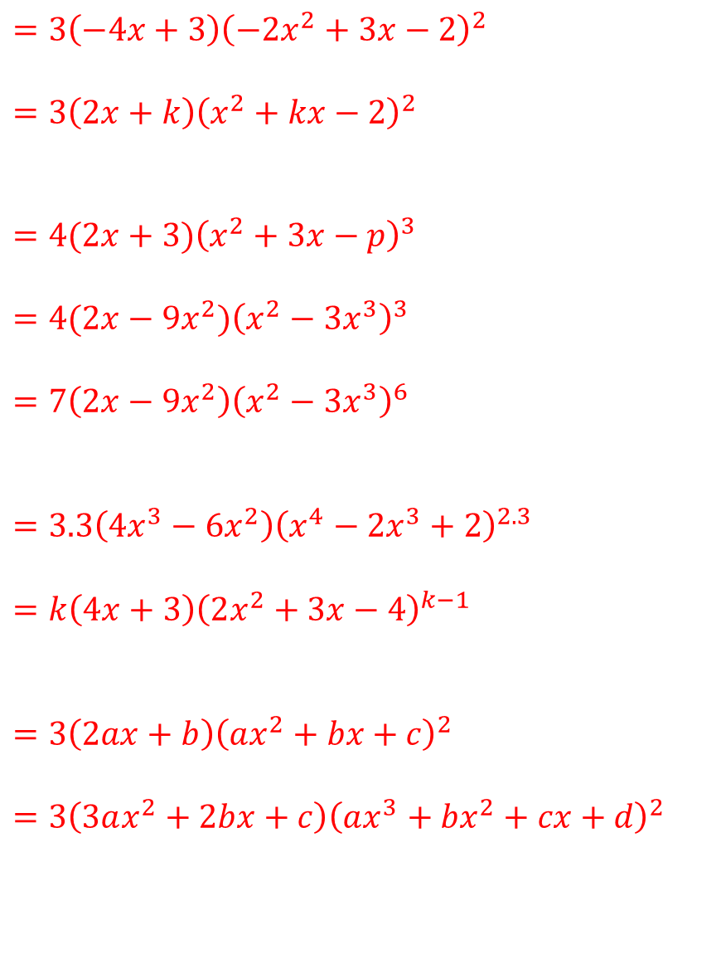
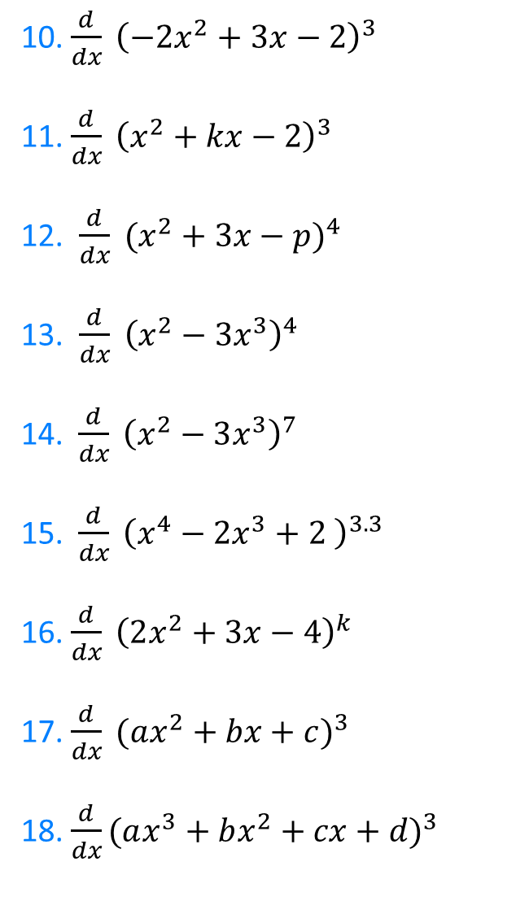
10. $\frac{d}{dx} {\left(−2x^{2}+3x−2\right)}^{3}$
11. $\frac{d}{dx} {\left(x^{2}+kx−2\right)}^{3}$
12. $\frac{d}{dx} {(x^{2}+3x−p)}^{4}$
13. $\frac{d}{dx} {\left(x^{2}−3x^{3}\right)}^{4}$
14. $\frac{d}{dx} {\left(x^{2}−3x^{3}\right)}^{7}$
15.$\frac{d}{dx} {\left(x^{4}−2x^{3}+2 \right)}^{3.3}$
16. $\frac{d}{dx} {\left(2x^{2}+3x−4\right)}^{k}$
17. $\frac{d}{dx} {(ax^{2}+bx+c)}^{3}$
18. $\frac{d}{dx}{(ax^{3}+bx^{2}+cx+d)}^{3}$
$$=3\left(−4x+3\right){\left(−2x^{2}+3x−2\right)}^{2}$$
$$=3{\left(2x+k\right)\left(x^{2}+kx−2\right)}^{2}$$
$$=4(2x+3){\left(x^{2}+3x−p\right)}^{3}$$
$$=4(2x−9x^{2}){\left(x^{2}−3x^{3}\right)}^{3}$$
$=7\left(2x−9x^{2}\right){\left(x^{2}−3x^{3}\right)}^{6}$
$$=3.3\left(4x^{3}−6x^{2}\right){\left(x^{4}−2x^{3}+2\right)}^{2.3}$$
$$=k\left(4x+3\right){\left(2x^{2}+3x−4\right)}^{k−1}$$
$$=3\left(2ax+b\right){\left(ax^{2}+bx+c\right)}^{2}$$
$$=3\left(3ax^{2}+2bx+c\right){\left(ax^{3}+bx^{2}+cx+d\right)}^{2}$$
@DrChris_Baker

Slide 6
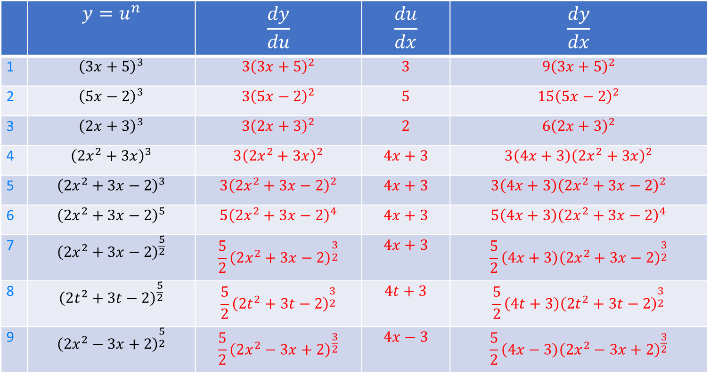
 | $$y=u^{n}$$ | $$\frac{dy}{du}$$ | $$\frac{du}{dx}$$ | $$\frac{dy}{dx}$$
1 | $${\left(3x+5\right)}^{3}$$ | $${3\left(3x+5\right)}^{2}$$ | $$3$$ | $${9\left(3x+5\right)}^{2}$$
2 | $${\left(5x−2\right)}^{3}$$ | $$3{\left(5x−2\right)}^{2}$$ | $$5$$ | $$15{\left(5x−2\right)}^{2}$$
3 | $${\left(2x+3\right)}^{3}$$ | $$3{\left(2x+3\right)}^{2}$$ | $$2$$ | $$6{\left(2x+3\right)}^{2}$$
4 | $${\left(2x^{2}+3x\right)}^{3}$$ | $$3{\left(2x^{2}+3x\right)}^{2}$$ | $$4x+3$$ | $$3{\left(4x+3\right)\left(2x^{2}+3x\right)}^{2}$$
5 | $${\left(2x^{2}+3x−2\right)}^{3}$$ | $$3{\left(2x^{2}+3x−2\right)}^{2}$$ | $$4x+3$$ | $$3\left(4x+3\right){\left(2x^{2}+3x−2\right)}^{2}$$
6 | $${\left(2x^{2}+3x−2\right)}^{5}$$ | $$5{\left(2x^{2}+3x−2\right)}^{4}$$ | $$4x+3$$ | $$5\left(4x+3\right){\left(2x^{2}+3x−2\right)}^{4}$$
7 | $${\left(2x^{2}+3x−2\right)}^{\frac{5}{2}}$$ | $$\frac{5}{2}{\left(2x^{2}+3x−2\right)}^{\frac{3}{2}}$$ | $$4x+3$$ | $$\frac{5}{2}{\left(4x+3\right)\left(2x^{2}+3x−2\right)}^{\frac{3}{2}}$$
8 | $${\left(2t^{2}+3t−2\right)}^{\frac{5}{2}}$$ | $$\frac{5}{2}{\left(2t^{2}+3t−2\right)}^{\frac{3}{2}}$$ | $$4t+3$$ | $$\frac{5}{2}{\left(4t+3\right)\left(2t^{2}+3t−2\right)}^{\frac{3}{2}}$$
9 | $${\left(2x^{2}−3x+2\right)}^{\frac{5}{2}}$$ | $$\frac{5}{2}{\left(2x^{2}−3x+2\right)}^{\frac{3}{2}}$$ | $$4x−3$$ | $$\frac{5}{2}{\left(4x−3\right)\left(2x^{2}−3x+2\right)}^{\frac{3}{2}}$$

Slide 7
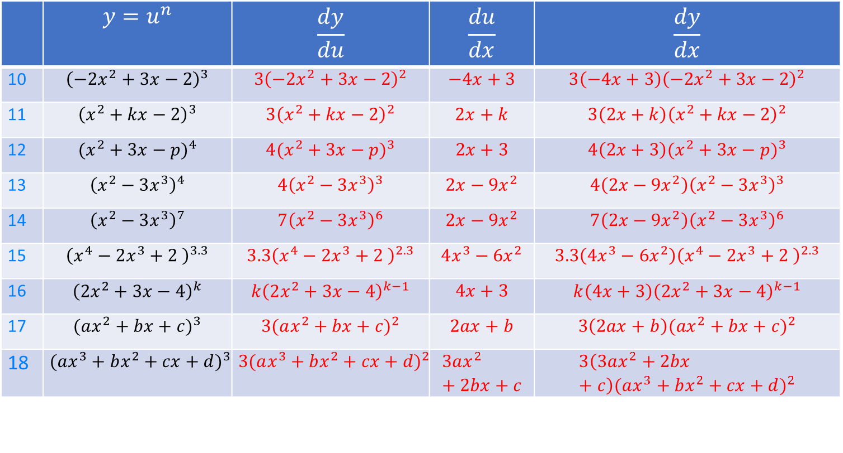
 | $$y=u^{n}$$ | $$\frac{dy}{du}$$ | $$\frac{du}{dx}$$ | $$\frac{dy}{dx}$$
10 | $${\left(−2x^{2}+3x−2\right)}^{3}$$ | $$3{\left(−2x^{2}+3x−2\right)}^{2}$$ | $$−4x+3$$ | $$3\left(−4x+3\right){\left(−2x^{2}+3x−2\right)}^{2}$$
11 | $${\left(x^{2}+kx−2\right)}^{3}$$ | $$3{\left(x^{2}+kx−2\right)}^{2}$$ | $$2x+k$$ | $$3\left(2x+k\right){\left(x^{2}+kx−2\right)}^{2}$$
12 | $${(x^{2}+3x−p)}^{4}$$ | $$4{(x^{2}+3x−p)}^{3}$$ | $$2x+3$$ | $$4{\left(2x+3\right)(x^{2}+3x−p)}^{3}$$
13 | $${\left(x^{2}−3x^{3}\right)}^{4}$$ | $$4{\left(x^{2}−3x^{3}\right)}^{3}$$ | $$2x−{9x}^{2}$$ | $$4\left(2x−{9x}^{2}\right){\left(x^{2}−3x^{3}\right)}^{3}$$
14 | $${\left(x^{2}−3x^{3}\right)}^{7}$$ | $$7{\left(x^{2}−3x^{3}\right)}^{6}$$ | $$2x−{9x}^{2}$$ | $$7\left(2x−{9x}^{2}\right){\left(x^{2}−3x^{3}\right)}^{6}$$
15 | $${\left(x^{4}−2x^{3}+2 \right)}^{3.3}$$ | $$3.3{\left(x^{4}−2x^{3}+2 \right)}^{2.3}$$ | $$4x^{3}−{6x}^{2}$$ | $$3.3\left(4x^{3}−{6x}^{2}\right){\left(x^{4}−2x^{3}+2 \right)}^{2.3}$$
16 | $${\left(2x^{2}+3x−4\right)}^{k}$$ | $$k{\left(2x^{2}+3x−4\right)}^{k−1}$$ | $$4x+3$$ | $$k{\left(4x+3\right)\left(2x^{2}+3x−4\right)}^{k−1}$$
17 | $${(ax^{2}+bx+c)}^{3}$$ | $$3{(ax^{2}+bx+c)}^{2}$$ | $$2ax+b$$ | $$3{\left(2ax+b\right)(ax^{2}+bx+c)}^{2}$$
18 | $${(ax^{3}+bx^{2}+cx+d)}^{3}$$ | $$3{(ax^{3}+bx^{2}+cx+d)}^{2}$$ | $$3ax^{2}+2bx+c$$ | $$3\left(3ax^{2}+2bx+c\right){(ax^{3}+bx^{2}+cx+d)}^{2}$$

