Slide 1
Chain Rule
Silent
Teacher
Intelligent Practice
Narration
Your Turn
$$\frac{d}{dx}{\left(3x^{2}−2x+1\right)}^{4}$$
$$\frac{d}{dx}{\left(3x^{4}−1\right)}^{\frac{3}{2}}$$
Practice

Slide 2
Worked Example
Your Turn
Find $\frac{dy}{dx}$ of ${\left(x+2\right)}^{2}$
Find $\frac{dy}{dx}$ of ${\left(x+5\right)}^{2}$
Differentiate ${\left(2x+2\right)}^{4}$
Differentiate ${\left(x^{2}+2x\right)}^{4}$
@DrChris_Baker

Slide 3
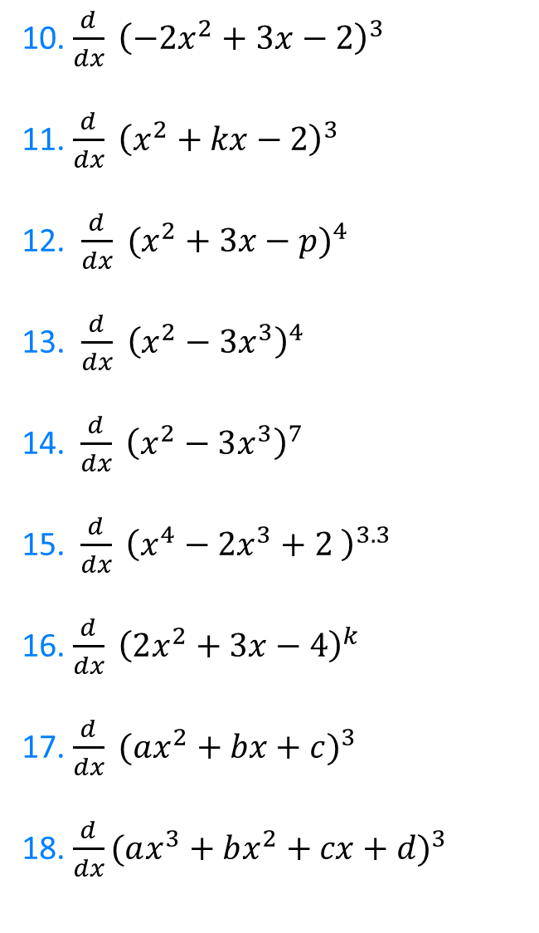

1. $\frac{d}{dx} {\left(3x+5\right)}^{3}$
2. $\frac{d}{dx} {\left(5x−2\right)}^{3}$
3. $\frac{d}{dx} {\left(2x+3\right)}^{3}$
4. $\frac{d}{dx} {\left(2x^{2}+3x\right)}^{3}$
5. $\frac{d}{dx} {\left(2x^{2}+3x−2\right)}^{3}$
6.$\frac{d}{dx} {\left(2x^{2}+3x−2\right)}^{5}$
7. $\frac{d}{dx} {\left(2x^{2}+3x−2\right)}^{\frac{5}{2}}$
8. $\frac{d}{dt} {\left(2t^{2}+3t−2\right)}^{\frac{5}{2}}$
9. $\frac{d}{dx} {\left(2x^{2}−3x+2\right)}^{\frac{5}{2}}$
10. $\frac{d}{dx} {\left(−2x^{2}+3x−2\right)}^{3}$
11. $\frac{d}{dx} {\left(x^{2}+kx−2\right)}^{3}$
12. $\frac{d}{dx} {(x^{2}+3x−p)}^{4}$
13. $\frac{d}{dx} {\left(x^{2}−3x^{3}\right)}^{4}$
14. $\frac{d}{dx} {\left(x^{2}−3x^{3}\right)}^{7}$
15.$\frac{d}{dx} {\left(x^{4}−2x^{3}+2 \right)}^{3.3}$
16. $\frac{d}{dx} {\left(2x^{2}+3x−4\right)}^{k}$
17. $\frac{d}{dx} {(ax^{2}+bx+c)}^{3}$
18. $\frac{d}{dx}{(ax^{3}+bx^{2}+cx+d)}^{3}$
@DrChris_Baker

Slide 4

1. $\frac{d}{dx} {\left(3x+5\right)}^{3}$
2. $\frac{d}{dx} {\left(5x−2\right)}^{3}$
3. $\frac{d}{dx} {\left(2x+3\right)}^{3}$
4. $\frac{d}{dx} {\left(2x^{2}+3x\right)}^{3}$
5. $\frac{d}{dx} {\left(2x^{2}+3x−2\right)}^{3}$
6.$\frac{d}{dx} {\left(2x^{2}+3x−2\right)}^{5}$
7. $\frac{d}{dx} {\left(2x^{2}+3x−2\right)}^{\frac{5}{2}}$
8. $\frac{d}{dt} {\left(2t^{2}+3t−2\right)}^{\frac{5}{2}}$
9. $\frac{d}{dx} {\left(2x^{2}−3x+2\right)}^{\frac{5}{2}}$
$$=9{\left(3x+5\right)}^{2}$$
$$=15{\left(5x−2\right)}^{2}$$
$$=6{\left(2x+3\right)}^{2}$$
$$=3\left(4x+3\right){\left(2x^{2}+3x\right)}^{2}$$
$=3\left(4x+3\right){\left(2x^{2}+3x\right)}^{2}$
$$=5\left(4x+3\right){\left(2x^{2}+3x−2\right)}^{4}$$
$$=\frac{5}{2}\left(4x+3\right){\left(2x^{2}+3x−2\right)}^{\frac{3}{2}}$$
$$=\frac{5}{2}\left(4t+3\right){\left(2t^{2}+3t−2\right)}^{\frac{3}{2}}$$
$$=\frac{5}{2}\left(4x−3\right){\left(2x^{2}−3x−2\right)}^{\frac{3}{2}}$$
@DrChris_Baker

Slide 5
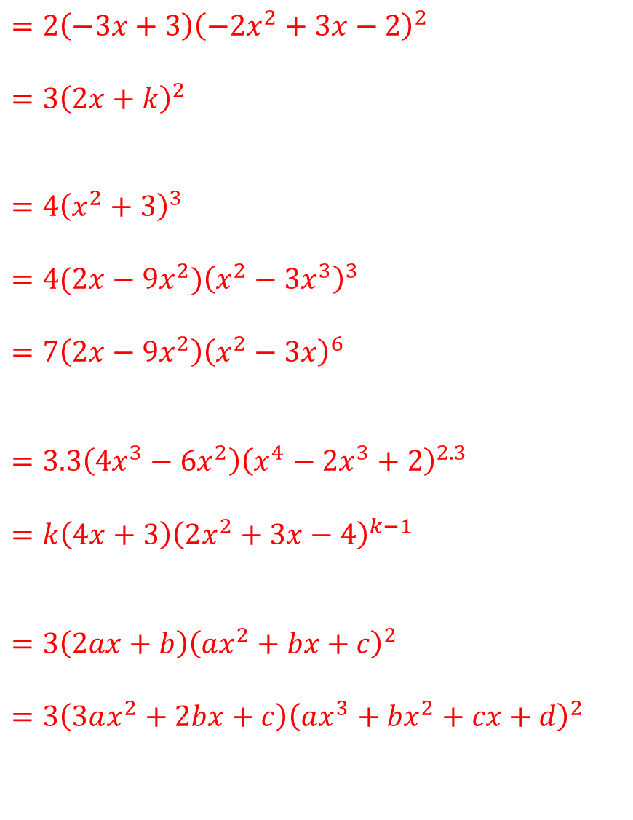
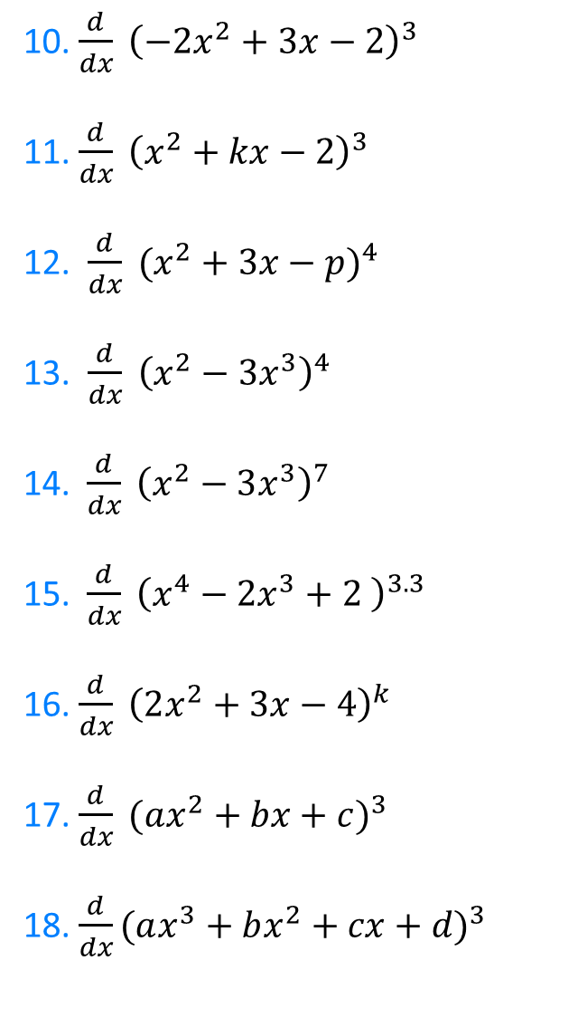
10. $\frac{d}{dx} {\left(−2x^{2}+3x−2\right)}^{3}$
11. $\frac{d}{dx} {\left(x^{2}+kx−2\right)}^{3}$
12. $\frac{d}{dx} {(x^{2}+3x−p)}^{4}$
13. $\frac{d}{dx} {\left(x^{2}−3x^{3}\right)}^{4}$
14. $\frac{d}{dx} {\left(x^{2}−3x^{3}\right)}^{7}$
15.$\frac{d}{dx} {\left(x^{4}−2x^{3}+2 \right)}^{3.3}$
16. $\frac{d}{dx} {\left(2x^{2}+3x−4\right)}^{k}$
17. $\frac{d}{dx} {(ax^{2}+bx+c)}^{3}$
18. $\frac{d}{dx}{(ax^{3}+bx^{2}+cx+d)}^{3}$
$$=2\left(−3x+3\right){\left(−2x^{2}+3x−2\right)}^{2}$$
$$=3{\left(2x+k\right)}^{2}$$
$$=4{\left(x^{2}+3\right)}^{3}$$
$$=4(2x−9x^{2}){\left(x^{2}−3x^{3}\right)}^{3}$$
$=7\left(2x−9x^{2}\right){\left(x^{2}−3x\right)}^{6}$
$$=3.3\left(4x^{3}−6x^{2}\right){\left(x^{4}−2x^{3}+2\right)}^{2.3}$$
$$=k\left(4x+3\right){\left(2x^{2}+3x−4\right)}^{k−1}$$
$$=3\left(2ax+b\right){\left(ax^{2}+bx+c\right)}^{2}$$
$$=3\left(3ax^{2}+2bx+c\right){\left(ax^{3}+bx^{2}+cx+d\right)}^{2}$$
@DrChris_Baker

