Slide 1
Complex Numbers Addition and Subtraction
Silent
Teacher
Intelligent Practice
Narration
Your Turn
$$\left(3+2i\right)+(5−i)$$
$$\left(−3+9i\right)−(−2+8i)$$
$$\left(−3−9i\right)−(−2−8i)$$
Practice

Slide 2
Worked Example
Your Turn
$$(2+3i)+(4+2i)$$
$$(6+2i)+(8−i)$$
$$\left(2−3i\right)−(4−2i)$$
$$\left(−5−6i\right)−(3−3i)$$
@DrChris_Baker

Slide 3
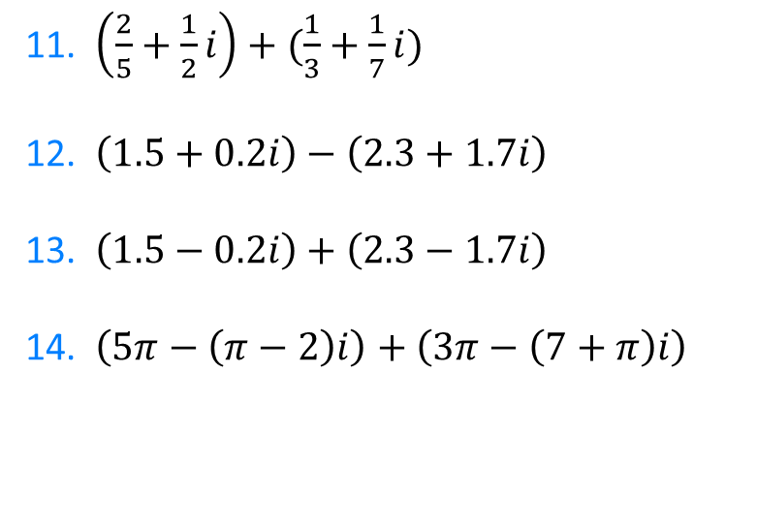
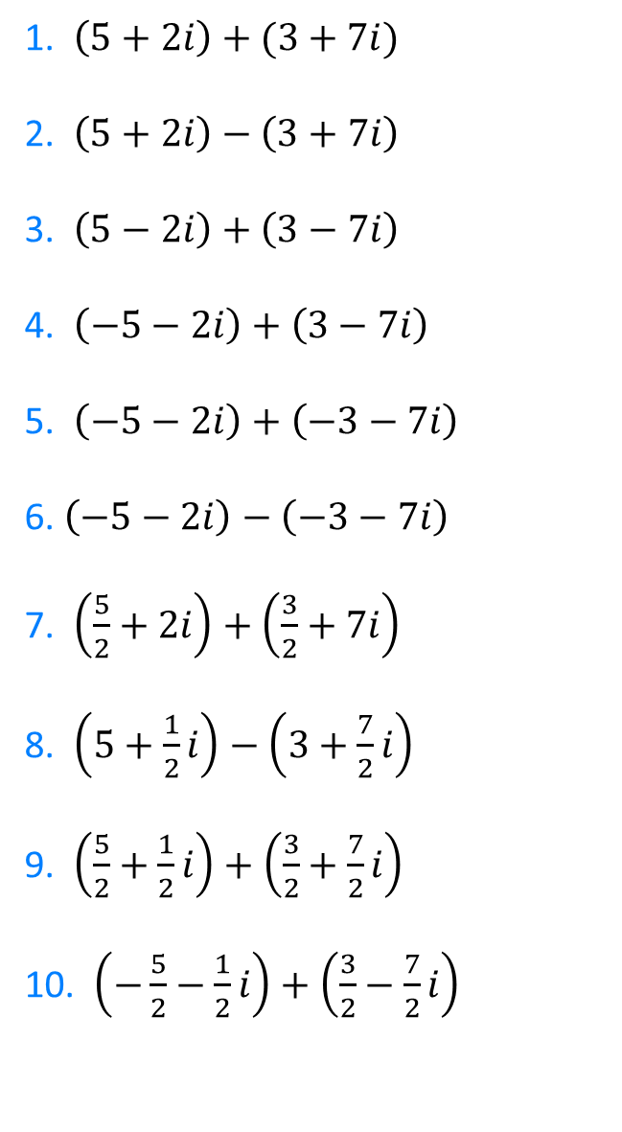
1. $\left(5+2i\right)+(3+7i)$
2. $\left(5+2i\right)−\left(3+7i\right)$
3. $\left(5−2i\right)+\left(3−7i\right)$
4. $\left(−5−2i\right)+\left(3−7i\right)$
5. $\left(−5−2i\right)+\left(−3−7i\right)$
6. $\left(−5−2i\right)−\left(−3−7i\right)$
7. $\left(\frac{5}{2}+2i\right)+\left(\frac{3}{2}+7i\right)$
8. $\left(5+\frac{1}{2}i\right)−\left(3+\frac{7}{2}i\right)$
9. $\left(\frac{5}{2}+\frac{1}{2}i\right)+\left(\frac{3}{2}+\frac{7}{2}i\right)$
10. $\left(−\frac{5}{2}−\frac{1}{2}i\right)+\left(\frac{3}{2}−\frac{7}{2}i\right)$
11. $\left(\frac{2}{5}+\frac{1}{2}i\right)+(\frac{1}{3}+\frac{1}{7}i)$
12. $\left(1.5+0.2i\right)−\left(2.3+1.7i\right)$
13. $\left(1.5−0.2i\right)+\left(2.3−1.7i\right)$
14. $\left(5π−\left(π−2\right)i\right)+\left(3π−\left(7+π\right)i\right)$
@DrChris_Baker

Slide 4

1. $\left(5+2i\right)+(3+7i)$
2. $\left(5+2i\right)−\left(3+7i\right)$
3. $\left(5−2i\right)+\left(3−7i\right)$
4. $\left(−5−2i\right)+\left(3−7i\right)$
5. $\left(−5−2i\right)+\left(−3−7i\right)$
6. $\left(−5−2i\right)−\left(−3−7i\right)$
7. $\left(\frac{5}{2}+2i\right)+\left(\frac{3}{2}+7i\right)$
8. $\left(5+\frac{1}{2}i\right)−\left(3+\frac{7}{2}i\right)$
9. $\left(\frac{5}{2}+\frac{1}{2}i\right)+\left(\frac{3}{2}+\frac{7}{2}i\right)$
10. $\left(−\frac{5}{2}−\frac{1}{2}i\right)+\left(\frac{3}{2}−\frac{7}{2}i\right)$
$$=8+9i$$
$$=2−5i$$
$$=8−9i$$
$$=−2−9i$$
$$=−8−9i$$
$$=−2+5i$$
$$=4+9i$$
$$=2+4i$$
$$=4+4i$$
$$=−1−3i$$
11. $\left(\frac{2}{5}+\frac{1}{2}i\right)+(\frac{1}{3}+\frac{1}{7}i)$
12. $\left(1.5+0.2i\right)−\left(2.3+1.7i\right)$
13. $\left(1.5−0.2i\right)+\left(2.3−1.7i\right)$
14. $\left(5π−\left(π−2\right)i\right)+\left(3π−\left(7+π\right)i\right)$
$$=\frac{11}{15}+\frac{9}{14}i$$
$$=3.8−1.5i$$
$$=3.8−1.9i$$
$$=8π−\left(2π+5\right)i$$
@DrChris_Baker

