Slide 1
Complex Numbers Division
Silent
Teacher
Intelligent Practice
Narration
Your Turn
$$\frac{2−i}{3+2i}$$
$$\frac{3−2i}{5+3i}$$
Practice

Slide 2
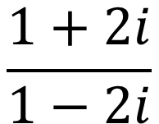
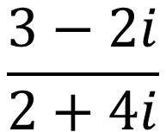
Worked Example
Your Turn
$$\frac{1+2i}{1−2i}$$
$$\frac{3−2i}{2+4i}$$
@DrChris_Baker

Slide 3

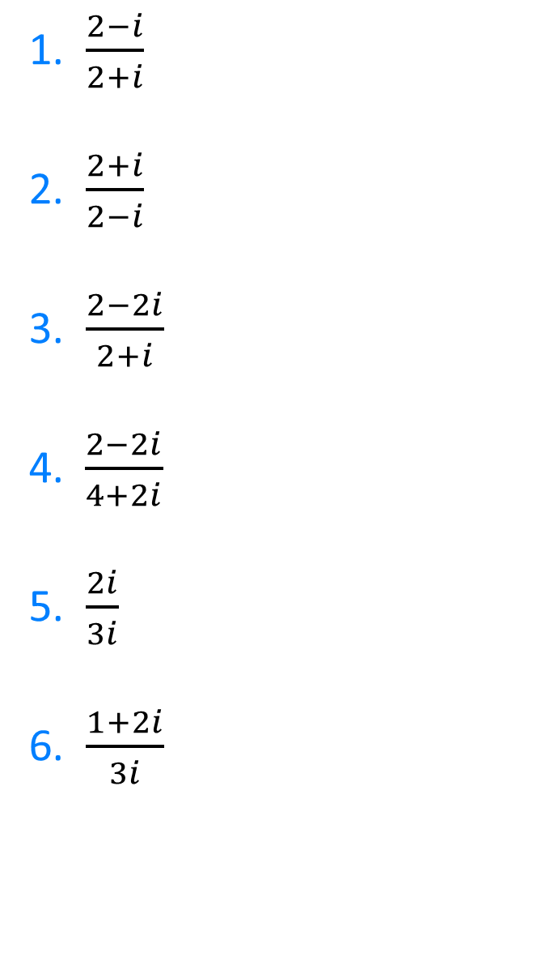
1. $\frac{2−i}{2+i}$
2. $\frac{2+i}{2−i}$
3. $\frac{2−2i}{2+i}$
4.$\frac{2−2i}{4+2i}$
5. $\frac{2i}{3i}$
6. $\frac{1+2i}{3i}$
7. $\frac{1+2i}{1+3i}$
8. $\frac{−1+2i}{−1+3i}$
9. $\frac{−1−2i}{−1−3i}$
10.$\frac{0.5−i}{0.25+0.5i}$
11 $\frac{\frac{1}{2}−\frac{1}{4}i}{\frac{1}{4}+\frac{1}{7}i}$
12. $\frac{\frac{1}{4}+\frac{1}{7}i}{\frac{1}{2}−\frac{1}{4}i}$
@DrChris_Baker

Slide 4
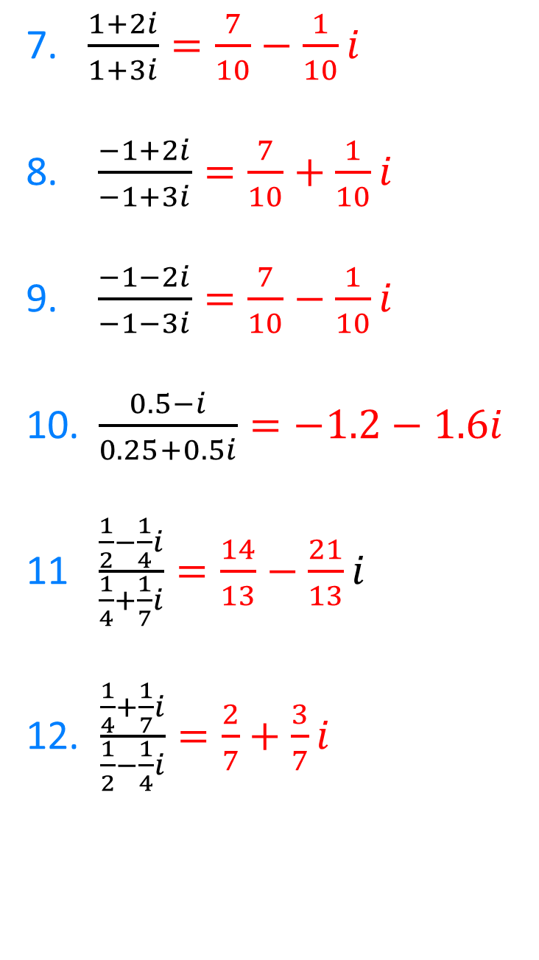

1. $\frac{2−i}{2+i}=\frac{3}{5}−\frac{4}{5}i$
2. $\frac{2+i}{2−i}=\frac{3}{5}+\frac{4}{5}i$
3. $\frac{2−2i}{2+i}=\frac{2}{5}−\frac{6}{5}i$
4.$\frac{2−2i}{4+2i}=\frac{1}{5}−\frac{3}{5}i$
5. $\frac{2i}{3i}=\frac{2}{3}$
6. $\frac{1+2i}{3i}=−\frac{2}{3}+\frac{1}{3}i$
7. $\frac{1+2i}{1+3i}=\frac{7}{10}−\frac{1}{10}i$
8. $\frac{−1+2i}{−1+3i}=\frac{7}{10}+\frac{1}{10}i$
9. $\frac{−1−2i}{−1−3i}=\frac{7}{10}−\frac{1}{10}i$
10.$\frac{0.5−i}{0.25+0.5i}=−1.2−1.6i$
11 $\frac{\frac{1}{2}−\frac{1}{4}i}{\frac{1}{4}+\frac{1}{7}i}=\frac{14}{13}−\frac{21}{13}i$
12. $\frac{\frac{1}{4}+\frac{1}{7}i}{\frac{1}{2}−\frac{1}{4}i}=\frac{2}{7}+\frac{3}{7}i$
@DrChris_Baker

