Slide 1
Complex Numbers Multiplication
Silent
Teacher
Intelligent Practice
Narration
Your Turn
$$\left(3+2i\right)×(5−i)$$
$$\left(−3+9i\right)×(−2+8i)$$
$$\left(−3−9i\right)×(−2−8i)$$
Practice

Slide 2
Worked Example
Your Turn
$$\left(2+3i\right)×(4+2i)$$
$$\left(6+2i\right)×(8−3i)$$
$$\left(2−3i\right)×(4−2i)$$
$$\left(−6−2i\right)×(−8−3i)$$
@DrChris_Baker

Slide 3
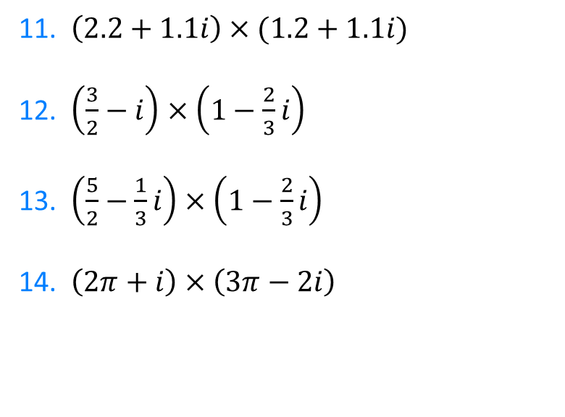
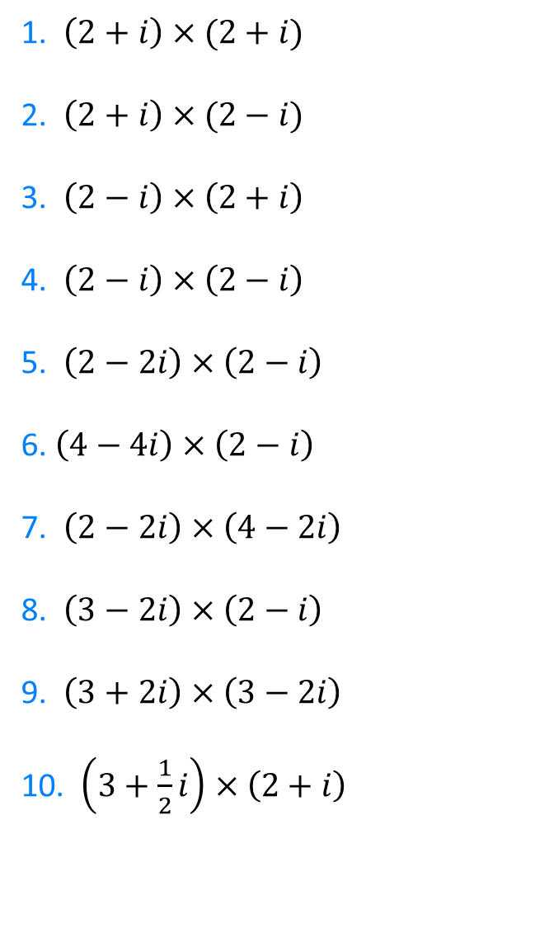
1. $\left(2+i\right)×(2+i)$
2. $\left(2+i\right)×(2−i)$
3. $\left(2−i\right)×\left(2+i\right)$
4. $\left(2−i\right)×\left(2−i\right)$
5. $\left(2−2i\right)×\left(2−i\right)$
6. $\left(4−4i\right)×\left(2−i\right)$
7. $\left(2−2i\right)×\left(4−2i\right)$
8. $\left(3−2i\right)×\left(2−i\right)$
9. $\left(3+2i\right)×\left(3−2i\right)$
10. $\left(3+\frac{1}{2}i\right)×\left(2+i\right)$
11. $\left(2.2+1.1i\right)×(1.2+1.1i)$
12. $\left(\frac{3}{2}−i\right)×\left(1−\frac{2}{3}i\right)$
13. $\left(\frac{5}{2}−\frac{1}{3}i\right)×\left(1−\frac{2}{3}i\right)$
14. $\left(2π+i\right)×\left(3π−2i\right)$
@DrChris_Baker

Slide 4
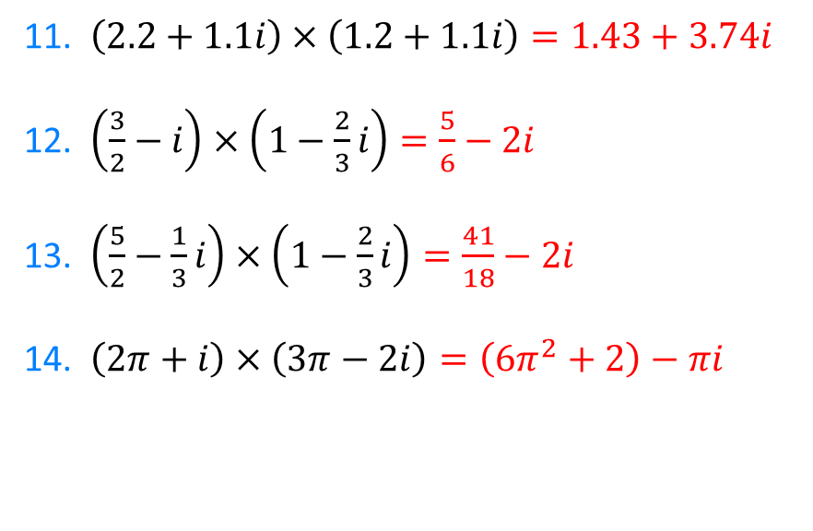
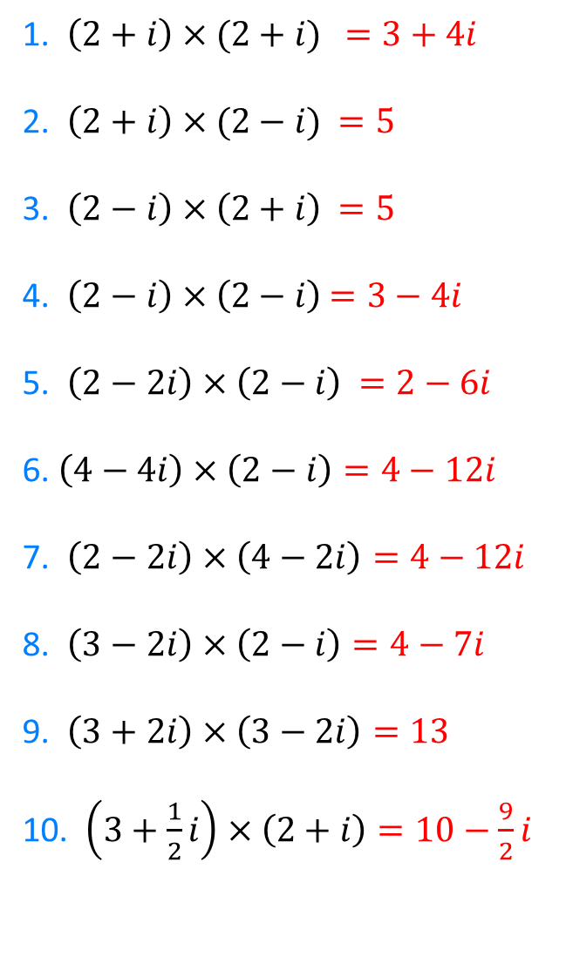
1. $\left(2+i\right)×(2+i)$ $=3+4i$
2. $\left(2+i\right)×(2−i)$ $=5$
3. $\left(2−i\right)×\left(2+i\right)$ $=5$
4. $\left(2−i\right)×\left(2−i\right)$ $=3−4i$
5. $\left(2−2i\right)×\left(2−i\right)$ $=2−6i$
6. $\left(4−4i\right)×\left(2−i\right)=4−12i$
7. $\left(2−2i\right)×\left(4−2i\right)=4−12i$
8. $\left(3−2i\right)×\left(2−i\right)=4−7i$
9. $\left(3+2i\right)×\left(3−2i\right)=13$
10. $\left(3+\frac{1}{2}i\right)×\left(2+i\right)=10−\frac{9}{2}i$
11. $\left(2.2+1.1i\right)×\left(1.2+1.1i\right)=1.43+3.74i$
12. $\left(\frac{3}{2}−i\right)×\left(1−\frac{2}{3}i\right)=\frac{5}{6}−2i$
13. $\left(\frac{5}{2}−\frac{1}{3}i\right)×\left(1−\frac{2}{3}i\right)=\frac{41}{18}−2i$
14. $\left(2π+i\right)×\left(3π−2i\right)=\left(6π^{2}+2\right)−πi$
@DrChris_Baker

