Slide 1
Integrating hyperbolic functions
Silent
Teacher
Intelligent Practice
Narration
Your Turn
$$\int{sinhxcosh^{2}x dx=}$$
$$\int{sinh^{3}xcosh^{2}x dx=}$$
$$\int{\sinh^{3}x dx=}$$
Practice

Slide 2
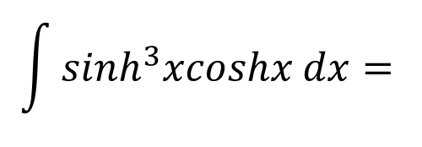
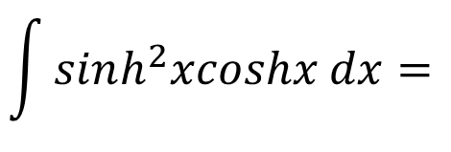
Worked Example
Your Turn
$$\int{sinh^{2}xcoshx dx=}$$
$$\int{sinh^{3}xcoshx dx=}$$
@billyads_47
Notes:
u=sinhx for both

Slide 3
Worked Example
Your Turn
$$\int{sinh^{2}xcosh^{3}x dx=}$$
$$\int{sinh^{3}xcosh^{2}x dx=}$$
@billyads_47
Notes:
Choose appropriate substitutions to leave (coshx)^2 or (sinhx)^2, then rearrange (coshx)^2 – (sinhx)^2 = 1
u = sinhx worked example, u = coshx for your turn

Slide 4
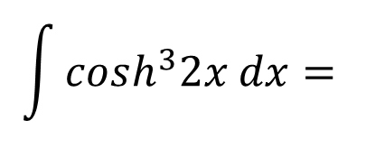
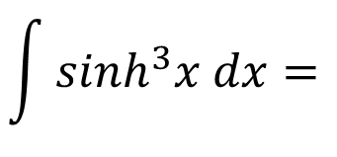
Worked Example
Your Turn
$$\int{sinh^{3}x dx=}$$
$$\int{cosh^{3}2x dx=}$$
@billyads_47
Notes:
Re-write as sinhx(sinhx)^2. Substitute (sinhx)^2 = (cosh)^2 – 1. Expand. Use integration by sub on first term, applying previous strategy.

Slide 5
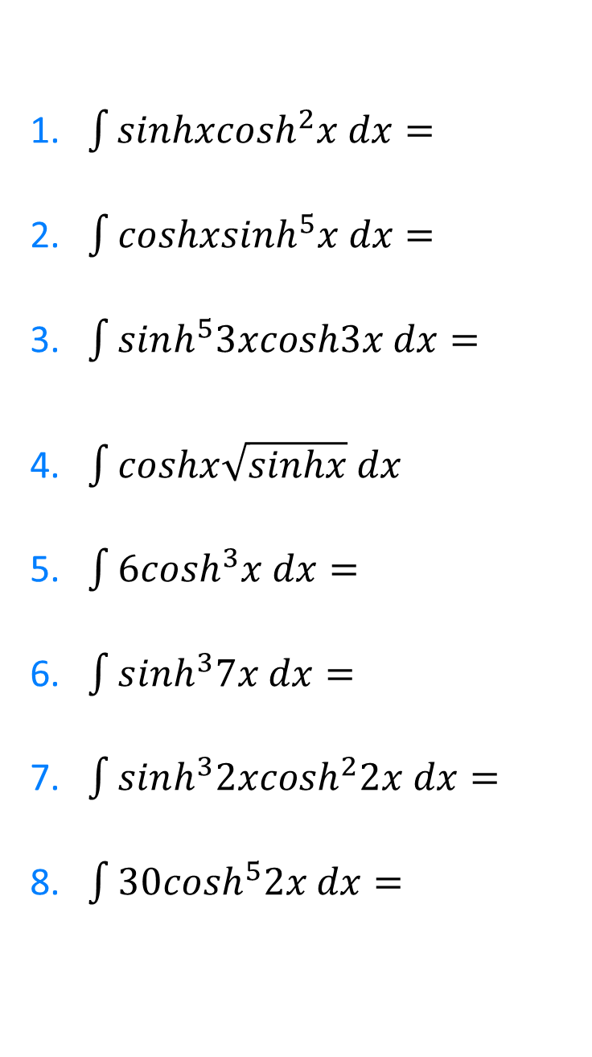
1.$\int{sinhxcosh^{2}x dx}=$
2. $\int{coshxsinh^{5}x dx}=$
3. $\int{sinh^{5}3xcosh3x dx}=$
4. $\int{coshx\sqrt{sinhx} dx}$
5. $\int{6cosh^{3}x dx}=$
6. $\int{s{inh}^{3}7x dx}=$
7. $\int{sinh^{3}2xcosh^{2}2x dx}=$
8. $\int{30cosh^{5}2x dx}=$
@billyads_47

Slide 6
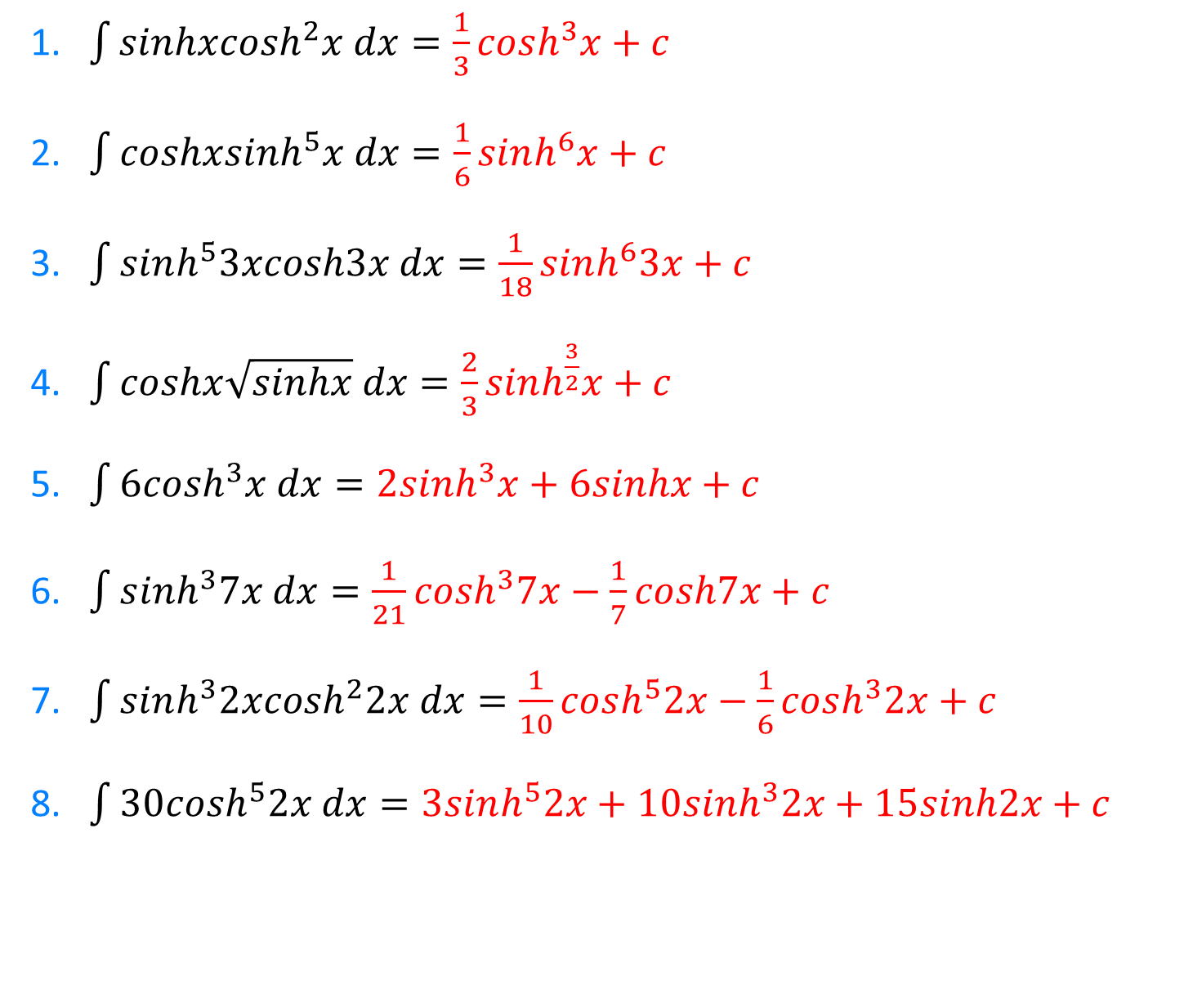
1.$\int{sinhxcosh^{2}x dx}=\frac{1}{3}cosh^{3}x+c$
2. $\int{coshxsinh^{5}x dx}=\frac{1}{6}sinh^{6}x+c$
3. $\int{sinh^{5}3xcosh3x dx}=\frac{1}{18}sinh^{6}3x+c$
4. $\int{coshx\sqrt{sinhx} dx}=\frac{2}{3}sinh^{\frac{3}{2}}x+c$
5. $\int{6cosh^{3}x dx}=2sinh^{3}x+6sinhx+c$
6. $\int{s{inh}^{3}7x dx}=\frac{1}{21}cosh^{3}7x−\frac{1}{7}cosh7x+c$
7. $\int{sinh^{3}2xcosh^{2}2x dx}=\frac{1}{10}cosh^{5}2x−\frac{1}{6}cosh^{3}2x+c$
8. $\int{30cosh^{5}2x dx}=3sinh^{5}2x+10sinh^{3}2x+15sinh2x+c$
@billyads_47

