Slide 1
Straight line Graphs: Fill in the gaps (alternate version)
Silent
Teacher
Intelligent Practice
Narration
Your Turn
Practice

Slide 2
Worked Example
Your Turn
$$y=5x+2$$
$$y=5x+15$$
Gradient:
$y$ intercept:
when $x$ = 0, $y$=
when $x$ = 1, $y$=
when $x$ = 2, $y$=
A parallel line:
Parallel which goes through (0,7):
Value of $x$ when$y$ = 0:
Gradient:
$y$ intercept:
when $x$ = 0, $y$=
when $x$ = 1, $y$=
when $x$ = 2, $y$=
A parallel line:
Parallel which goes through (0,7):
Value of $x$ when$y$ = 0:

Slide 3
Worked Example
Your Turn
$$y=3x+6$$
$$y=6x+3$$
• Gradient:
$\text{•} y$ intercept:
• when $x$ = 0, $y$=
• when $x$ = 1, $y$=
• when $x$ = 2, $y$=
• A parallel line:
• Parallel which goes through (0,7):
• Value of $x$ when$y$ = 0:
• Gradient:
$\text{•}y$ intercept:
• when $x$ = 0, $y$=
• when $x$ = 1, $y$=
• when $x$ = 2, $y$=
• A parallel line:
• Parallel which goes through (0,7):
• Value of $x$ when$y$ = 0:

Slide 4
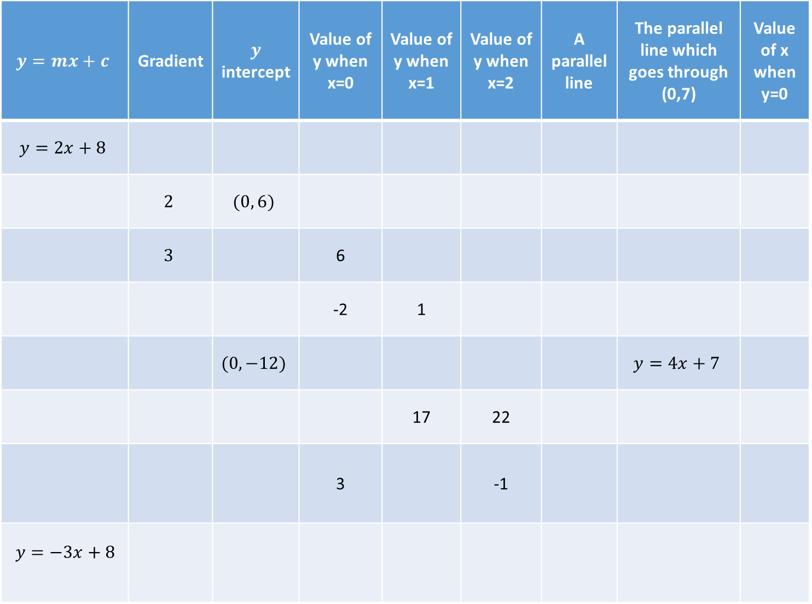
$$y=mx+c$$ | Gradient | $y$ intercept | Value of y when x=0 | Value of y when x=1 | Value of y when x=2 | A parallel line | The parallel line which goes through (0,7) | Value of x when y=0
$$y=2x+8$$
 | $$2$$ | $$(0, 6)$$
 | $$3$$ |  | 6
 |  |  | -2 | 1
 |  | $$(0, −12)$$ |  |  |  |  | $$y=4x+7$$
 |  |  |  | 17 | 22
 |  |  | 3 |  | -1
$$y=−3x+8$$

Slide 5
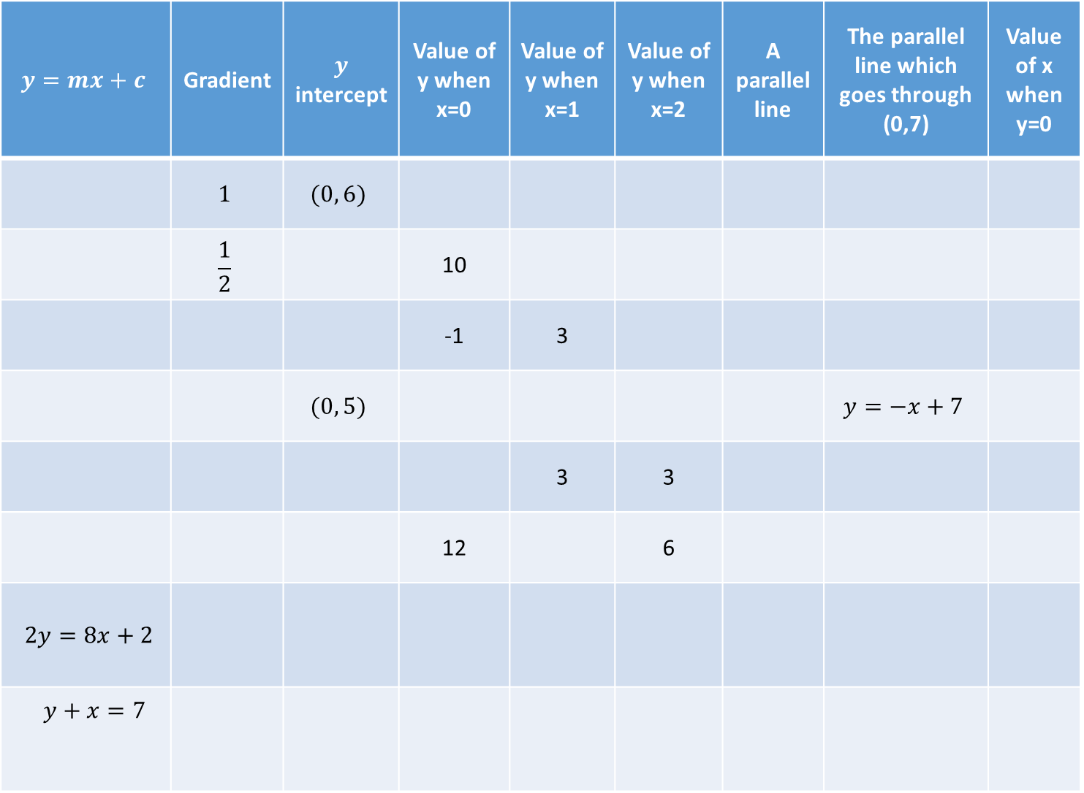
$$y=mx+c$$ | Gradient | $y$ intercept | Value of y when x=0 | Value of y when x=1 | Value of y when x=2 | A parallel line | The parallel line which goes through (0,7) | Value of x when y=0
 | $$1$$ | $$(0, 6)$$
 | $$\frac{1}{2}$$ |  | 10
 |  |  | -1 | 3
 |  | $$(0, 5)$$ |  |  |  |  | $$y=−x+7$$
 |  |  |  | 3 | 3
 |  |  | 12 |  | 6
$2y=8x+2$
$$y+x=7$$

Slide 6
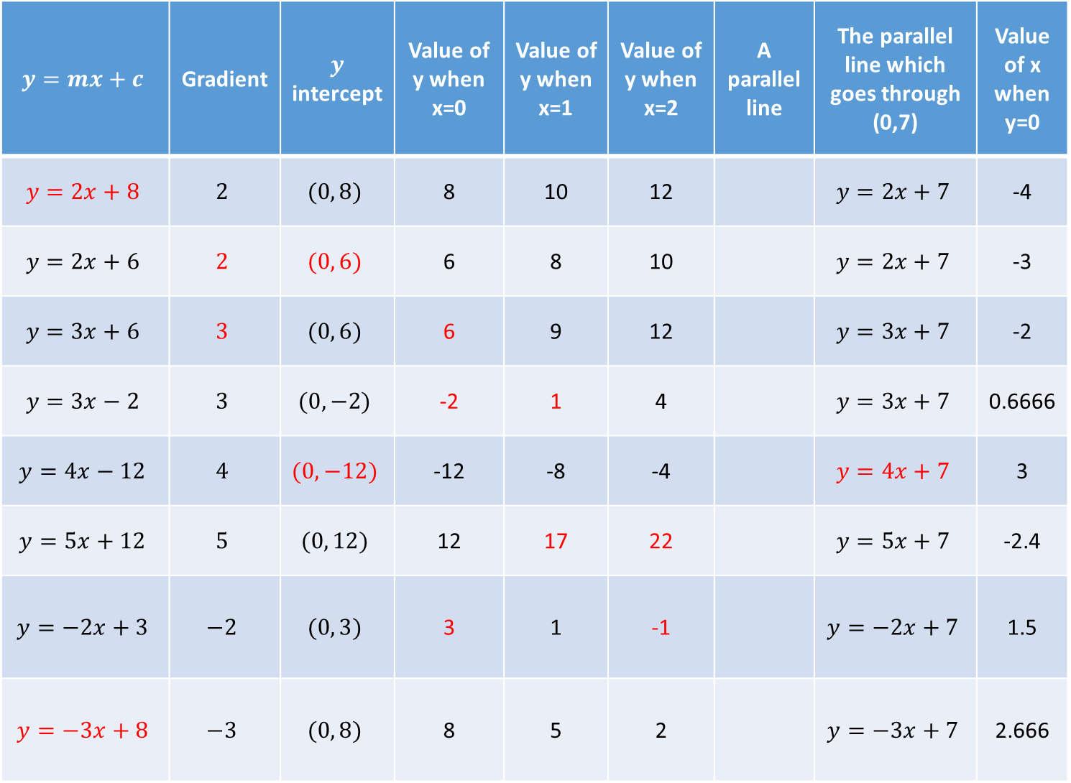
$$y=mx+c$$ | Gradient | $y$ intercept | Value of y when x=0 | Value of y when x=1 | Value of y when x=2 | A parallel line | The parallel line which goes through (0,7) | Value of x when y=0
$$y=2x+8$$ | $$2$$ | $$(0, 8)$$ | 8 | 10 | 12 |  | $$y=2x+7$$ | -4
$$y=2x+6$$ | $$2$$ | $$(0, 6)$$ | 6 | 8 | 10 |  | $$y=2x+7$$ | -3
$$y=3x+6$$ | $$3$$ | $$(0, 6)$$ | 6 | 9 | 12 |  | $$y=3x+7$$ | -2
$$y=3x−2$$ | $$3$$ | $$(0, −2)$$ | -2 | 1 | 4 |  | $$y=3x+7$$ | 0.6666
$$y=4x−12$$ | $$4$$ | $$(0, −12)$$ | -12 | -8 | -4 |  | $$y=4x+7$$ | 3
$$y=5x+12$$ | $$5$$ | $$(0, 12)$$ | 12 | 17 | 22 |  | $$y=5x+7$$ | -2.4
$$y=−2x+3$$ | $$−2$$ | $$(0, 3)$$ | 3 | 1 | -1 |  | $$y=−2x+7$$ | 1.5
$$y=−3x+8$$ | $$−3$$ | $$(0, 8)$$ | 8 | 5 | 2 |  | $$y=−3x+7$$ | 2.666

Slide 7
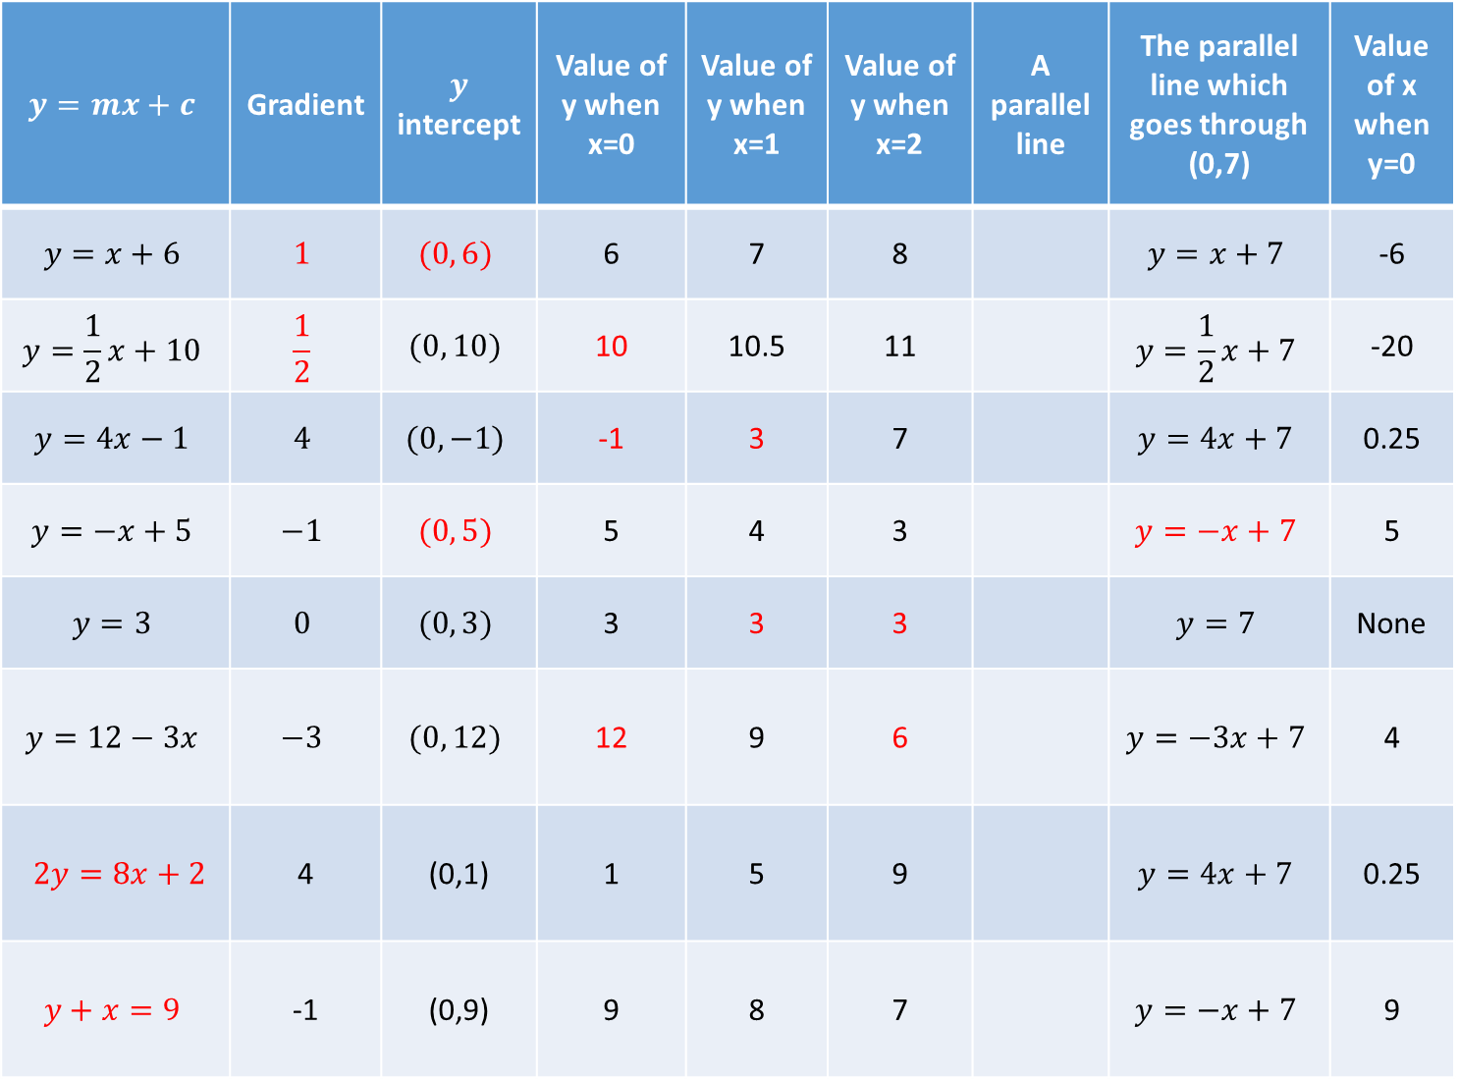
$$y=mx+c$$ | Gradient | $y$ intercept | Value of y when x=0 | Value of y when x=1 | Value of y when x=2 | A parallel line | The parallel line which goes through (0,7) | Value of x when y=0
$$y=x+6$$ | $$1$$ | $$(0, 6)$$ | 6 | 7 | 8 |  | $$y=x+7$$ | -6
$$y=\frac{1}{2}x+10$$ | $$\frac{1}{2}$$ | $$(0, 10)$$ | 10 | 10.5 | 11 |  | $$y=\frac{1}{2}x+7$$ | -20
$$y=4x−1$$ | $$4$$ | $$(0, −1)$$ | -1 | 3 | 7 |  | $$y=4x+7$$ | 0.25
$$y=−x+5$$ | $$−1$$ | $$(0, 5)$$ | 5 | 4 | 3 |  | $$y=−x+7$$ | 5
$$y=3$$ | $$0$$ | $$(0, 3)$$ | 3 | 3 | 3 |  | $$y=7$$ | None
$$y=12−3x$$ | $$−3$$ | $$(0, 12)$$ | 12 | 9 | 6 |  | $$y=−3x+7$$ | 4
$2y=8x+2$ | 4 | (0,1) | 1 | 5 | 9 |  | $$y=4x+7$$ | 0.25
$$y+x=9$$ | -1 | (0,9) | 9 | 8 | 7 |  | $$y=−x+7$$ | 9

