Slide 1
Negative numbers – add & subtract: Fill in the gaps
Silent
Teacher
Intelligent Practice
Narration
Your Turn
$$−3+4=$$
Practice

Slide 2
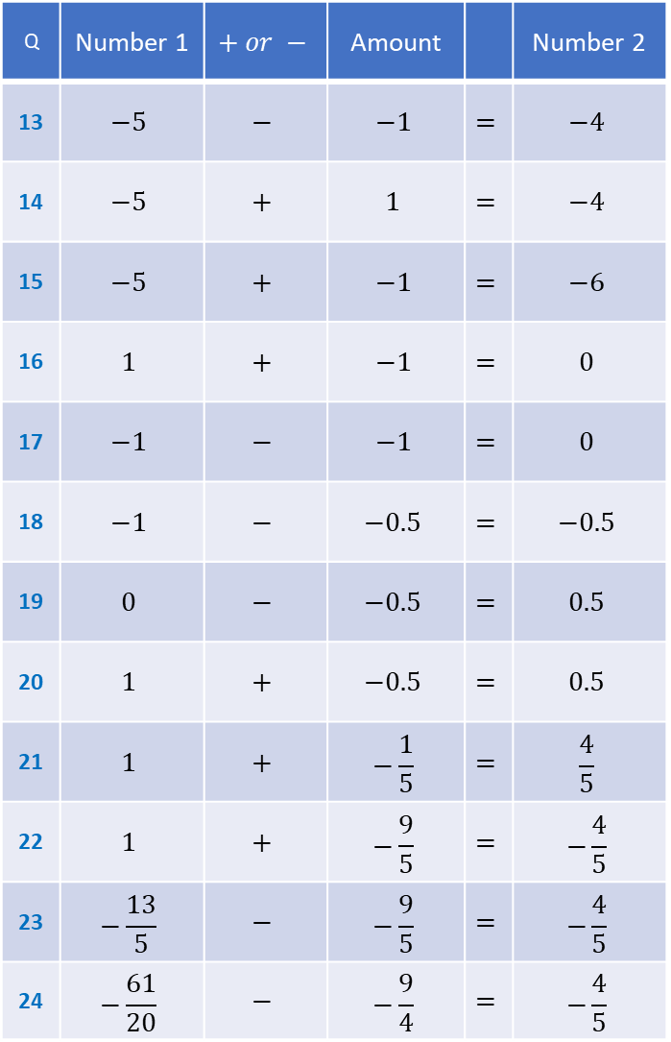
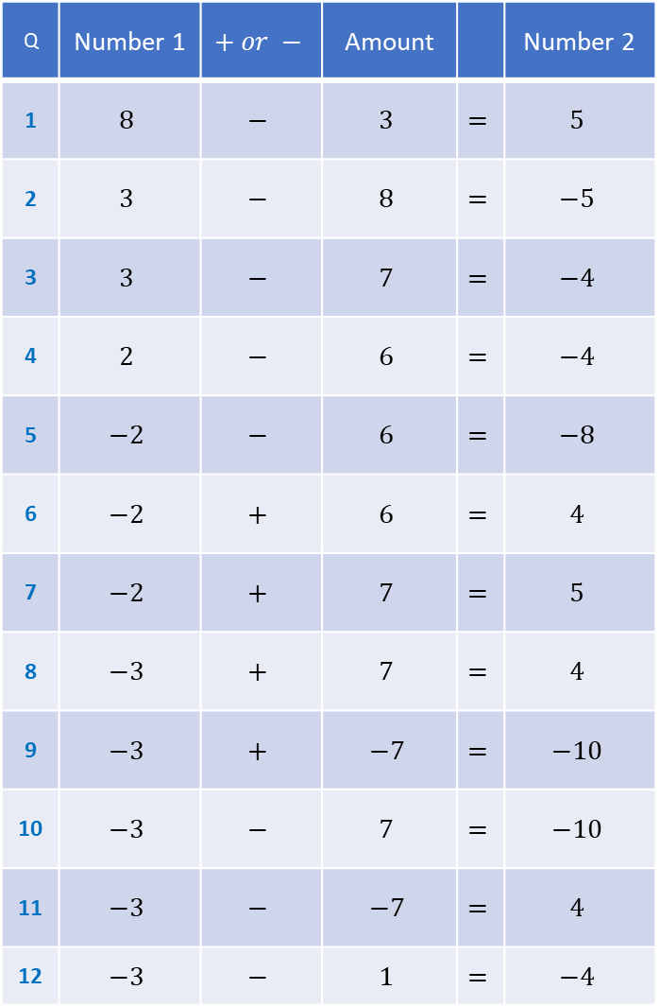
Q | Number 1 | $$+ or −$$ | Amount |  | Number 2
1 | $$8$$ | $$−$$ | $$3$$ | $$=$$ | $$5$$
2 | $$3$$ | $$−$$ | $$8$$ | $$=$$ | $$−5$$
3 | $$3$$ | $$−$$ | $$7$$ | $$=$$ | $$−4$$
4 | $$2$$ | $$−$$ | $$6$$ | $$=$$ | $$−4$$
5 | $$−2$$ | $$−$$ | $$6$$ | $$=$$ | $$−8$$
6 | $$−2$$ | $$+$$ | $$6$$ | $$=$$ | $$4$$
7 | $$−2$$ | $$+$$ | $$7$$ | $$=$$ | $$5$$
8 | $$−3$$ | $$+$$ | $$7$$ | $$=$$ | $$4$$
9 | $$−3$$ | $$+$$ | $$−7$$ | $$=$$ | $$−10$$
10 | $$−3$$ | $$−$$ | $$7$$ | $$=$$ | $$−10$$
11 | $$−3$$ | $$−$$ | $$−7$$ | $$=$$ | $$4$$
12 | $$−3$$ | $$−$$ | $$1$$ | $$=$$ | $$−4$$
Q | Number 1 | $$+ or −$$ | Amount |  | Number 2
13 | $$−5$$ | $$−$$ | $$−1$$ | $$=$$ | $$−4$$
14 | $$−5$$ | $$+$$ | $$1$$ | $$=$$ | $$−4$$
15 | $$−5$$ | $$+$$ | $$−1$$ | $$=$$ | $$−6$$
16 | $$1$$ | $$+$$ | $$−1$$ | $$=$$ | $$0$$
17 | $$−1$$ | $$−$$ | $$−1$$ | $$=$$ | $$0$$
18 | $$−1$$ | $$−$$ | $$−0.5$$ | $$=$$ | $$−0.5$$
19 | $$0$$ | $$−$$ | $$−0.5$$ | $$=$$ | $$0.5$$
20 | $$1$$ | $$+$$ | $$−0.5$$ | $$=$$ | $$0.5$$
21 | $$1$$ | $$+$$ | $$−\frac{1}{5}$$ | $$=$$ | $$\frac{4}{5}$$
22 | $$1$$ | $$+$$ | $$−\frac{9}{5}$$ | $$=$$ | $$−\frac{4}{5}$$
23 | $$−\frac{13}{5}$$ | $$−$$ | $$−\frac{9}{5}$$ | $$=$$ | $$−\frac{4}{5}$$
24 | $$−\frac{61}{20}$$ | $$−$$ | $$−\frac{9}{4}$$ | $$=$$ | $$−\frac{4}{5}$$

Slide 3
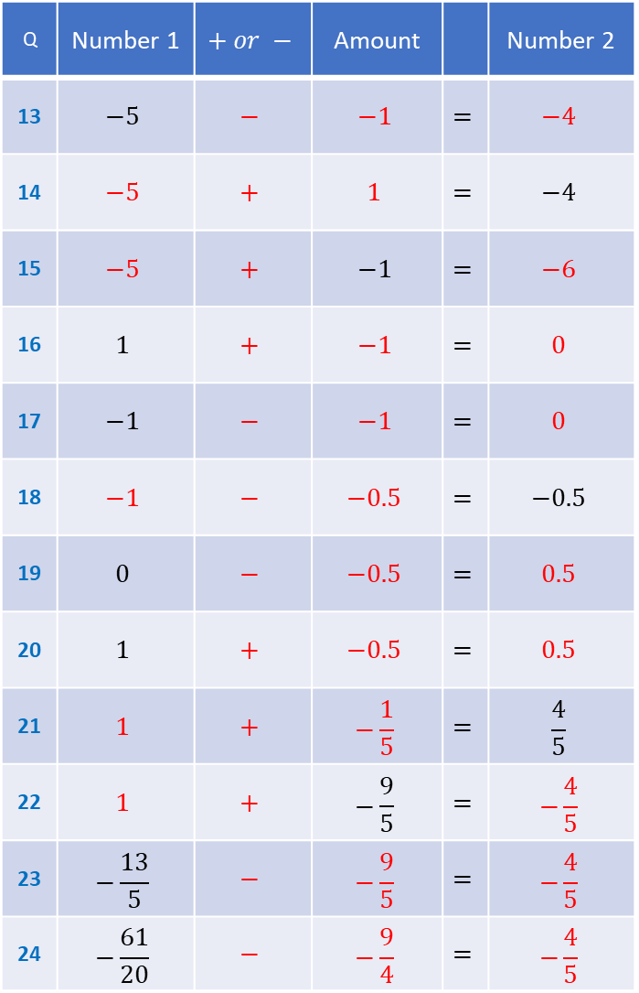
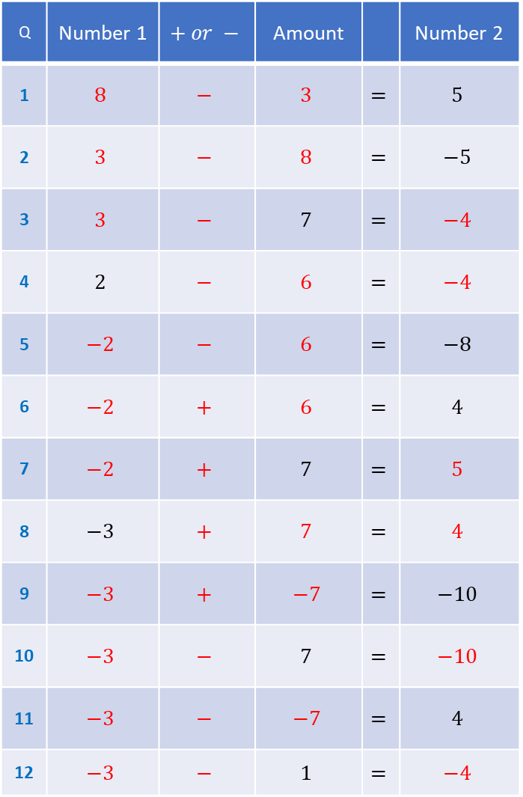
Q | Number 1 | $$+ or −$$ | Amount |  | Number 2
1 | $$8$$ | $$−$$ | $$3$$ | $$=$$ | $$5$$
2 | $$3$$ | $$−$$ | $$8$$ | $$=$$ | $$−5$$
3 | $$3$$ | $$−$$ | $$7$$ | $$=$$ | $$−4$$
4 | $$2$$ | $$−$$ | $$6$$ | $$=$$ | $$−4$$
5 | $$−2$$ | $$−$$ | $$6$$ | $$=$$ | $$−8$$
6 | $$−2$$ | $$+$$ | $$6$$ | $$=$$ | $$4$$
7 | $$−2$$ | $$+$$ | $$7$$ | $$=$$ | $$5$$
8 | $$−3$$ | $$+$$ | $$7$$ | $$=$$ | $$4$$
9 | $$−3$$ | $$+$$ | $$−7$$ | $$=$$ | $$−10$$
10 | $$−3$$ | $$−$$ | $$7$$ | $$=$$ | $$−10$$
11 | $$−3$$ | $$−$$ | $$−7$$ | $$=$$ | $$4$$
12 | $$−3$$ | $$−$$ | $$1$$ | $$=$$ | $$−4$$
Q | Number 1 | $$+ or −$$ | Amount |  | Number 2
13 | $$−5$$ | $$−$$ | $$−1$$ | $$=$$ | $$−4$$
14 | $$−5$$ | $$+$$ | $$1$$ | $$=$$ | $$−4$$
15 | $$−5$$ | $$+$$ | $$−1$$ | $$=$$ | $$−6$$
16 | $$1$$ | $$+$$ | $$−1$$ | $$=$$ | $$0$$
17 | $$−1$$ | $$−$$ | $$−1$$ | $$=$$ | $$0$$
18 | $$−1$$ | $$−$$ | $$−0.5$$ | $$=$$ | $$−0.5$$
19 | $$0$$ | $$−$$ | $$−0.5$$ | $$=$$ | $$0.5$$
20 | $$1$$ | $$+$$ | $$−0.5$$ | $$=$$ | $$0.5$$
21 | $$1$$ | $$+$$ | $$−\frac{1}{5}$$ | $$=$$ | $$\frac{4}{5}$$
22 | $$1$$ | $$+$$ | $$−\frac{9}{5}$$ | $$=$$ | $$−\frac{4}{5}$$
23 | $$−\frac{13}{5}$$ | $$−$$ | $$−\frac{9}{5}$$ | $$=$$ | $$−\frac{4}{5}$$
24 | $$−\frac{61}{20}$$ | $$−$$ | $$−\frac{9}{4}$$ | $$=$$ | $$−\frac{4}{5}$$

