Slide 1
Revision: Constructions
Silent
Teacher
Intelligent Practice
Narration
Your Turn
Practice

Slide 2
1. Show all the points that are 4cm from point A
2. Show all the points that are 4cm from point A and 6cm from point B
3. Show all the points that are the same distance from points A and B
4. Show all the points that are closer to point A than point B

Slide 3
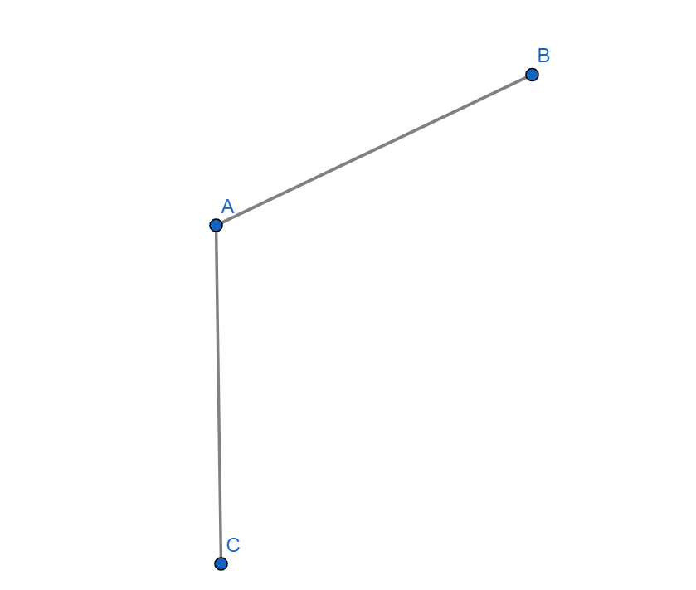
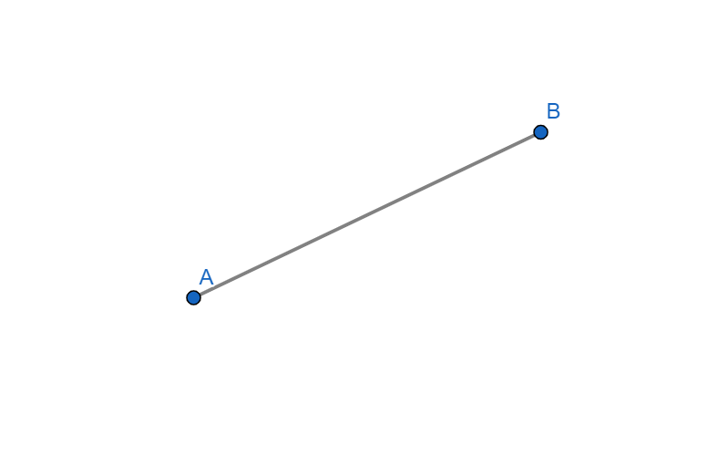
5. Show all the points that are 4cm from the line segment AB
6. Show all the points that are the same distance from the line segments AB and AC
7. Show all the points that are the same distance from the line segments AB and AC, and the same distance from points A and B
8. Show all the points that are closer to line segment AB than AC, and less than 4cm from point A

Slide 4
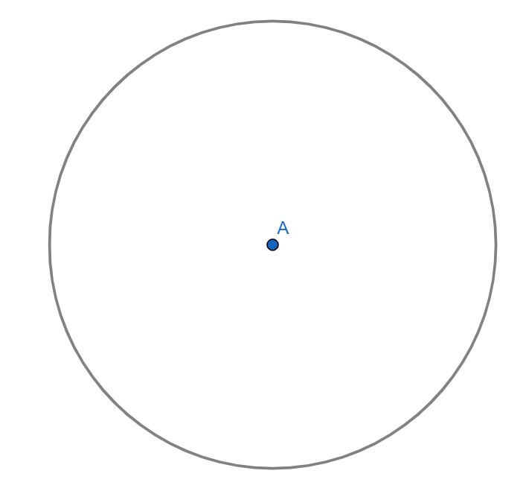
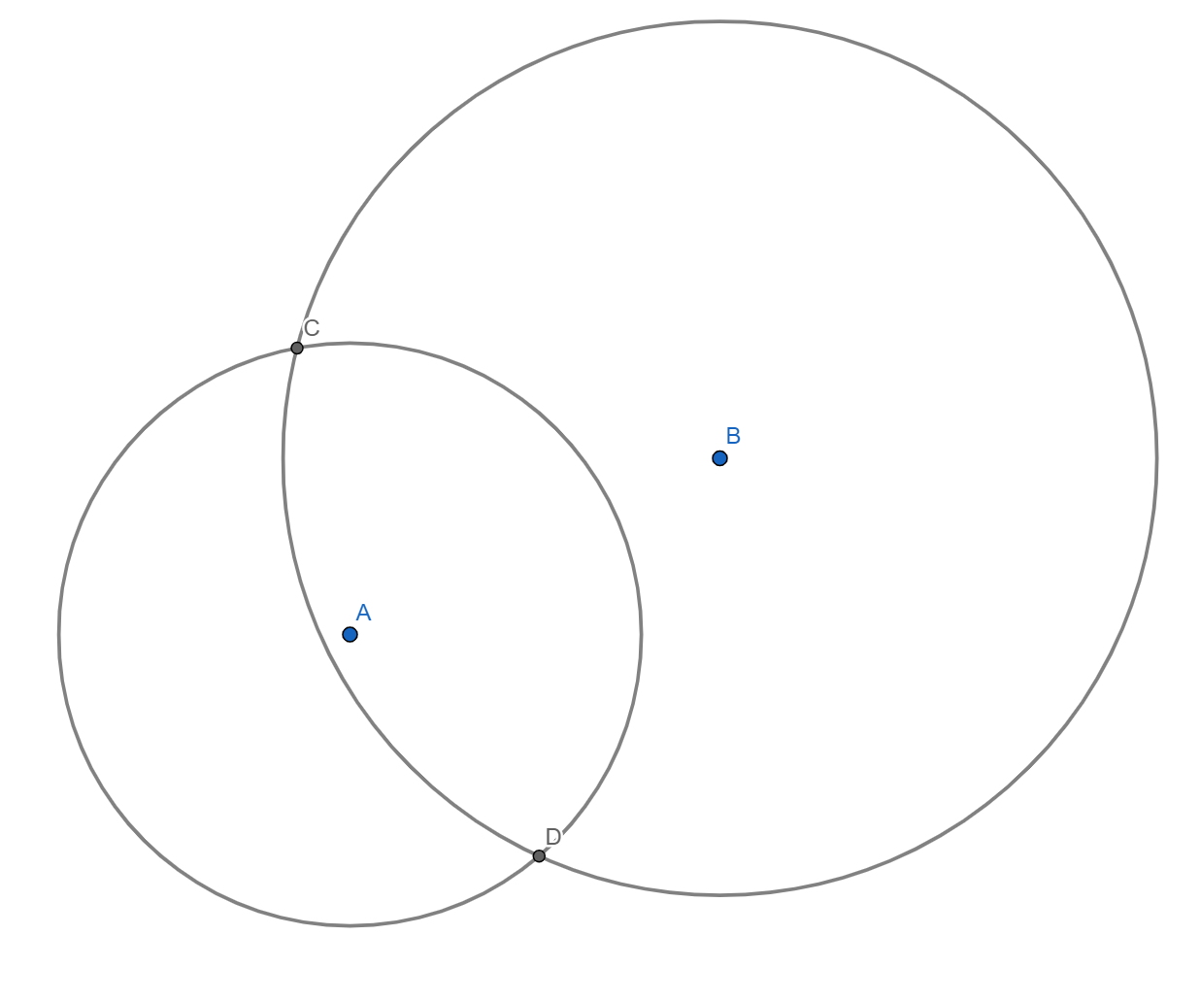
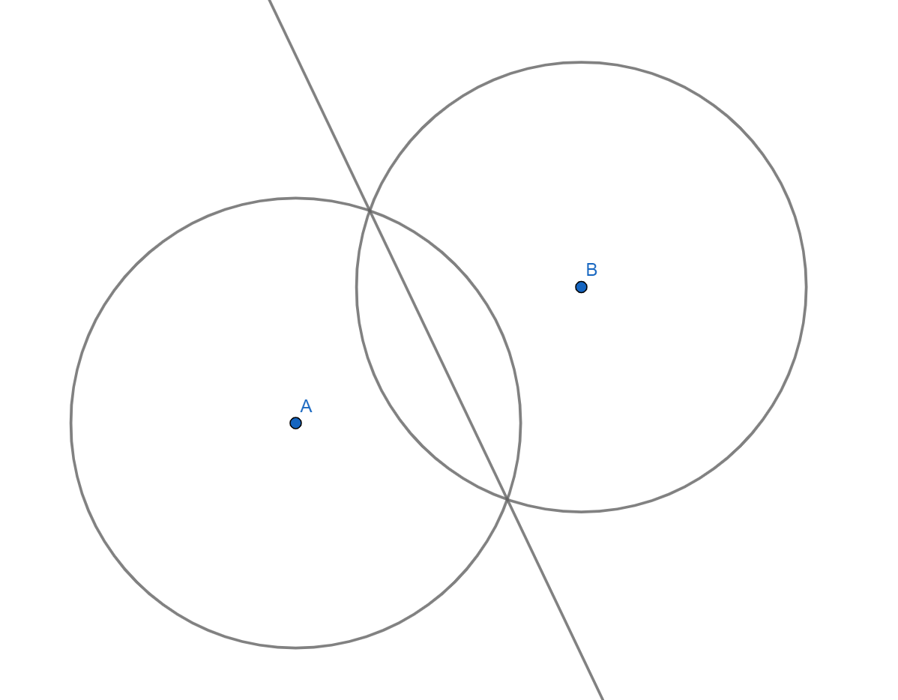
1. Show all the points that are 4cm from point A
2. Show all the points that are 4cm from point A and 6cm from point B
3. Show all the points that are the same distance from points A and B
4. Show all the points that are closer to point A than point B

Slide 5
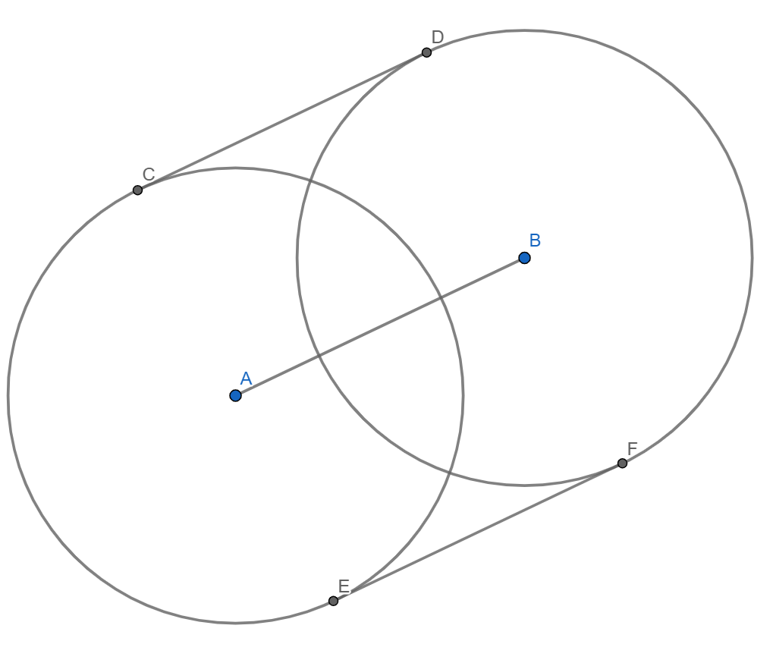
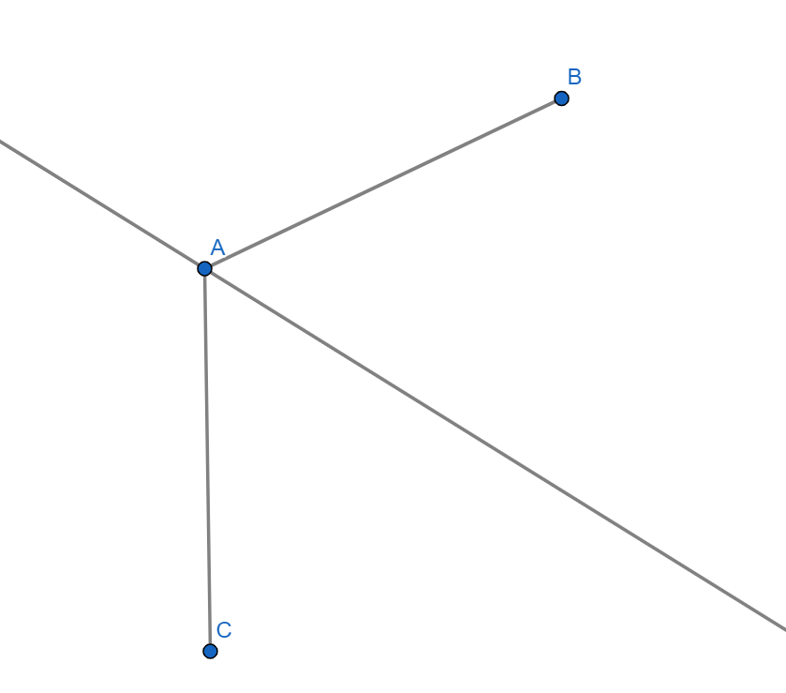
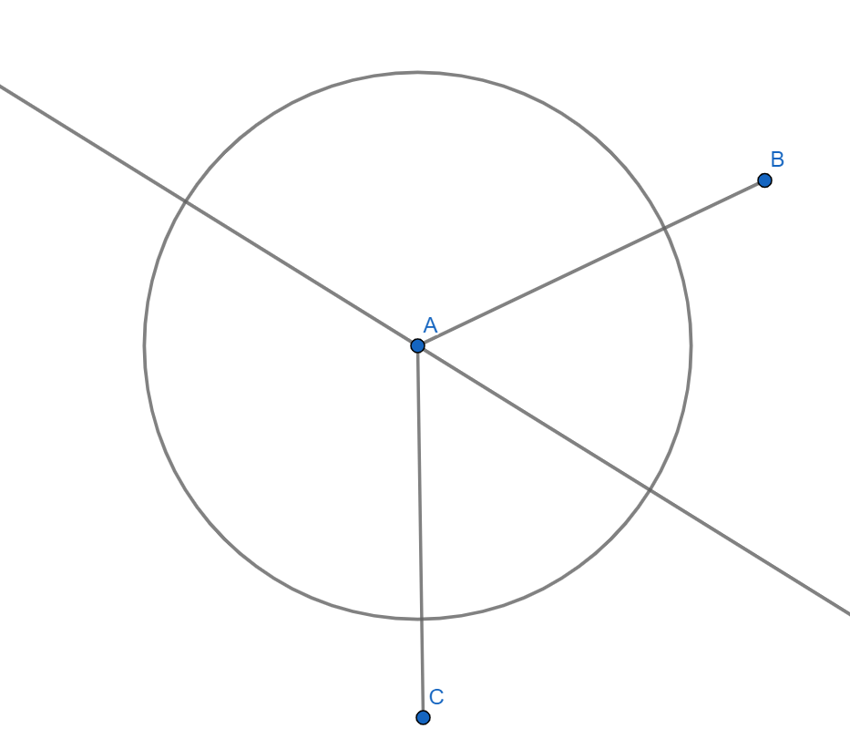
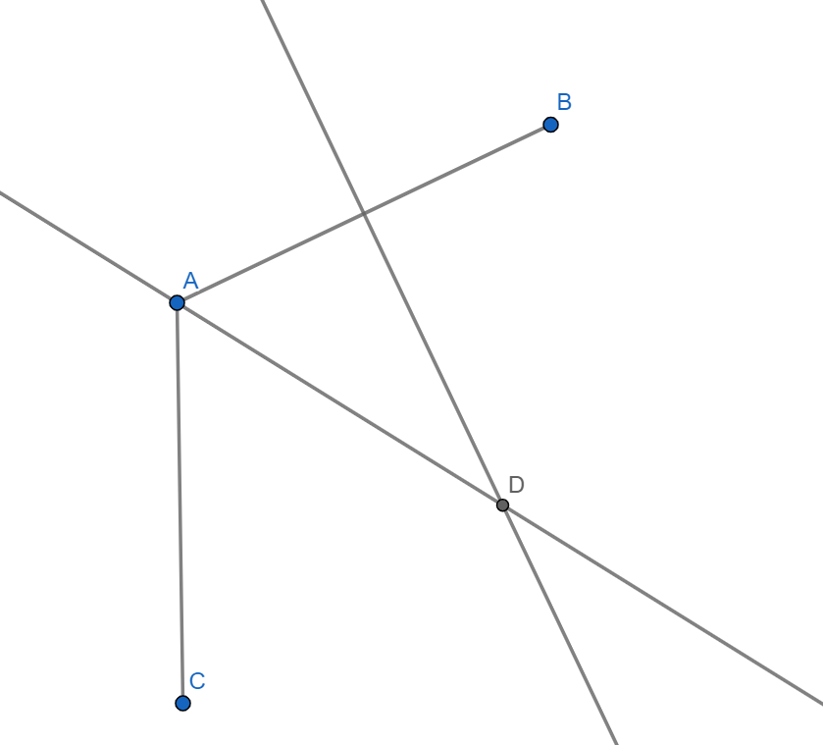
5. Show all the points that are 4cm from the line segment AB
6. Show all the points that are the same distance from the line segments AB and AC
7. Show all the points that are the same distance from the line segments AB and AC, and the same distance from points A and B
8. Show all the points that are closer to line segment AB than AC, and less than 4cm from point A

