Slide 1
Proportion: Direct proportion (rulers – V2)
Silent
Teacher
Intelligent Practice
Narration
Your Turn
$$\text{3 }\text{rulers} \text{cost}\text{ £12. }\text{How} \text{much} \text{do}\text{ 4 }\text{rulers} \text{cost}\text{?}$$
$$\text{6} \text{rulers} \text{cost}\text{ £12. }\text{How} \text{much} \text{do}\text{ 4 }\text{rulers} \text{cost}\text{?}$$
$$\text{6} \text{rulers} \text{cost}\text{ £24. }\text{How} \text{much} \text{do}\text{ 4 }\text{rulers} \text{cost}\text{?}$$
Practice

Slide 2
Worked Example
Your Turn
4 rulers cost £32.
How much does 1 ruler cost?
How much do 5 rulers cost?
8 rulers cost £32.
How much does 1 ruler cost?
How much do 5 rulers cost?
@mrbartonmaths

Slide 3
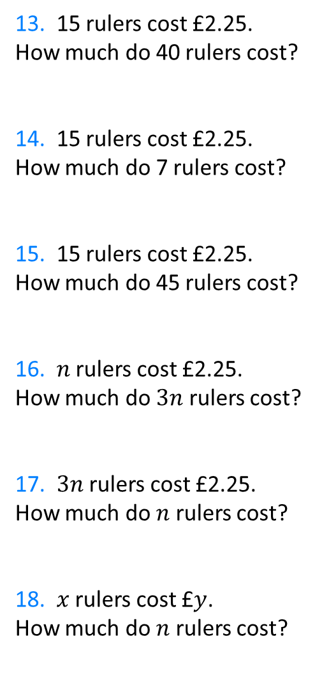
1. 2 pens cost £30.
How much does 1 pen cost?
2. 2 rulers cost £30.
How much does 1 ruler cost?
3. 4 rulers cost £30.
How much does 1 ruler cost?
4. 4 rulers cost £60.
How much does 1 ruler cost?
5. 6 rulers cost £90.
How much does 1 ruler cost?
6. 60 rulers cost £90.
How much does 1 ruler cost?
7. 60 rulers cost £9.
How much does 1 ruler cost?
8. 60 rulers cost £9.
How much do 2 rulers cost?
9. 60 rulers cost £9.
How much do 20 rulers cost?
10. 40 rulers cost £9.
How much do 20 rulers cost?
11. 20 rulers cost £9.
How much do 40 rulers cost?
12. 5 rulers cost £2.25.
How much do 40 rulers cost?
13. 15 rulers cost £2.25.
How much do 40 rulers cost?
14. 15 rulers cost £2.25.
How much do 7 rulers cost?
15. 15 rulers cost £2.25.
How much do 45 rulers cost?
16. $n$ rulers cost £2.25.
How much do $3n$ rulers cost?
17. $3n$ rulers cost £2.25.
How much do $n$ rulers cost?
18. $x$ rulers cost £$y$.
How much do $n$ rulers cost?
@mrbartonmaths

Slide 4
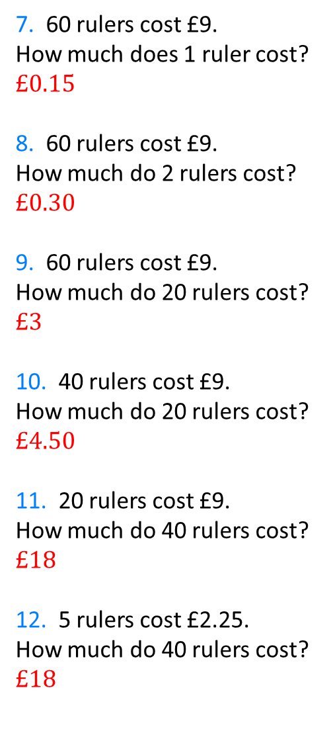
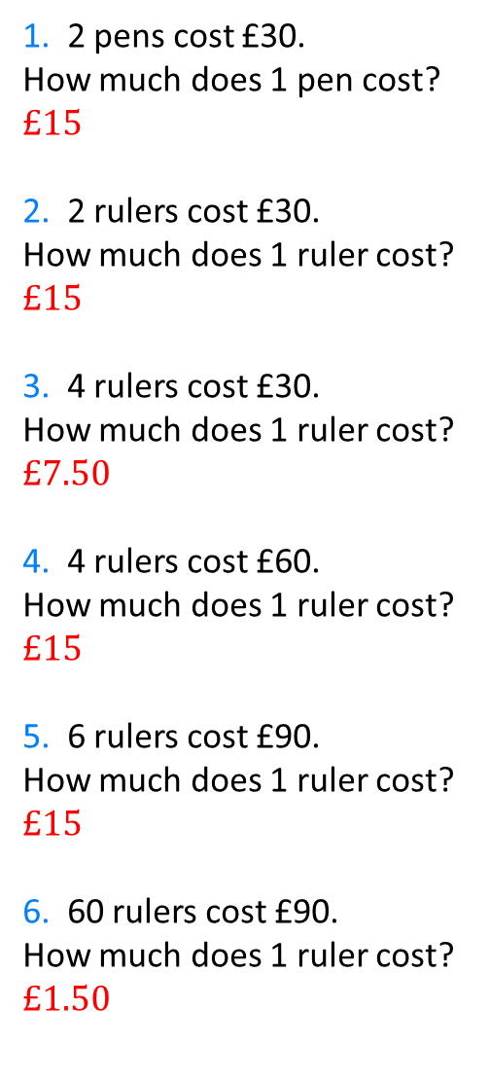
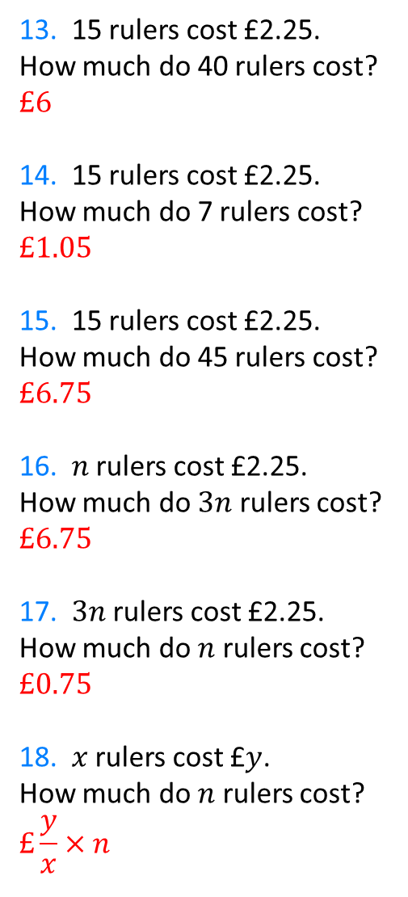
1. 2 pens cost £30.
How much does 1 pen cost?
$$£15$$
2. 2 rulers cost £30.
How much does 1 ruler cost?
$$£15$$
3. 4 rulers cost £30.
How much does 1 ruler cost?
$$£7.50$$
4. 4 rulers cost £60.
How much does 1 ruler cost?
$$£15$$
5. 6 rulers cost £90.
How much does 1 ruler cost?
$$£15$$
6. 60 rulers cost £90.
How much does 1 ruler cost?
$$£1.50$$
7. 60 rulers cost £9.
How much does 1 ruler cost?
$$£0.15$$
8. 60 rulers cost £9.
How much do 2 rulers cost?
$$£0.30$$
9. 60 rulers cost £9.
How much do 20 rulers cost?
$$£3$$
10. 40 rulers cost £9.
How much do 20 rulers cost?
$$£4.50$$
11. 20 rulers cost £9.
How much do 40 rulers cost?
$$£18$$
12. 5 rulers cost £2.25.
How much do 40 rulers cost?
$$£18$$
13. 15 rulers cost £2.25.
How much do 40 rulers cost?
$$£6$$
14. 15 rulers cost £2.25.
How much do 7 rulers cost?
$$£1.05$$
15. 15 rulers cost £2.25.
How much do 45 rulers cost?
$$£6.75$$
16. $n$ rulers cost £2.25.
How much do $3n$ rulers cost?
$$£6.75$$
17. $3n$ rulers cost £2.25.
How much do $n$ rulers cost?
$$£0.75$$
18. $x$ rulers cost £$y$.
How much do $n$ rulers cost?
$$£\frac{y}{x}×n$$
@mrbartonmaths

